Slide 1
World War Two
Fill in the blanks on your notes sheet AND take extra notes on the side
If you don’t know already WWII was kind of a big deal ☺

Slide 3
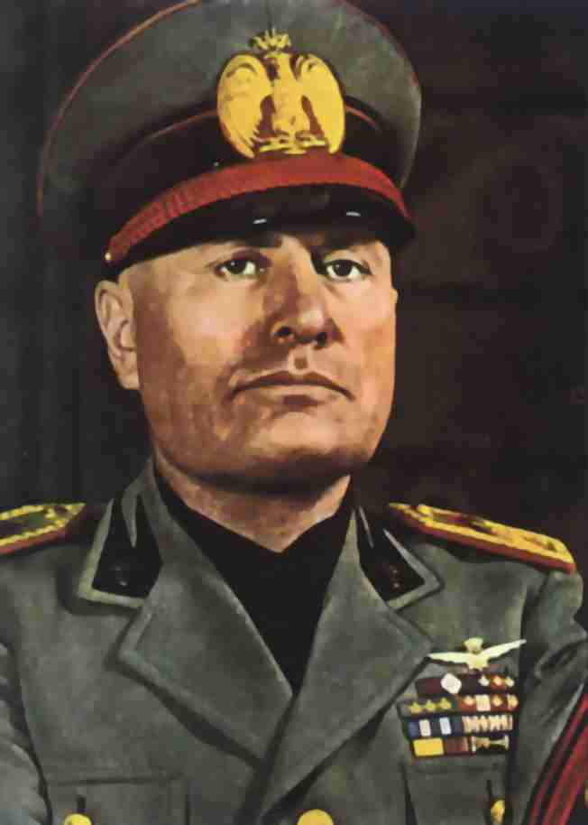
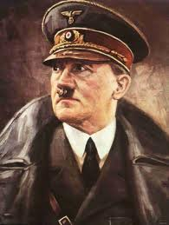
Who’s Who
Germany: Adolph Hitler: National Socialist (Or Nazi) Racial (Aryan Race)
Italy:
Benito Mussolini Fascist Party
Both believed in nationalism and militarism

Slide 4
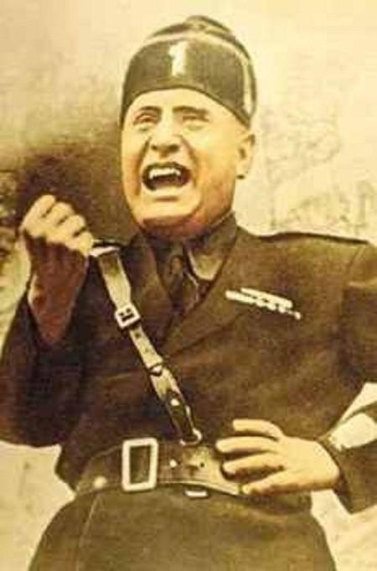
Benito Mussolini
“It is better to live one day as a lion than 100 years as a sheep.”
Benito Mussolini became the dictator of Italy during the 1930’s. Mussolini limited free speech and imprisoned political opponents..
He started the Fascist Party which created a government dominated by the military. He also had an army of Blackshirts which were his police/Thugs to crush opposition and carry out his orders

Slide 5
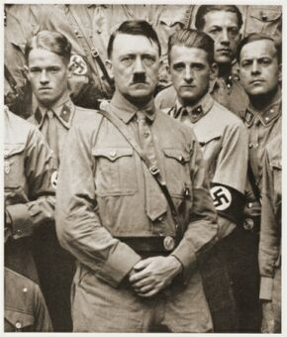
Adolph Hitler
“If you tell a big enough lie and tell it frequently enough, it will be believed.”
Adolph Hitler came to power in Germany during the1930’s. He promised recovery from the Great Depression. Hitler ended all opposition parties & free press was outlawed..
He abolished any laws that contradicted the Nazi Party’s goals and stripped the Reichstag (German Parliament) of all power naming himself the dictator of Germany

Slide 6
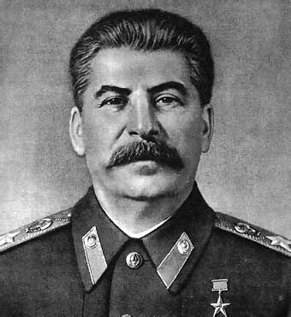
Joseph Stalin
“A single death is a tragedy; a million deaths is a statistic.”
Joseph Stalin came to power in Russia after Lenin’s death. Stalin continued communism in Russia/ Soviet Union. He made Russia /USSR a totalitarian state which is a country where the government has complete control over every aspect of a citizen’s life.

Slide 7
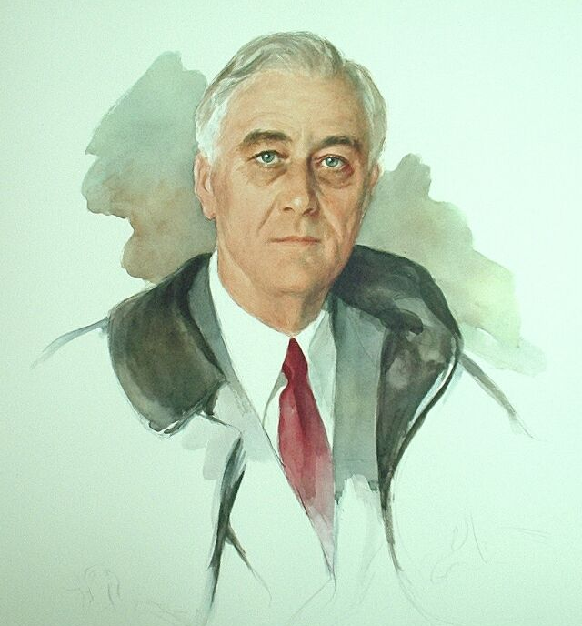
Franklin Delano Roosevelt (FDR)
"The only thing we have to fear is itself"
President of the United States: March 4, 1933 – April 12, 1945 (Democrat)
Only U.S. president elected to more than 2 terms.
Lead the U.S. out of the Depression (New Deal)
Was president through WWII, died before it ended and was succeeded by V.P. Harry Truman.

Slide 8
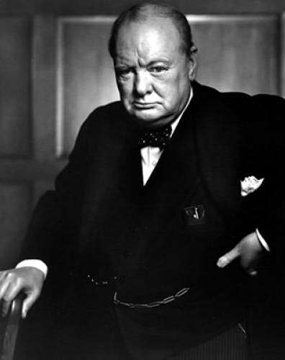
Winston Churchill
"You have enemies? Good. That means you've stood up for something, sometime in your life."
Prime Minister (Leader) of Great Britain during WWII
His steadfast refusal to consider defeat, surrender, or a compromise peace helped inspire British resistance, especially during the difficult early days of the War when Britain stood alone among European countries in its active opposition to Adolf Hitler.
Churchill Famous For: speeches and radio broadcasts, which helped inspire the British people.
He led Britain as Prime Minister until victory over Nazi Germany had been secured.

Slide 9
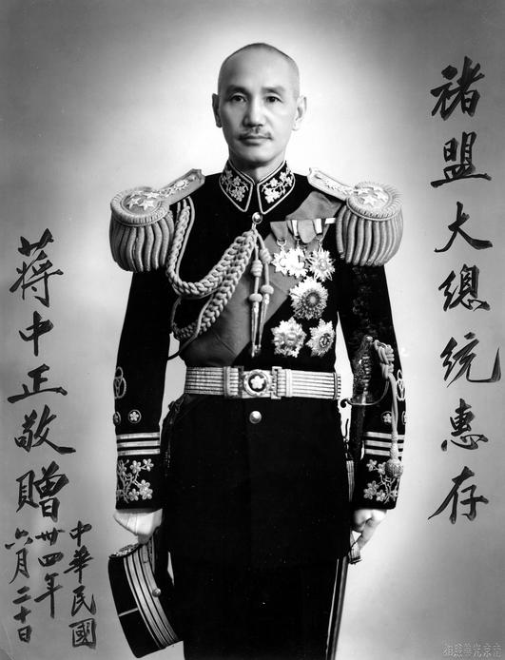
Who’s Who
"We become what we do."
Worst yet Japan: worried about S.U. and China leader (Chiang Kai-shek) Led a coup to take over MANCHURIA...then started to attack Shanghai + (U.s response? Warning)
Everyone was in a depression, not paying make loans, money and gold standard (FDR bombshell)
Due to FDR war payment except from Finland stopped for good (stopped trying to help countries that owed us money: loans)

Slide 10
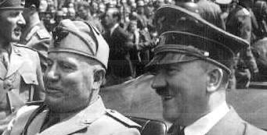
United States and Soviet Union try to be allies (S.U. worried about Japan and U.S. wanted to trade)
To practice Isolationism again (due to League of Nation failure and American views) 2/3
Italy invaded Ethiopia to build colonies in Africa

Slide 11
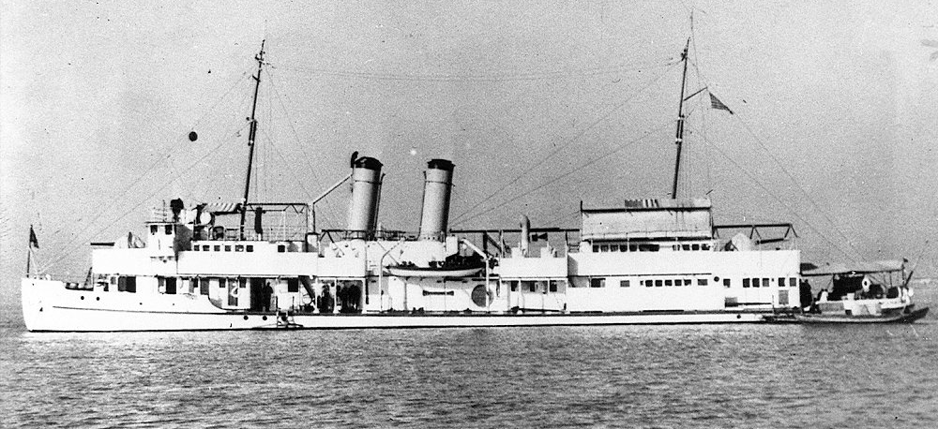
Neutrality Acts: 1935,36, 37: designed to prevent U.S. getting pulled in to war (sea at own risk and cash and carry: not selling weapons)
1937: Japan sank U.S. gunship Panay: Americans wanted no war and accepted Japanese apology although probably not an accident

Slide 12
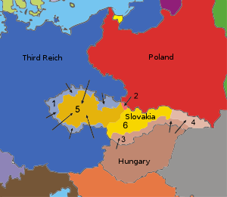
Germany violated the Treaty of Versailles by expanding (added Austria Hitler native land) and wanted Czechoslovakia
Munich Conference: G.B. and France said ok, only if Hitler promised to stop expanding: He promised but lied (Appeasement) now he wanted Poland
Stalin was asked to help, but was not invited to Munich, signed a pact with Hitler in 1939

Slide 13
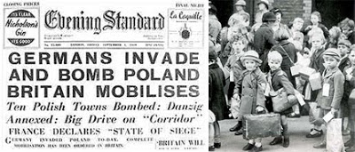
Attack on Poland
Germany attacks Poland, who was promised help my G.B. and France…2 days later they declared war on Germany and WW2 starts!
U.S. was neutral but FDR said citizens could be whatever (liked allies better) changed neutrality act by allowing then to now cash and carry arms

Slide 14
The War Continues…
S.U. takes advantage of situation and adds small countries like Latvia, Estonia and Lithuania… then invades Finland
Germany by now captured 4 more countries and finally got France: They attacked north while Italy their buddies, took out the South
Americans freaked out, 66% believed Germany would attack the U.S: FDR got 1 billion more to spend on military, started helping GB a lot and even set up the 1st peace time draft (Burke-Wadsworth Act) Still Americans disagreed on what to do

Slide 16
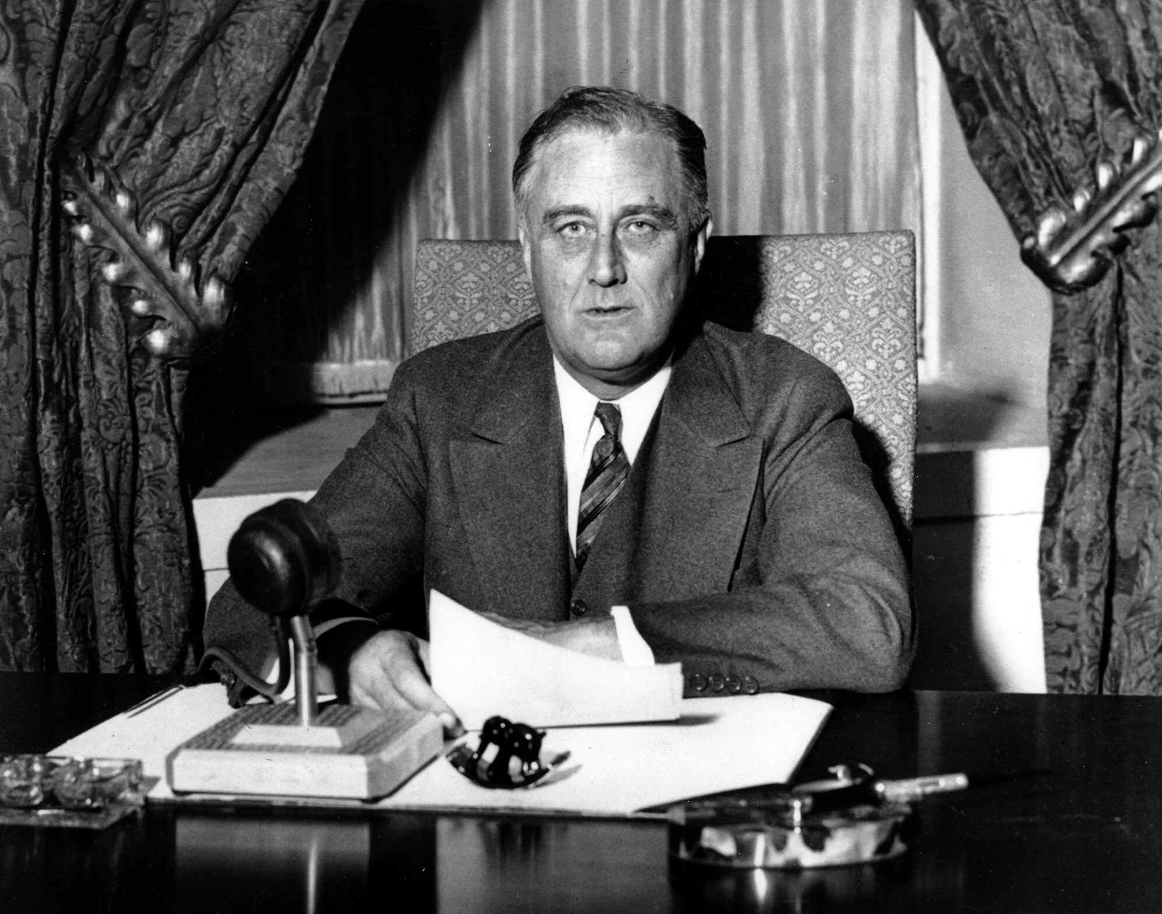
The War Continues…
FDR runs for 3rd term and defeats Wendell Willkie by get 55% of popular vote, but said they would not enter ww2, but aid allies
Lend and Lease; replaced cash and carry due to the fact that G.B. was poor and given only to countries deemed “vital to the defense of the U.S” critics?

Slide 17
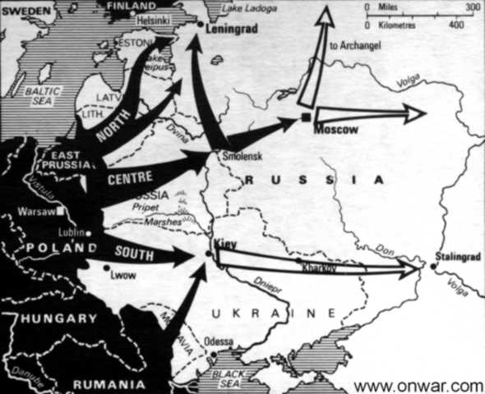
Soviet-American Alliance
By fall 1941 Germany attacked S.U., ending pact, and creating a Soviet-American alliance, by giving them a lend and lease… Also means we are helping 2 of Hitler’s foes = Germany U-boats attacking our merchant ships like Greer and Reuben James… we were told to shot Germany U-boats on sight-=naval war against Germany

Slide 18
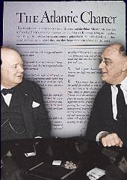
The War Continues…
U.S. met with Churchill on a British vessel and discussed game plans if the U.S. entered the war (Atlantic Charter)
Tripartite Pact: Japan…… Germany and Italy: Axis of Power
In the meaning from 1931-1941 Japan was attacking China: Nanjing, seized Vietnam and more of the Pacific.

Slide 19
The War Continues…
FDR cut off trade with Japan (mainly oil…can’t expand without)
Japan needed to make amends with the U.S. or find other supplies. Japanese Prime minister was willingly to compromise with the U.S., but he was run out of office and Hideki Tojo replaced him.
Tojo pretended to agree to Secretary of Defense: Henry Stimson request to stop war with China, but we knew better

Slide 20
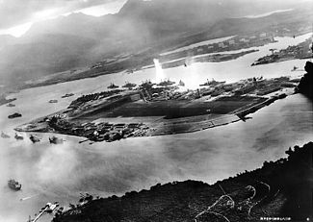
Pearl Harbor
Although we were aware they wanted to attack, we did not thing Pearl Harbor and on Dec. 7th 1941 (The day that would live infamy) in 2 hours 188 planes, 8 battleships (that were just parked waiting) were destroyed plus more and 2,000 killed and 1,000 injured

Slide 21
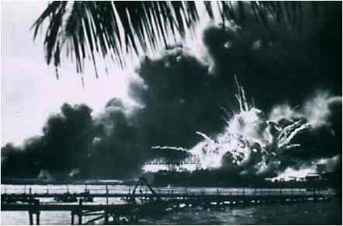
Pearl Harbor
December 8th FDR asked the House for war all agreed except for one congressman (Jeanette Rankin) and 3 days later Axis of Power declared war on U.S.

Slide 22
The War Continues…
At the start of the war it was going badly (France was gone, G.B. almost there and S.U. struggling) Japan attacked the U.S. at Manila (Philippines) and 3 days later took Guam from U.S.
Master plan: General Douglas Macarthur would move north (Australia) and Admiral Chester Nimitz would move west (Hawaii) and would meet in Japan: Island hopping
Battle of Coral Sea: U.S. turns back unstoppable Japanese fleet.

Slide 23
The War Continues
Midway: tiny island near Hawaii which was a U.S. outpost: huge U.S. victory... Guadalcanal
By 1943: U.S. stopped Japan advances
In Europe wanted to “free French” forces by taking the English Channel was supported by army chief of staff George C. Marshall, but went with G.B. plan instead to free Africa and then S. Europe first

Slide 24
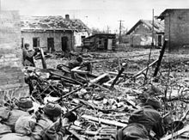
This made the S.U. upset because we were tied up in Africa while they were holding off Germany invasion in Stalingrad, where Stalin army held off Hitler from 1942-43! HUGE
Due to this S.U. loses were far greater than other warring nations (20 million casualties)

Slide 25
The War Continues
Jan. 1943 U.S. and G.B. attack Sicily Italy: 38 days later success: Mussolini fled to Germany. He was replaced by Pietro Badoglio, who added Italy to the allies sided, but Germany fought back and finally June 4th 1944 the allies captured Rome (Italy)
France left untouched which pissed off the S.U. because they felt it was a deliberate way to make them due all the hard work (dying)

Slide 26
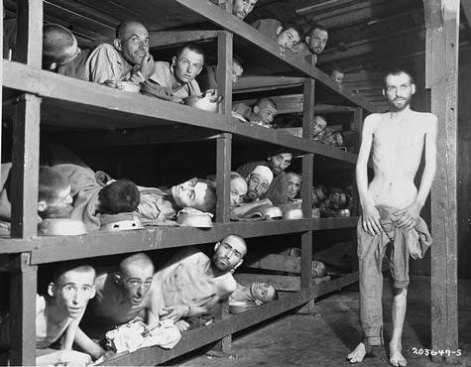
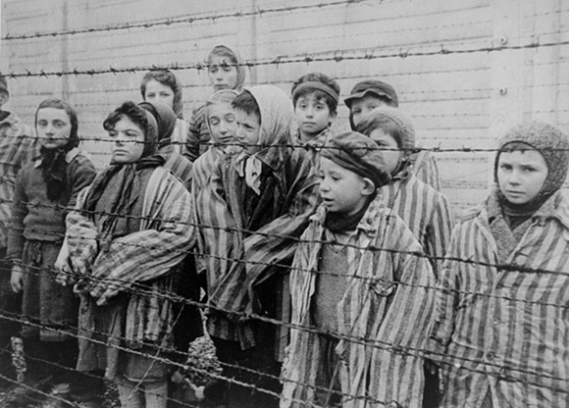
The Holocaust
Meantime the Holocaust was happening all over Europe and the U.S. was not helping. 6 million Jews and 4 million (Poles, gypsies, communist, homosexuals, disabled etc) killed
Many death camps like Auschwitz in Poland with crematoriums and railroads that led prisoners to camps were left untouched.

Slide 27
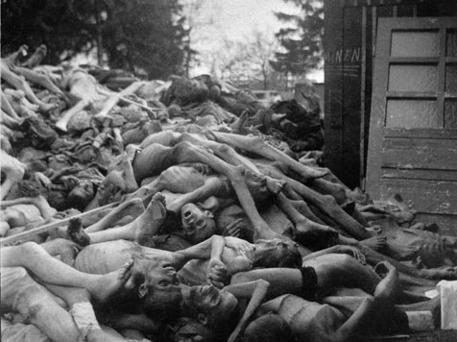
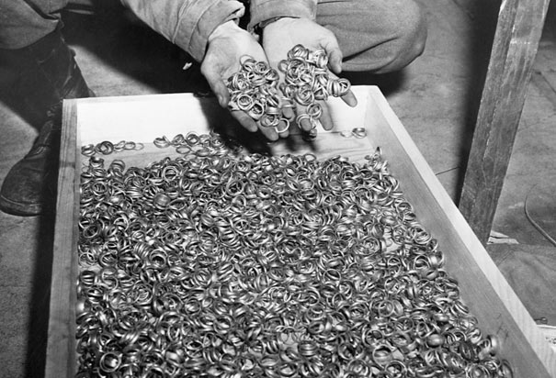
The Holocaust
Refugees tried to leave, but just the boat St. Louis that was headed for the U.S. they were turned away, even though 90% of our quota was not used up (anti-Semitism U.S.? G.B.?)

Slide 28
The War Continues…
WW2 ended great depression; government spending went from 9 billion to 100 billion. Shortage of goods to buy = people saved money which keep U.S. economy alive in 50’s
Unions gained power while allies nations, especially the U.S. needs to gain support for the work due to scarcity = rations. Solution = propaganda

Slide 29
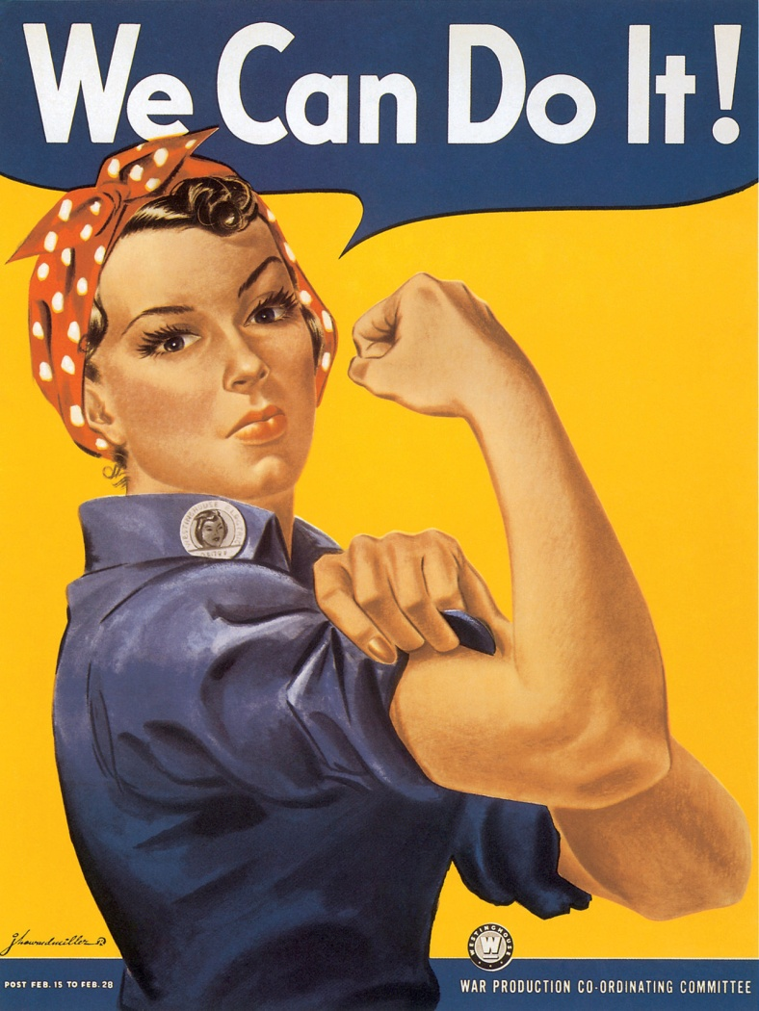
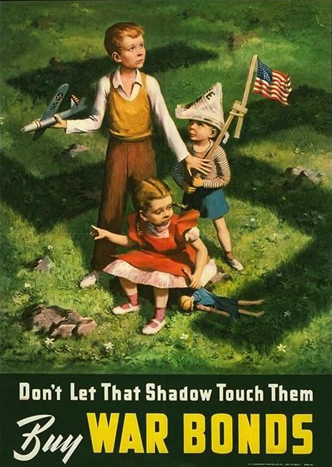

Slide 30
The War Continues…
At first Germany and Japan had better technology: tanks etc. By 1942 U.S. & G.B. made so many advances we were better than enemy in technology and amount of weapons (mass production)
Ended U-boats & naval mines power by using radar and sonar to find them in the water

Slide 31
The War Continues…
Rocket Technology: First Germany used on G.B. by 1942 our were better: fly high longer and had electronic devices to guide bombs to target (GEE system) and Oboe system: sent sonic message to pilot when they were 20 yards from target
Ultra then Bombe was G.B. computer technology to decode secret German messages (they never knew) U.S version called “Magic”

Slide 32
Racial Issues and War…
WW2 as a whole helped blur racial issues, Italians were not allowed to travel though and of course..... Our Japanese which was horrible but compared to WW1 much better
Internment of Japanese Americans during WW2: violated their civil right, but 2/3 were Nisei (native born) and 1/3 Issei: Most lived in California, but citizens there did not see them as spies, although they quickly took their stuff when they only had 2 weeks to move, but the gov. saw them as spies/threat. So in 1942 the war relocation authority (WRA) created relocation camps for them to live till late 4/45.

Slide 33
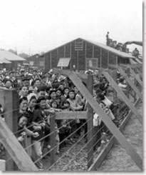
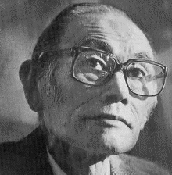
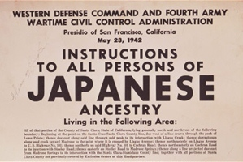
Korematsu vs. U.S.
Korematsu vs. U.S.: 1944 Supreme Court said it was constitutional.... but then barred “loyal citizens” by 1988 they were finally given reparations.

Slide 34
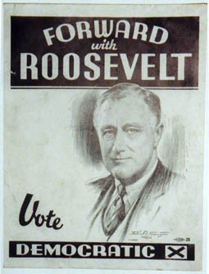
The War Continues…
Although the new deal was slowly being dismantled: FDR used new deal to Win the war was reelected with 53.5% of the popular vote making Truman his V.P.
By middle on 1943: allies stopped advances in Europe and Pacific: Offensive Time!! Strategic bombing in Germany

Slide 35
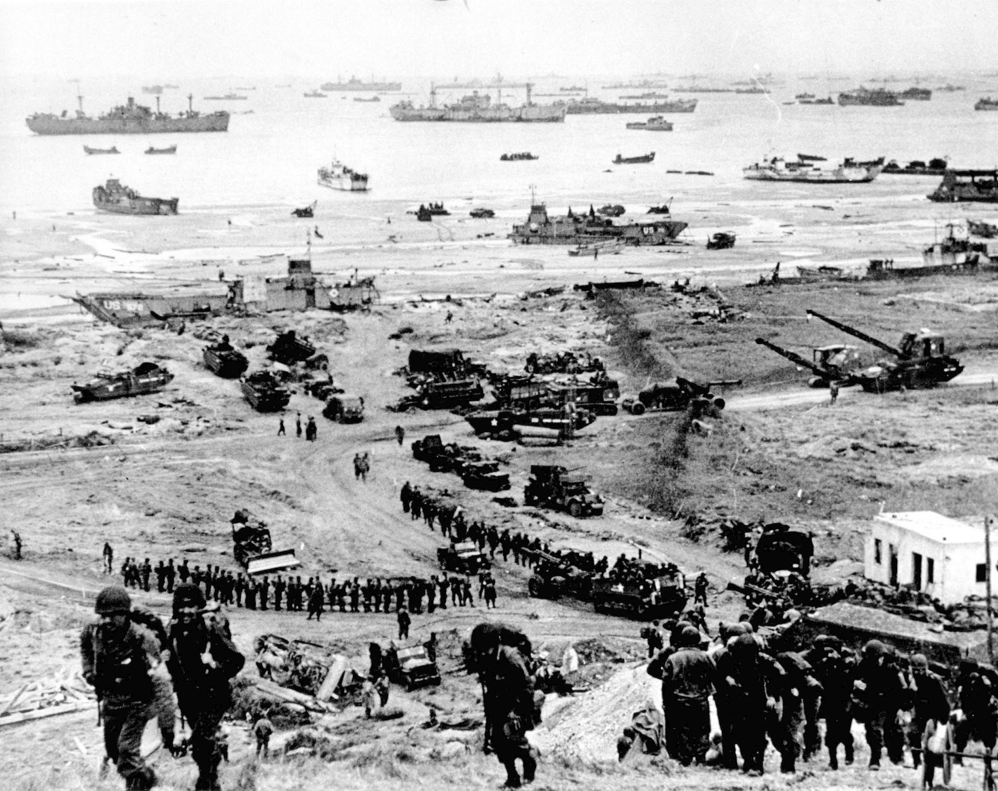
The War is at an end…
June 6th 1944 D-Day: 3 million troops under Dwight Eisenhower led stormed the beach of Normandy (operative overload)
Battle of The Bulge: Hitler announced this battle was determine whether Germany won or lost with G.B. and the U.S. moving in from both sides in Germany. At first they pushed the U.S troops back but were soon forced to retreat.

Slide 36
The War is at an end…
With the S.U. entering Germany as well Hitler and his wife commit suicide and Germany surrenders unconditionally.
May 8th 1945 German surrounded unconditionally= V.E .Day
Now back to the Pacific by 1944: Japanese people were short on food and gas and had lost Tinian, Guam and Spain and the Battle of Leyte Gulf (largest naval war) U.S basically stopped Japan from any ore naval fighting

Slide 37
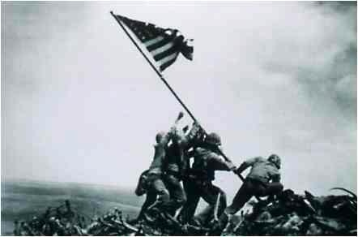
The War is at an end…
Huge bloody victory Okinawa: Japanese sent kamikaze allies lost 50,000 and over 100,000 Japanese when in was captured finally late June 1945 (island close to Japan)
Japan weak: almost no ships or planes left: yet military leader did not want to surrender.

Slide 38
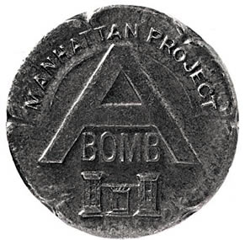
The Manhattan Project…
Enter the Manhattan project: we found out Germany in 39 had started to create an atomic bomb. 2 billion spent trying to create an atomic bomb, hidden labs, experimenting with plutonium: J. Robert Oppenheimer created it!!
July 16th in a desert in New
Mexico the Trinity bomb
(1st atomic explosion) was tested

Slide 39
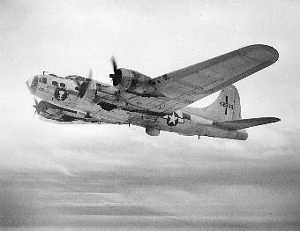
Hiroshima
Due to FDR death Harry Truman was now the president: he gave Japan ultimatum surrender by August 3rd or “face complete devastation”. Japan hinted they would if they could retain their emperor but U.S wanted unconditional surrender
On August 6th 1945 Enola Gay dropped the atomic bomb (Fat Man) on Hiroshima: 4 square miles completely incinerated: 80,000 + died (birth defects)

Slide 40
Nagasaki
August 8th S.U. declares war on Japan and we dropped our 2nd (Little Boy) and last bomb on Nagasaki: 100.000 + died = Japan surrenders on August 14th and Sept. 2nd on battleship the Missouri Japan signed articles of surrender
The war was over, many many died compare to other countries our were less serve however 322,000 dead and 800,000 injured

Slide 41
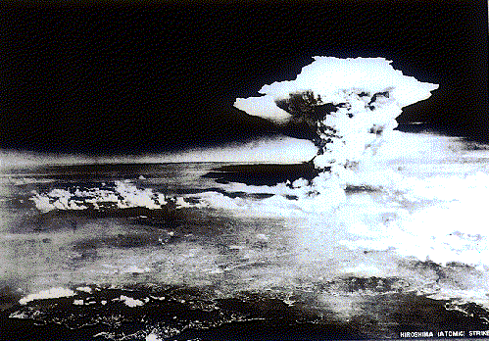

Slide 43
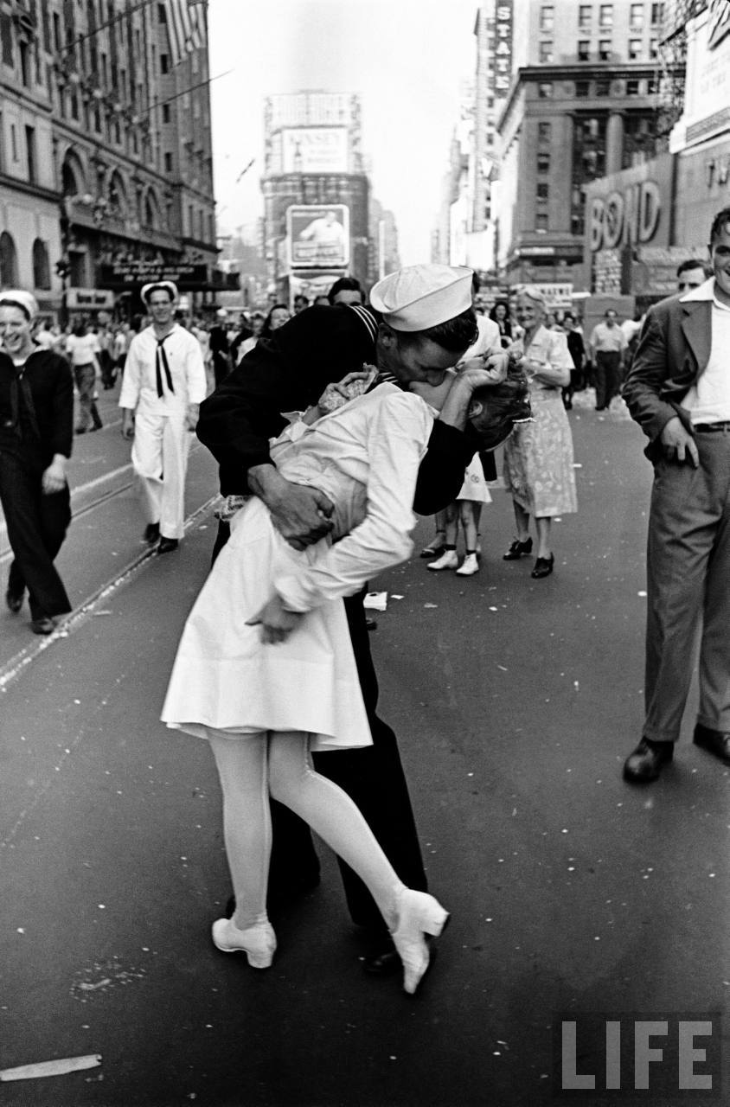
Results of WWII
Europe and Japan in ruins; cities completely destroyed, deaths, no homes, no government
Nuremberg Trials: dealt with war crimes like the holocaust: 22 Nazi leaders
Douglas Macarthur returns to Japan with two goals: demilitarization and democratization!

Slide 44
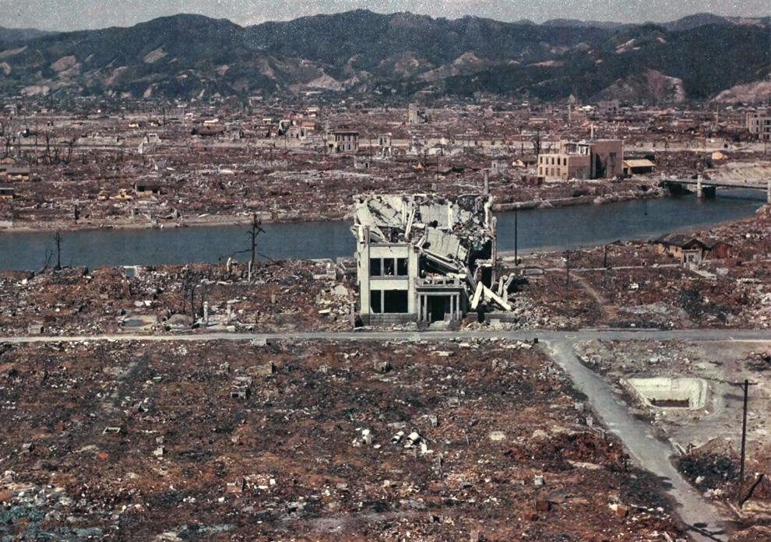

Slide 45
Video
http://www.youtube.com/watch?v=Q78COTwT7nE
Crashcourse
http://www.youtube.com/watch?v=p7fCsXjCW1M
Review
http://www.youtube.com/watch?v=ThSIzuG_Fwc
Proproganda all visual

