Slide 1
World War One
Take notes on a separate piece of paper, paying close attention to Titles and words in BOLD

Slide 2
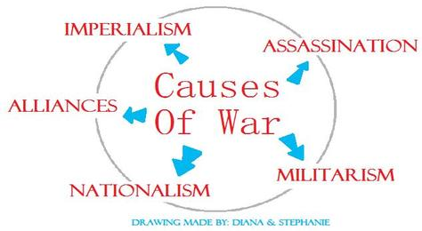
World War One: WWI

Slide 3
What caused WW1?
WW1 is debated for even having a true cause or just a series of blunders HOWEVER the alliance system in Europe is partially to blame = Nationalism, Imperialism, and Militarism and of course…

Slide 4
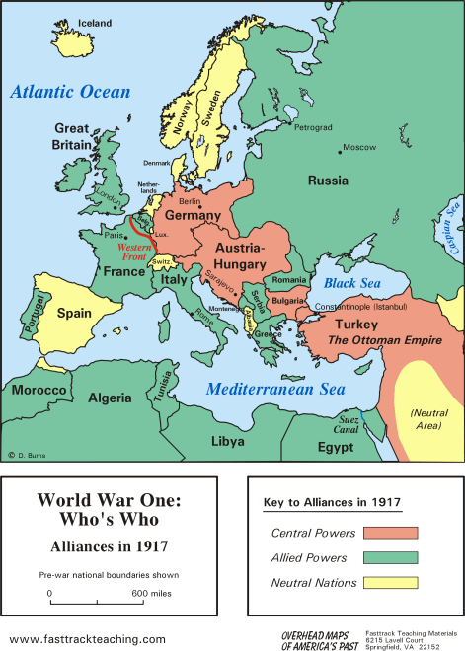

Slide 5
Who’s fight who?
BY 1914: alliances were formed by
Triple Alliance (also known as Central Powers)
GERMANY, Austria Hungarian Empire, Ottoman Empire and Italy. This was formed due to Otto Van Bismarck as a way to make sure France had no allies/ power

Slide 6
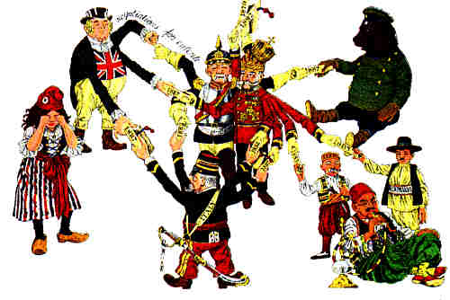

Slide 7
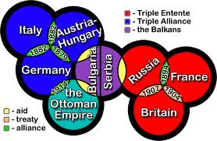

Slide 8
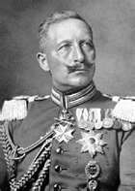
Then Kaiser Wihlem II took power and alienated Russia and Great Britain who formed the other side
Triple Entente: (also known as the Allies)
Russia, France, GREAT BRITIAN and Serbia

Slide 9
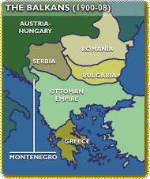
Crisis in The Balkans
The Balkans were known as the “powder keg of Europe”
Stop and jot what does that mean about the Balkans ?

Slide 10
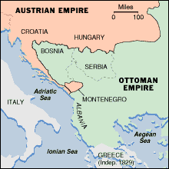
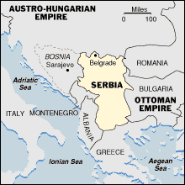
Balkan Maps
1815-1835 1914 eve of ww1

Slide 11
Crisis in The Balkans
In the early 1900’s due to NATIONALISM (and not wanting to be ruled by the Ottoman Turks) many countries were breaking apart from their rule (Bulgaria, Greece, Romania, and Serbia. They also had a strong desire to expand.
Austria annexed (took over) Bosnia- Herzegovina and Serbia was angry because they wanted that region….

Slide 12
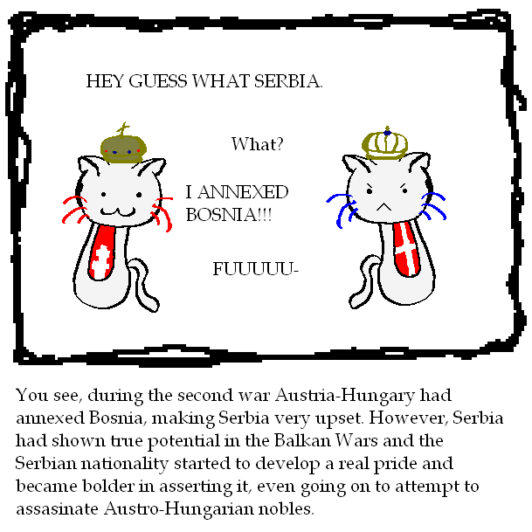

Slide 13
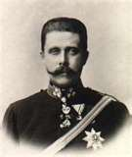
The event that actually started the war was when Archduke Franz Ferndidand (A.H leader and wife) was assassinated by a nationalist group (The Black Hands) from Serbia on June 28th 1914
A.H attacked Serbia; Serbia asks Russia for help; A.H asks Germany for help and Russia brought in France, (while Germany is invading Belgium) and G.B is eager to follow to hurt their biggest threat Germany.

Slide 14
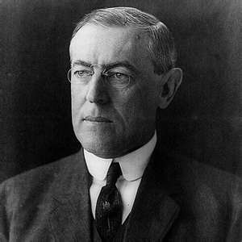
Why did u.s enter ww1?
The predicted short war turned into a stalemate, which led to trench warfare
U.S president, Woodrow Wilson states that they will remain neutral. “Impartial in thought as well as deed”
Citizens sympathized with different sides and even Wilson admired the England, stating they had a moral quality unlike the Central Powers

Slide 15
Why did the U.S enter into Europe’s fight?
But it all comes down to money and the U.S was trading with both countries.
Britain puts up a blockade so supplies can not make it to Germany and therefore we can not trade with them anymore, but we still are trading with the G.B
The U.S traded 2.3 billion with the allies and only 23 million with Central Powers
WW1 becomes one of the biggest economic booms in our nation’s history

Slide 16
Why did the U.S enter into Europe’s fight?
To stop G.B blockade Germany starts to use U-boats (submarines) which starts fighting in water. The U.S is very unhappy; especially when British passenger boat the Lusitania (killing 1,198 people, including 128 AMERICANS) is bombed
Wilson tells Germany to stop using U-boats they reluctantly agree, however they sink another boat (Sussex) and Wilson has to tell them again to stop

Slide 17
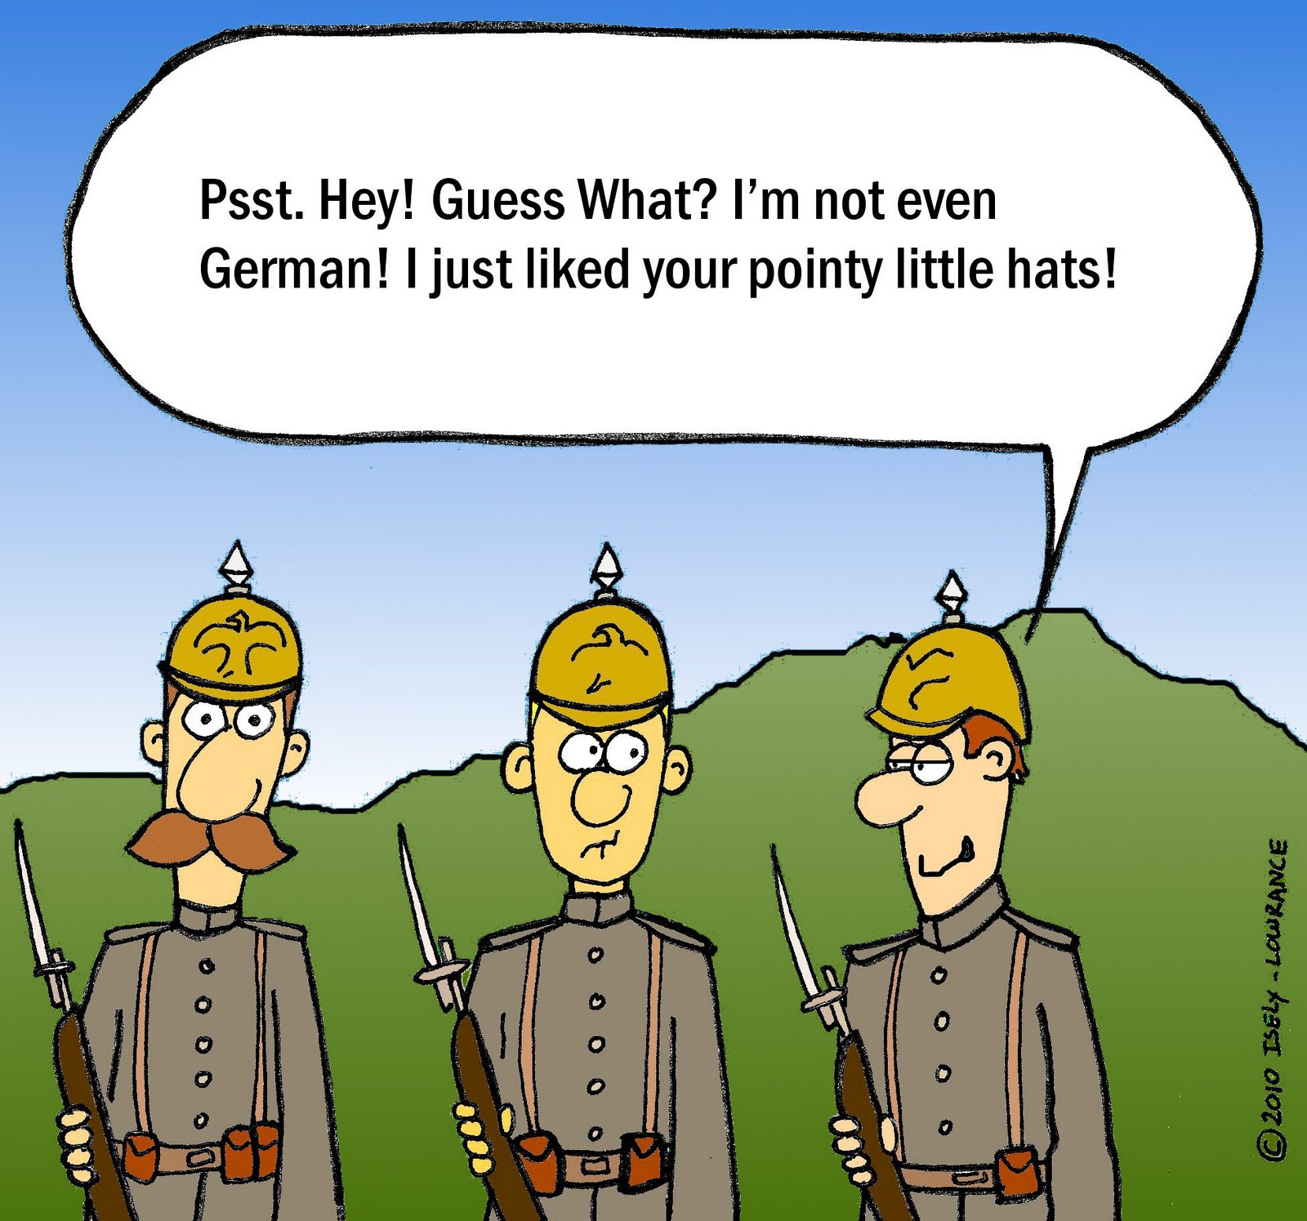
ww1

Slide 18
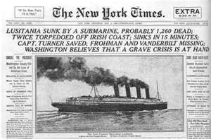

Slide 19
Still the U.S waited to enter, most citizens did not want to go to war, Wilson barely was reelected however the slogan people gave him “He kept us out of the war” won the election. But we did not want to seem like Pacifist either

Slide 20
Why did the U.S enter into Europe’s fight?
Germany started to use U boats again, however the Zimmerman Note helped turn many Americans for the war (G.B intercepted a note from Germany to Mexico asking them to attack us (distract us) and in return they would get land back from the U.S

Slide 21
Why did the U.S enter into Europe’s fight?
Our allies were getting weaker and weaker, Great Britian was about to lose because Russia left the war due to a revolution in their country; making it easier for the U.S to enter and not be aligned with a monarchy country. And 3 U.S boats were attacked
1 in every 4 ships that went to Europe did not come back when we entered the war

Slide 22
1 in every 4 ships that went to Europe did not come back when we entered the war
The U.S helped greatly; we attacked U. boats and used warships to bring merchants ships to destinations. (A convoy)
Not a single U.S troop ship was lost at sea during WW1
Russia Bolshevik revolution gave them a new government (led by Lenin) who formed peace with Germany (freeing up more German soldiers to fight)

Slide 23
New Technology: improve machine guns, tanks, flame-throwers, air planes, (dog fighting) mustard gas and gas masks and the NAVY: No man’s land and trenches
All resulting in HUGE Casualties, affecting Europe for years to come (and of course leading to WW2)

Slide 24
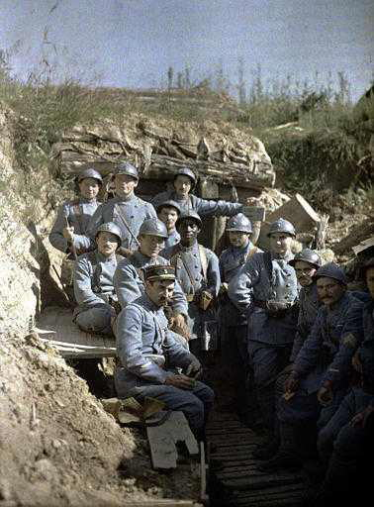
Trench Warfare

Slide 25
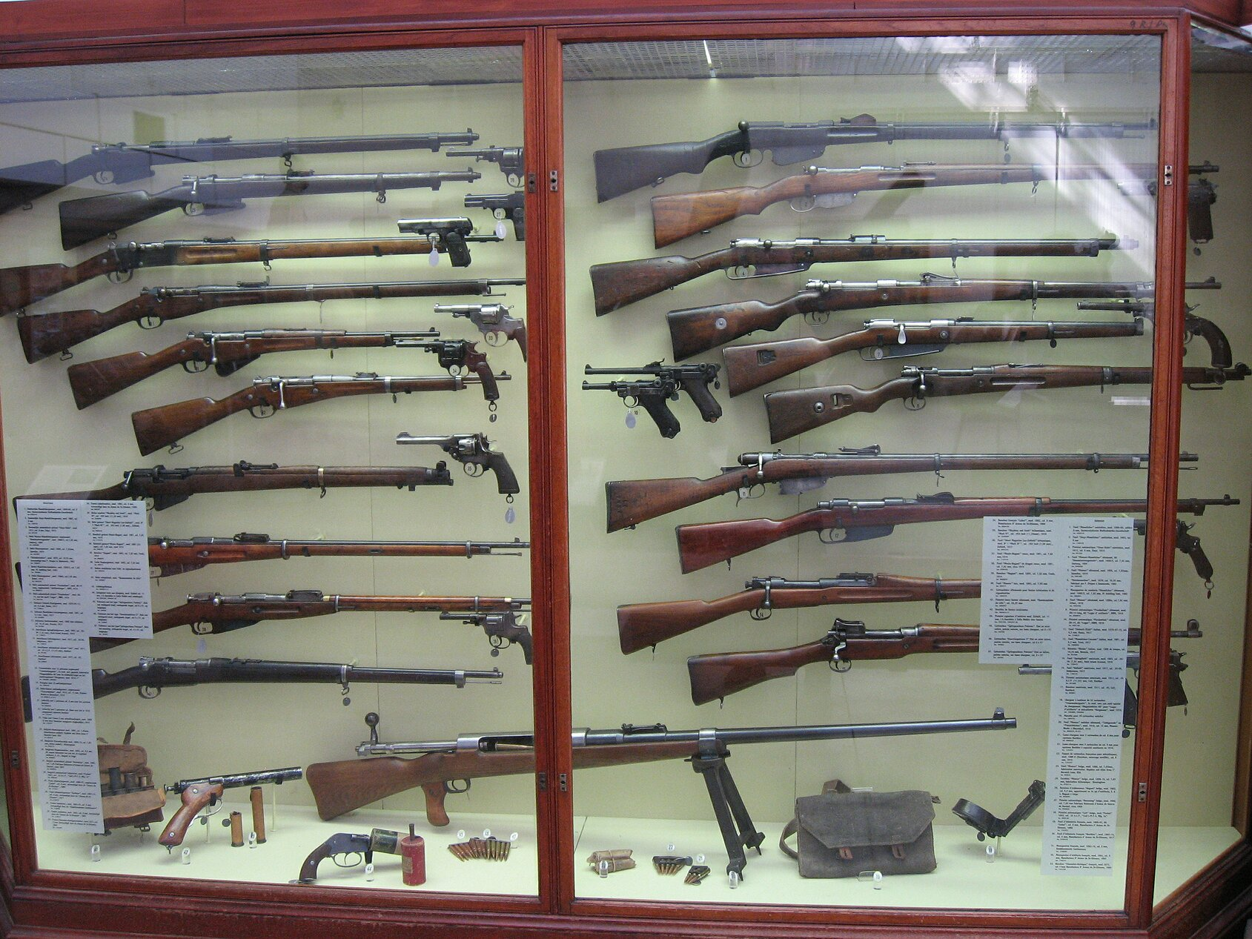

Slide 26
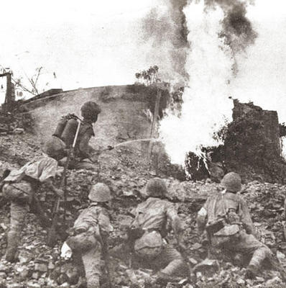
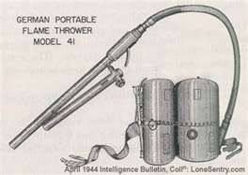
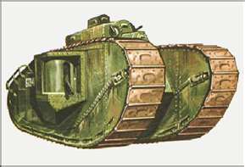

Slide 27
Europe was in a Total War were they had to spend all their resources into winning the war! They needed more men, more food (rations) and propaganda to encourage the war and winning!
Germany finally surrenders last due to America sending troops and the German’s turning on the Kaiser, he steps down and the new government signs an armistice (agree to stop fighting)

Slide 28
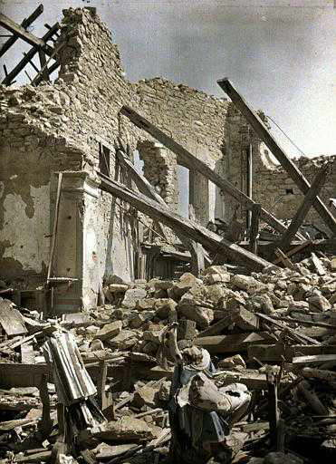
How did new technologies and scientific breakthroughs both benefit and imperil humankind?

Slide 29
End Result: 8.5 million killed, 21 million wounded, and countless civilian lives = entire generation of Europeans lost ☹ economically crushed economy $338 billion spent and lead to WWII

Slide 30
14 point plan: Wilson laid out his plan for world peace 1st 5 point: why the war started 8 points how we need to change land boundaries and last point he wanted to create the League of Nations. His beliefs were progressive and the world started to look to the U.S now for guidance

Slide 31
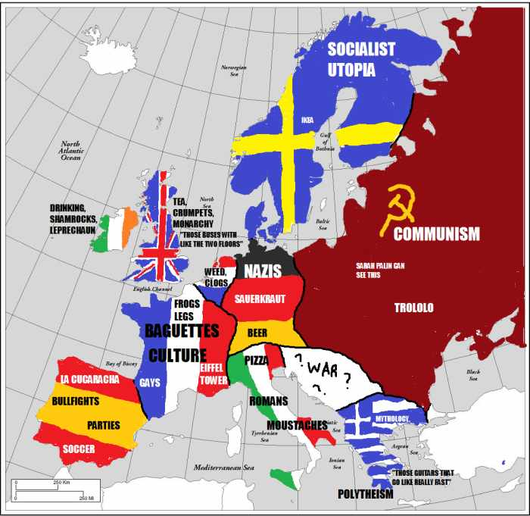

Slide 32
Yet Wilson challenge was convince the rest of the world who resented his moral superiority, allies like G.B wanted to kill the Kaiser and due to a Republican taking over the house it demonstrated we did not even support his plan, who didn’t like him especially when no republican were appointed to negotiate it!

Slide 33
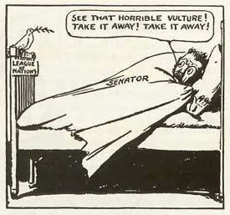

Slide 34
Treaty of Versailles: At the Paris Peace Conference on Dec. 13th 1918 the Big Four (G.B, France, Italy & U.S) got together to decide the fate of Europe yet concerns with instability and communism. G.B refused Wilson’s idea of free trade and they wanted reparation from the Central powers (56 billion later changed to 9). And goal was that Germany would never gain power like that again. Yet approved League of Nation (9 nation council)

Slide 35
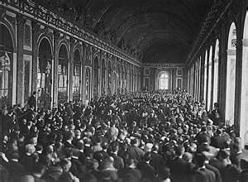

Slide 36
Wilson unwillingly to compromise was left with an America that wanted to stay out of Europe’s affairs.
Yet the new social environment was not progressive but repression and hostile due to recession right after WW1. They needed to change our markets and with prices being inflated and American losing their jobs this created a recession. Which created work rights to be taken = strikes!

