Slide 1
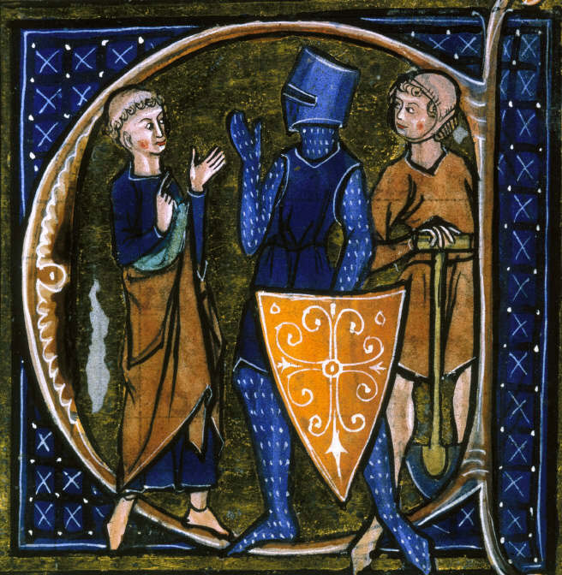
The Middle Ages

Slide 2
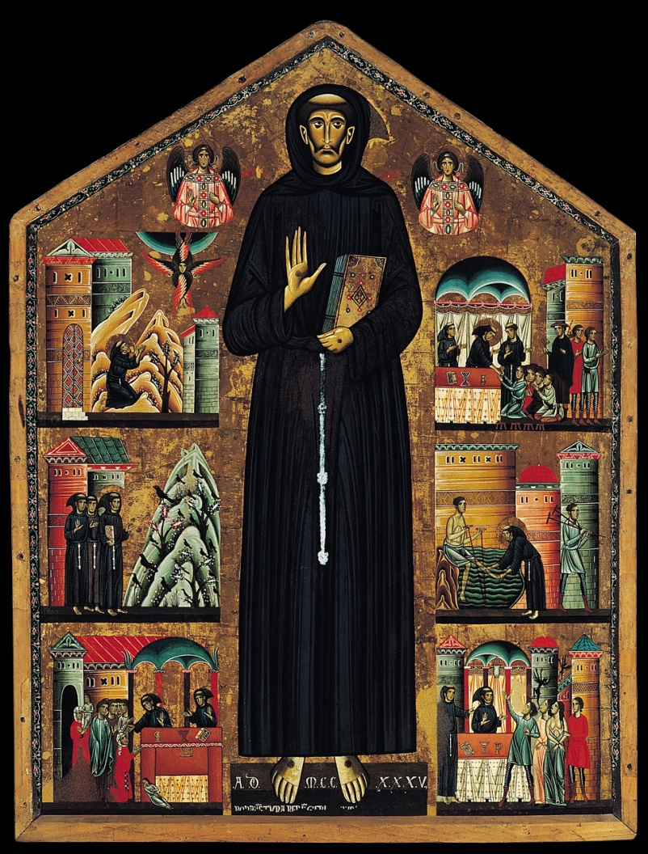
The Middle Ages
Period of history following the collapse of the Western Roman Empire
500 – 1500 CE
Also known as the Medieval period
Review: Why did the Roman Empire collapse?

Slide 3
What was happening to Europe in the Middle Ages?
Repeated invasions by Germanic invaders
Disruption of trade
Downfall of cities
Urban → Rural (people moved from cities to farms)

Slide 4
Effect on Language and Learning
Germanic tribes had a rich oral tradition, but no written language
Literacy declined
Decline of Latin as a common spoken language
Evolution of Romance languages

Slide 5
German Kingdoms
Small Germanic kingdoms replaced Roman provinces between 400-600 CE
Competing warrior kingdoms led by chiefs
Held together by family ties and personal loyalty

Slide 6
Germans Adopt Christianity
German leaders ally with the Roman Catholic Church after 600 CE
Germanic people gradually convert from paganism to Christianity
Catholic monasteries become centers of learning during the Middle Ages

Slide 7
Carolingian Empire
Ruled by Charlemagne, leader of the Franks (Germanic tribe)
Appointed by Pope Leo III
First empire in Western Europe since the collapse of the Western Roman Empire
Existed from 800-888 CE

Slide 8
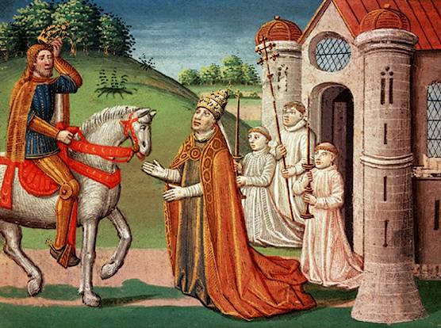

Slide 9
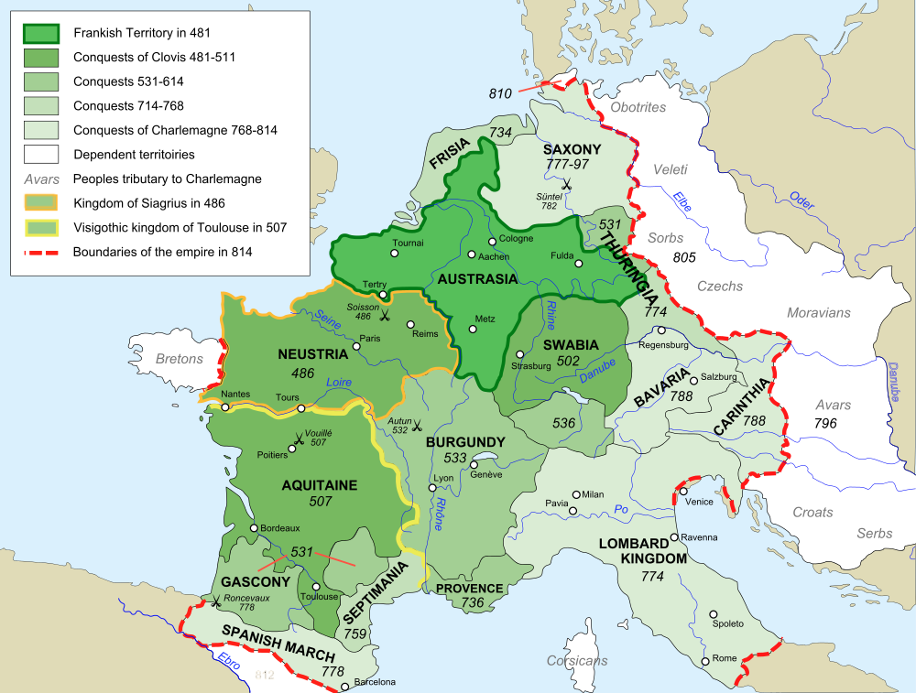

Slide 10
Carolingian Renaissance
Charlemagne’s royal court became a great center of learning
Renewed interest in Roman culture
Trivium: grammar, logic, and rhetoric
Quadrivium: arithmetic, geometry, music, and astronomy
Rhetoric: speech meant to inform or persuade

Slide 11
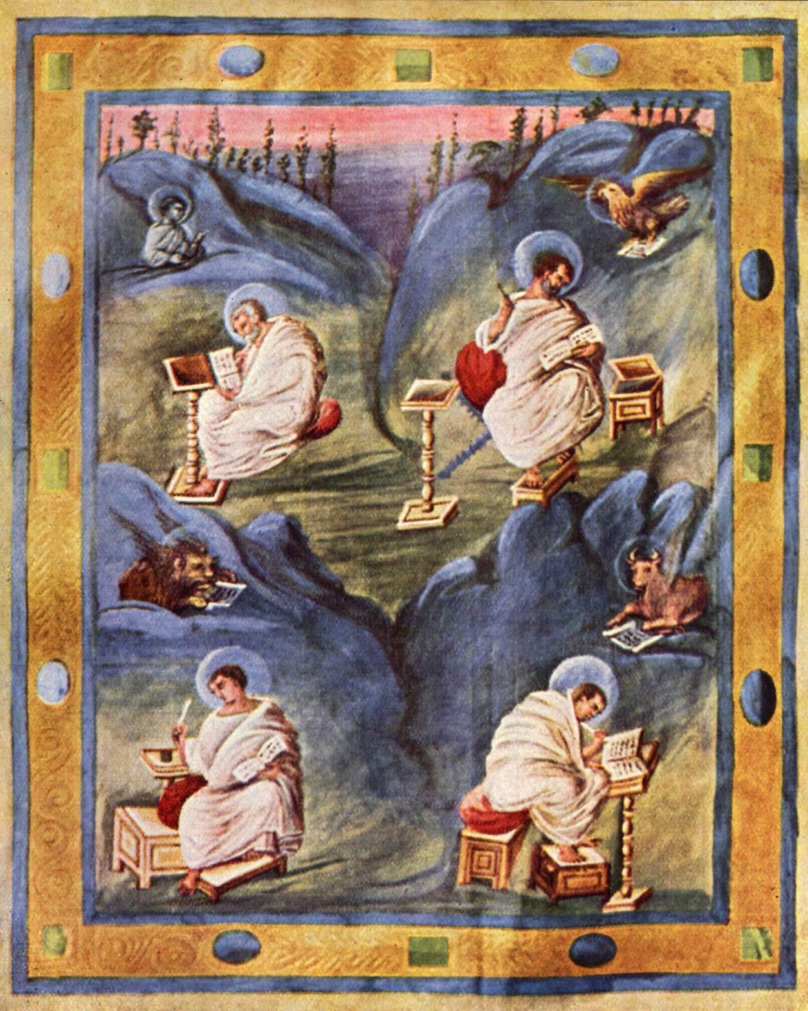
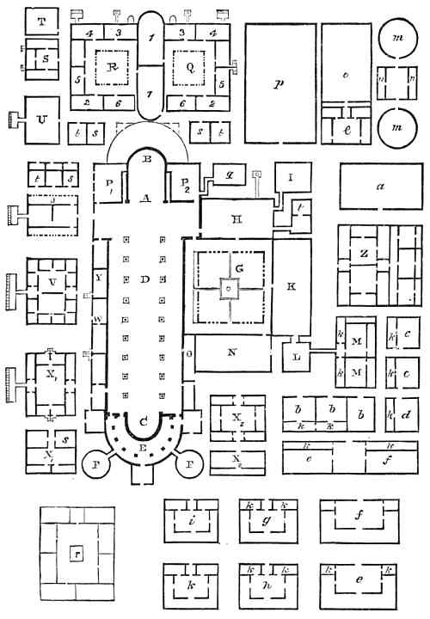
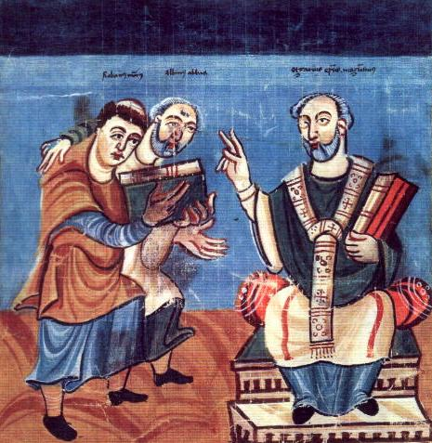

Slide 12
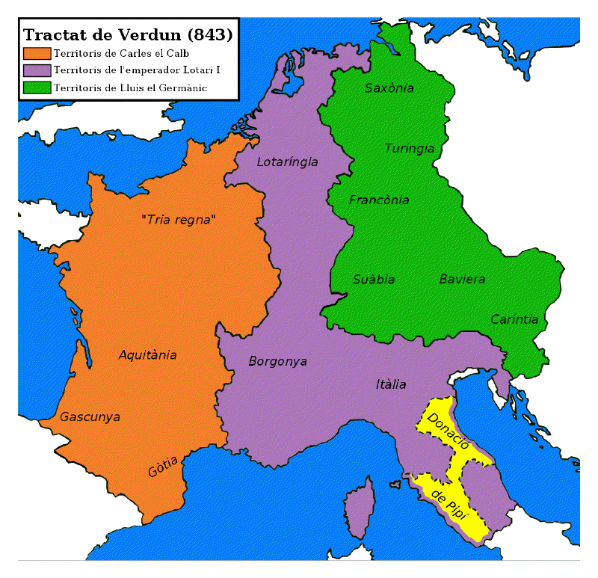
Fall of the Carolingian Empire
Treaty of Verdun: following Charlemagne’s death, the empire is split between his three feuding sons
Weakened by invasions (800-1000 CE)
Muslims from the South
Conquer Rome in 846
Magyars from the East
Vikings from the North

