Slide 1
WWII Leaders Rise to Power
“Demoralize the enemy from within by surprise, terror, sabotage, assassination. This is the war of the future.”
“By the skillful and sustained use of propaganda, one can make a people see even heaven as hell or an extremely wretched life as paradise.”
-Adolf Hitler

Slide 2
Define Terms
Fascism
Nazism
Totalitarianism
Isolationism
Appeasement
Propaganda
Anti-Semitic (pg 913)

Slide 3
New Militant Political Movement
What was the new militant political movement that rose in Europe in response to the unstable economy and weak democracies?

Slide 5
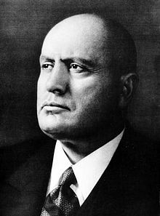
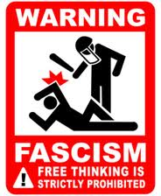
Italy Benito Mussolini: Biography of Fascist Italy's Dictator
Benito Mussolini rids Italy of democracy in favor of a fascist state. He censored and imprisons his people, outlaws strikes and only also fascist documents to be published. Italy attacks and attacks Ethiopia and Albania.

Slide 6
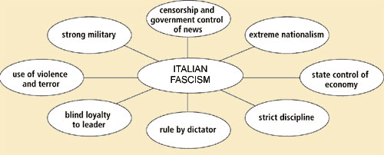
Ideas Behind Fascism

Slide 7
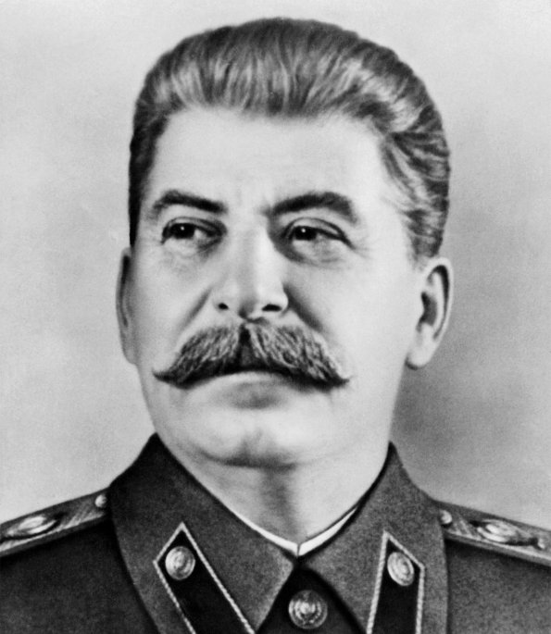
Soviet Union Biography of the Communist Soviet Dictator
Joseph Stalin had a Totalitarian government when he gained power after Lenin died. He has a command economy, a great purge where he kills millions, uses censorship, propaganda and police terror to rule. When he makes an alliance with Hitler he starts expanding his territory.

Slide 8
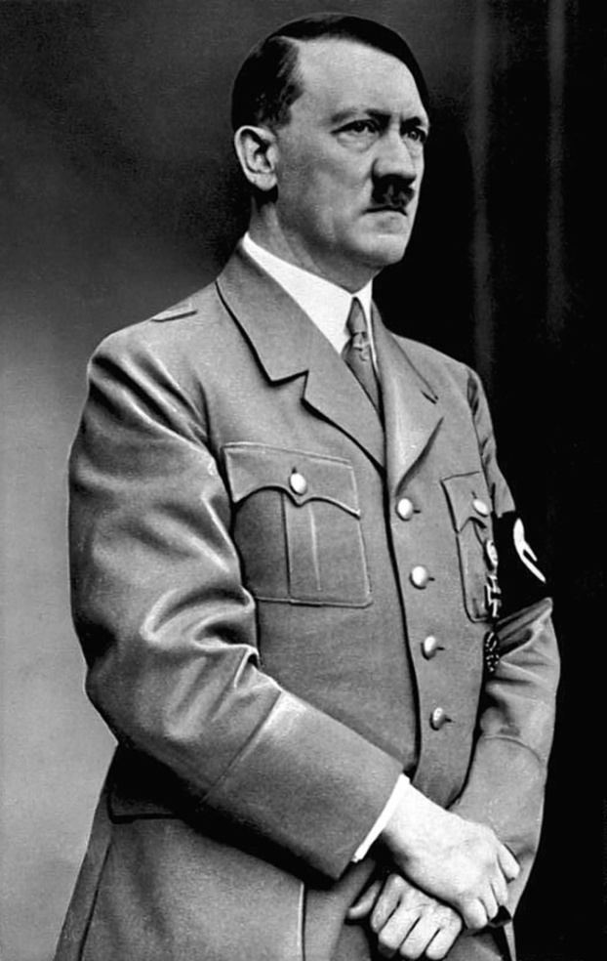
Germany World War II: The Rise of Hitler - Biography
Adolf Hitler makes Germany a Totalitarianism state under his Nazi regime. He kills others in power and continues to put opponents in work camps, censor books, free speech and makes the youth join the “Hitler Youth” program. He also creates an anti-Semitic atmosphere and later has the Jews sent and killed in the Holocaust . Germany causes WWII due to their relentless expanding of territory in Europe.

Slide 9
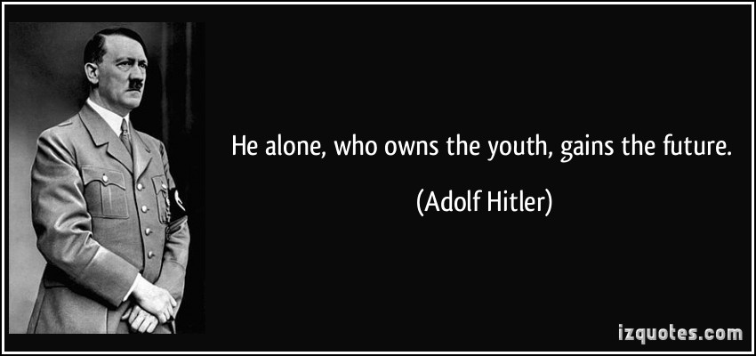

Slide 10
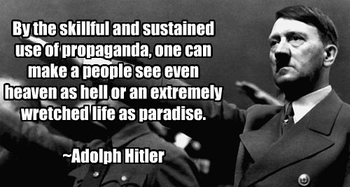

Slide 11
Questions:
Why was Germany so aggressive in taking land from Europe?
What were they trying to restore?
How could this have been avoided?

Slide 12
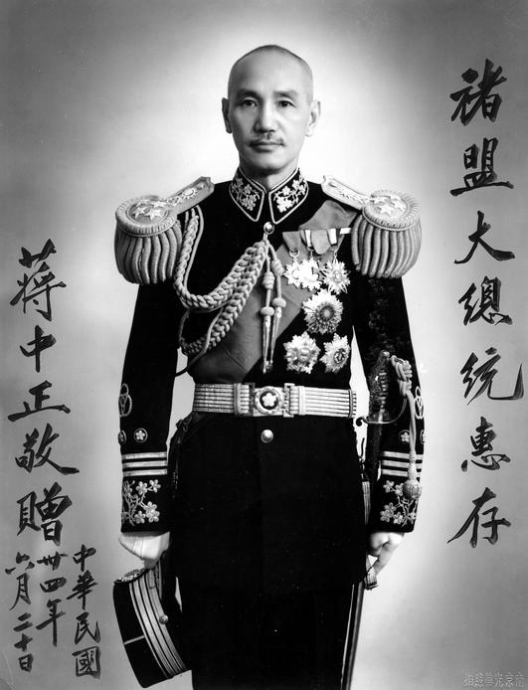
Japan
Military leaders gain power in Japan after the great depression because they wanted to restore the emperor as the symbol of state power. EXTREME NATIONALISM lead to them expanding their land and in the process infecting a horrific genocide on the people of Nanjing.

Slide 13
Germany, Italy and Japan were all doing?

Slide 14
Causes of WWII
List the 4 causes of WWII and then explain HOW they caused WWII!
There are many elements of each cause!

