Slide 1
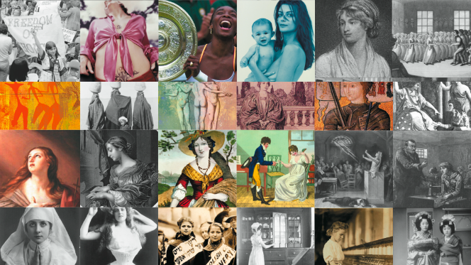
Women Fight for equality throughout World History
OPHS World History

Slide 2
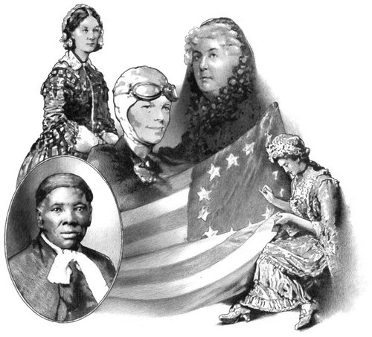
Has anyone noticed yet we haven’t mentioned much on women?
That’s because throughout most empires, countries and up to WWI they were being subdued!
AKA: they were not “allowed” to lead or really have any power so why mention them?
So why did this happen to women?

Slide 3
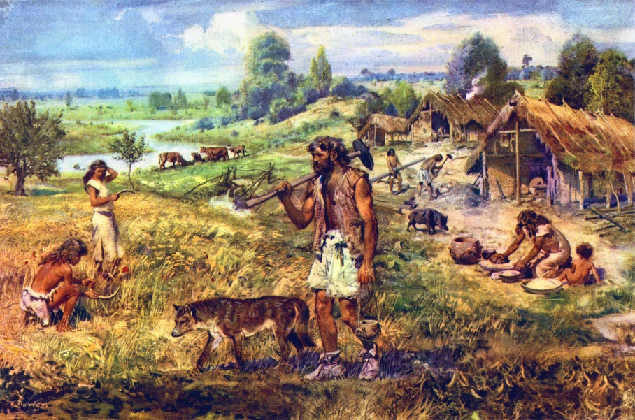
In the beginning…..hunters and gathers
Most historian believe that it started with the idea that men were the hunters and women were the gathers however when they switched over to agricultural life this is beginning of their discrimination. It was this notion that women could not do the “hard work” that mean could so therefore men were superior.

Slide 4
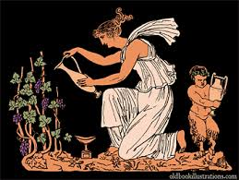
As time went on…
People viewed women as their “role” to be a good mother and take care of the family. There sole purpose in life was to be a good wife and mother. Therefore they did not need to be educated in anything outside of motherhood, vote or anything else besides preparing to fit the role of a caregiver.

Slide 5
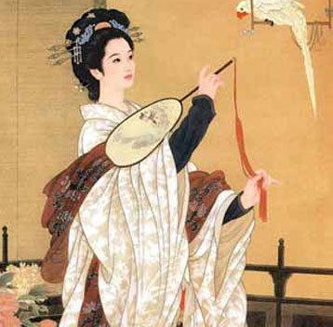
This being said…
There was a HUGE effort placed on women finding a husband and women who did not marry were shunned!
Think about it today…How much are women valued for their looks?
Their brains?

Slide 6
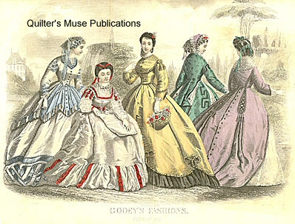
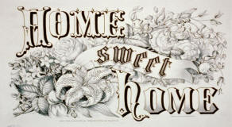
The Cult of Domesticity and True Womanhood
In America (and other parts of the world) there was a new concept that a women’s role was at home while the male went to work as a “the bread winner” The cult of domesticity laid out what American women ideals were…
Piety
Purity
Submissive
Domesticity

Slide 7
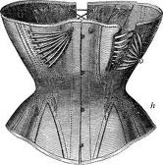
So as always…SADLY
Women rarely questioned this system and would go to insane lengths (just like today hello high heels) to “look attractive” to men.

Slide 8
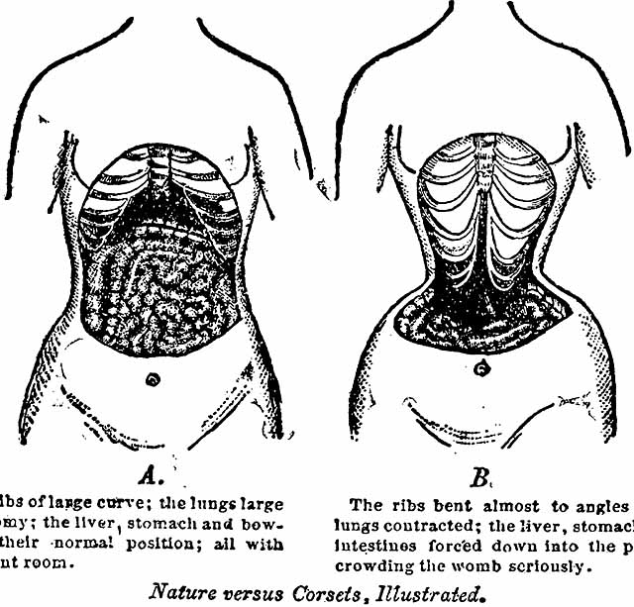
Physical Effects of the Corset:
The Corset: Bent ribs, damage to the heart, lungs, circulatory system, stomach, liver, colon, uterus, gall bladder, muscles, all possibly leading to ORGAN FAILURE!

Slide 9
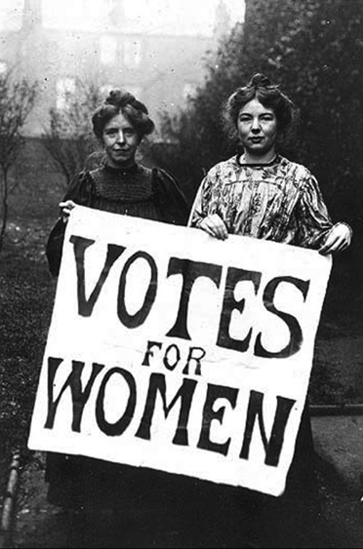
However…
There were some women would did not conform to society view of women and many of them helped shatter some of this stereotypes. Yet the biggest thing women finally started was the fight for suffrage (right to vote ☺)

Slide 10
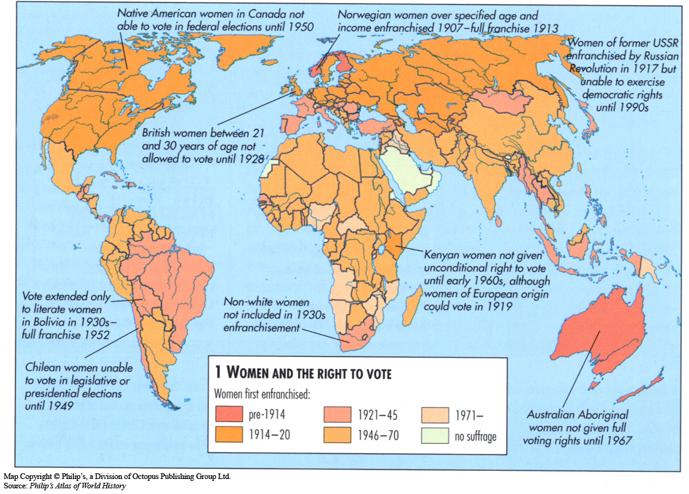
United States and Europe
The biggest gains in the world have come from the United States and Europe. In fact New Zealand (under British rule) is a trend setter and is the first country to grant women the right to vote. This inspires our women and we start the grueling process of fighting for equality.

Slide 11
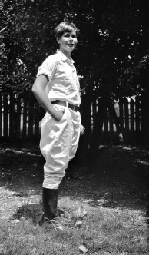
Right to Vote
In 1888 women activist from around the world meet to discuss how to get the right to vote.
There were many different strategies and views on how they could change the government. Some organizations wanted to still “act like a lady” only wanted to fight for the right to vote whereas more radical groups wanted to change the stereotype and started cutting their hair short and wearing pants (GASP!)

Slide 12
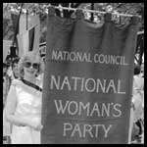
Right to Vote
However it was an uphill battle so many women turned to more militant form. In Britain the Women’s Social and Political union (WSPU) was formed and they inspired the Americas NWP. Both groups went to jail and went on a hunger strike to show their government they meant business.
Both countries women earned the right to vote after WW1

Slide 13
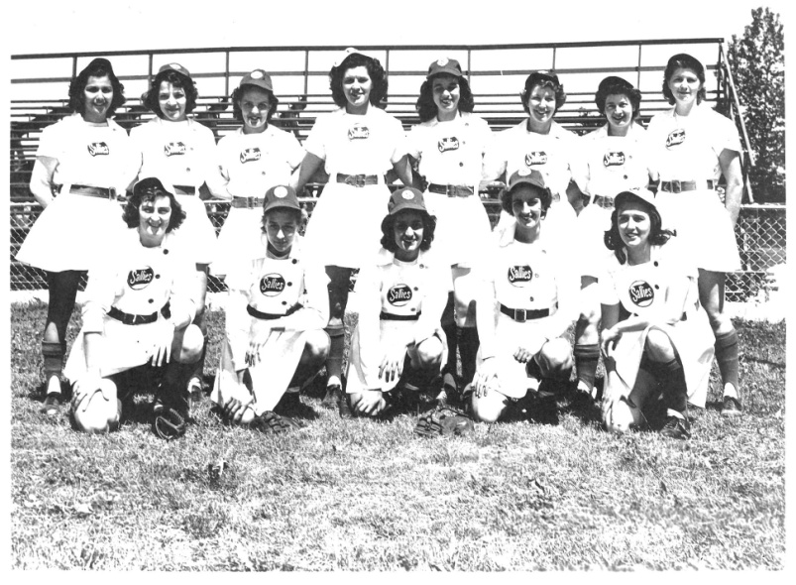
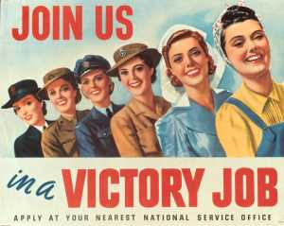
1950s
Although just like many minority groups, women gained power during WWII because they needed them. Women worked in the factories, were sent overseas to assist the war, and even played baseball. However when the war ended they were asked to step down into their role as “housewife.”

Slide 14
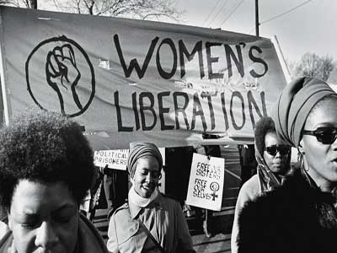
However the fight for equality wages on…
In the 1970s in America feminism was born. Even though women were granted the right to vote this did not change stereotypes of “women work.” Women have been fighting to equality in the work force (glass ceiling) sports, and against violence done to women.

Slide 15
However the fight for equality wages on…
Depending on what country you live in rape is still a huge issue. In fact in Mexico a women in the 1980s had to marry her rapist, not to mention many countries still today do not view marital rape as rape.
In many parts of the world gangs use women to demonstrate their power over the government and will rape women, disfiguring their face and other parts of their bodies as a way to shun them to be keep them quiet and the village in line.

Slide 16
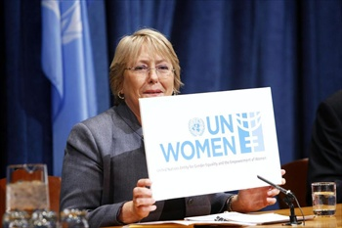
So now what?
Well to put it simply women’s equality is still an uphill battle. The United Nations has been working to end the human rights violations done to women; however women will not be able to change things unless they speak out and become educated.

Slide 17
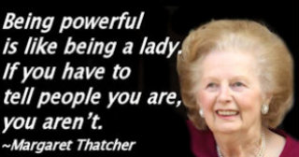
So what can we do?
Thoughts?
Brainstorms?

