Slide 1
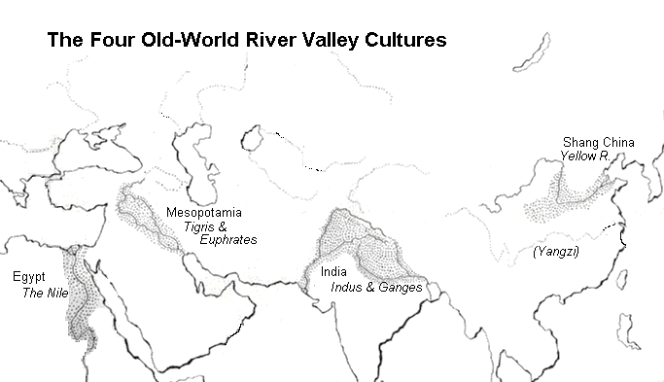
Welcome to the 1st civilizations!

Slide 2
Why were they all located by rivers?
1. Offered rich soils for agriculture
2. Tended to be located in places that could offer protection from nomadic invaders
Don’t forget our focus question this unit
“What kind of role did geography play in ancient civilizations?”
Hint what role did river play (large or small)
Look for other geographically features ☺

Slide 3
 | Environment/ Geography | Government/Religion | Achievements
Mesopotamia Sumer
Egypt
Indus
China | .

Slide 4
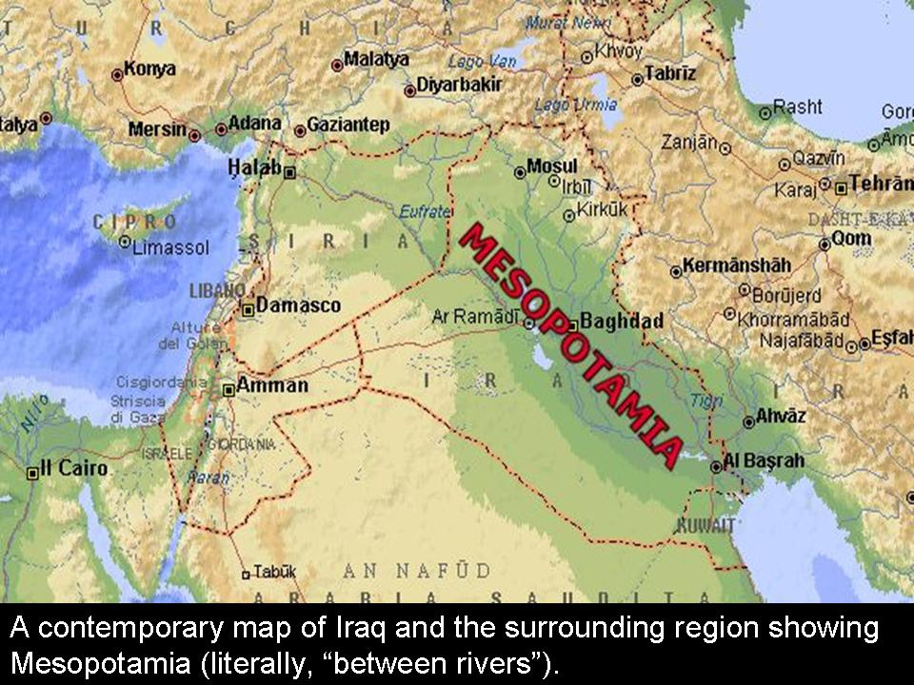
Mesopotmia

Slide 5
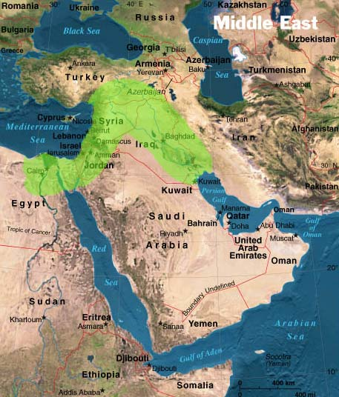
The Fertile Crescent
Arc of land between the Persian Gulf and the Mediterranean Sea in Southwest Asia

Slide 6
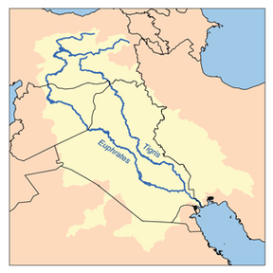
One land…Two Rivers
Mesopotamia means = “land between the rivers”
Tigris River and Euphrates River
Both rivers flooded once a year and left thick bed of silt.
Silt: rich, new soil farmers could plant and harvest enormous quantities of wheat and barley

Slide 7
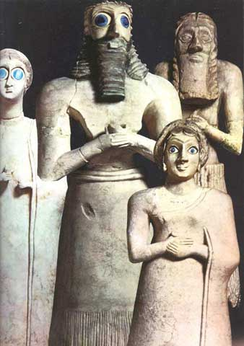
Political
Power of the Priests
Sumer’s earliest governments were controlled by temple priests
Farmers believed they needed blessings for success of their crops
Priests were the middle man for the Gods
Priests demanded portion of farmer crops as tax

Slide 8
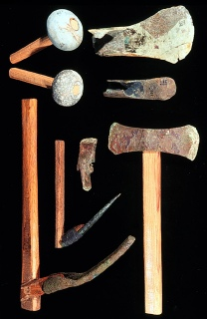
Economy
• Metal tools and weapons (bronze, iron)
• Increasing agricultural surplus (better tools, plows, irrigation)
• Increasing trade along rivers – traded with Egypt
• Development of the world’s first cities
• Specialization of labor

Slide 9
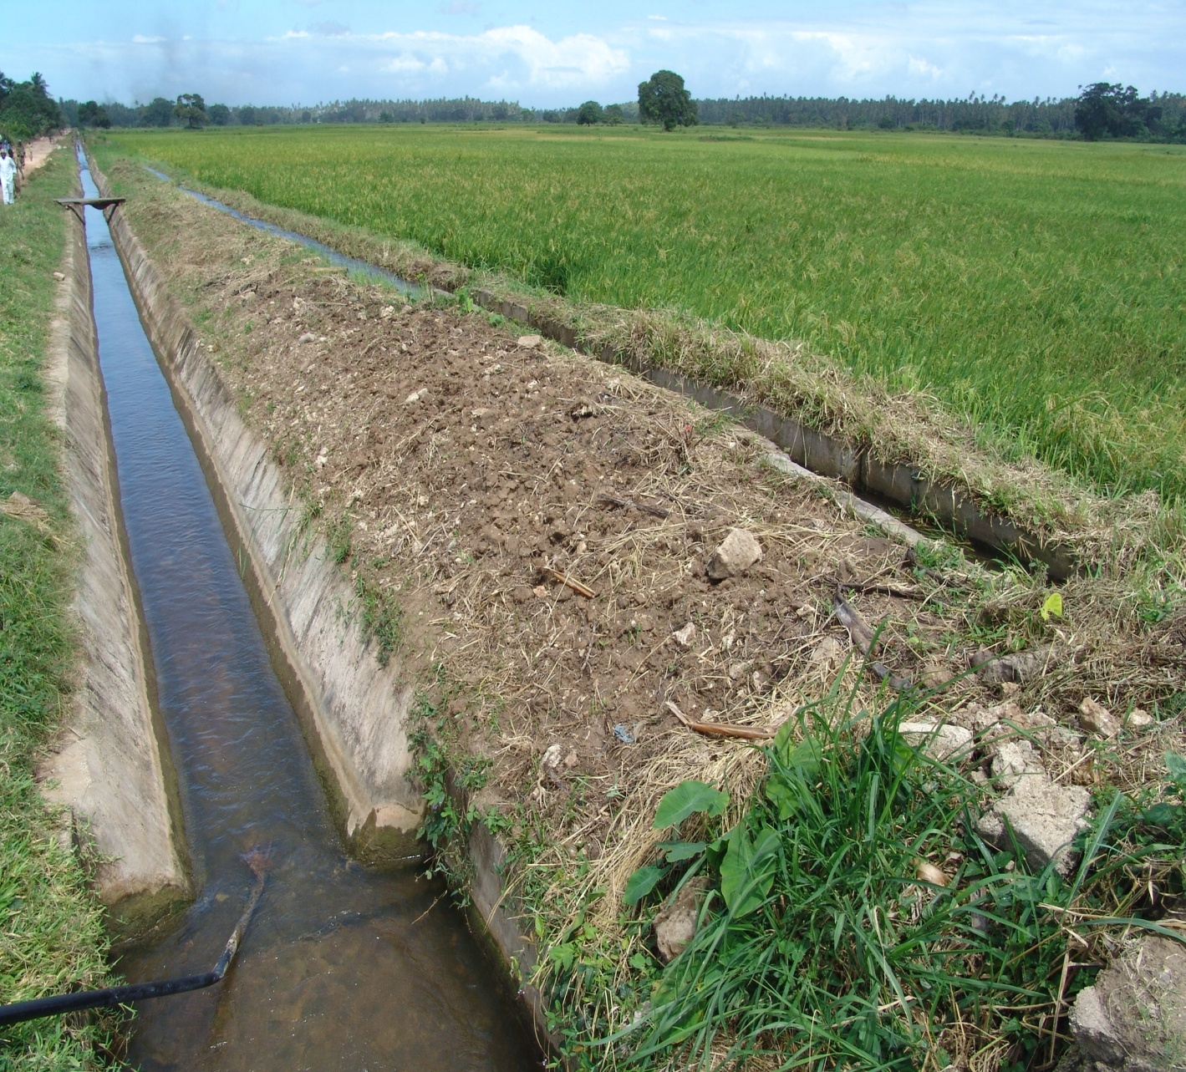
Achievements
Science and Technology
Invented the wheel, the sail, the plow
First to use bronze.
Developed system of writing
Built irrigation systems, buildings, surveyed flooded fields.
One of the earliest works of literature in the world = Epic of Gilgamesh
Written language =Cuneiform

Slide 10
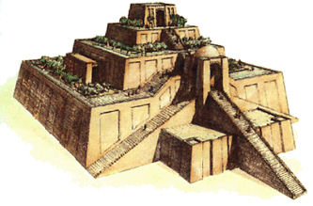
Religion
Polytheistic: Belief in Many Gods (3,000!!!)
Gods could be angered at any moment and to keep them happy Sumerians:
Built impressive ziggurats or temples to sacrifice food, wine and animals
Souls of the dead wandered in the land of no return

Slide 11
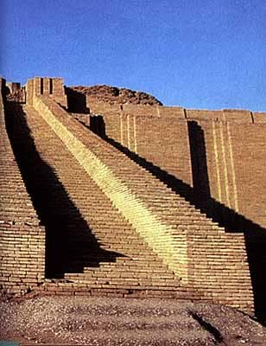
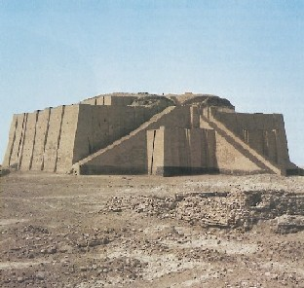
MORE
ZIGGURATS!!!

Slide 12
Sumerian Society
Kings and Priests
Wealthy merchants
Ordinary Sumerian people
Slaves

Slide 13
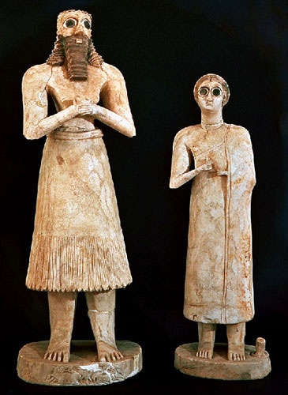
Women
Could hold property
Join lower ranks of priesthood
There were few women scribes
Scholars think that girls were not allowed to attend schools

Slide 14
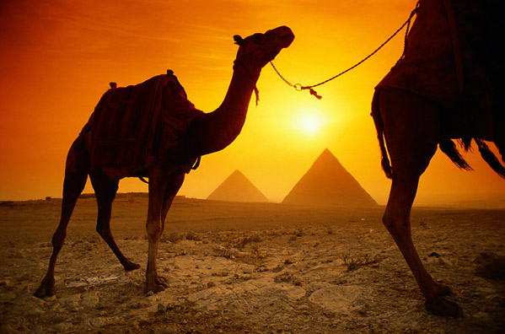
Ancient
Egypt
Copyright © Clara Kim 2007. All rights reserved.

Slide 15
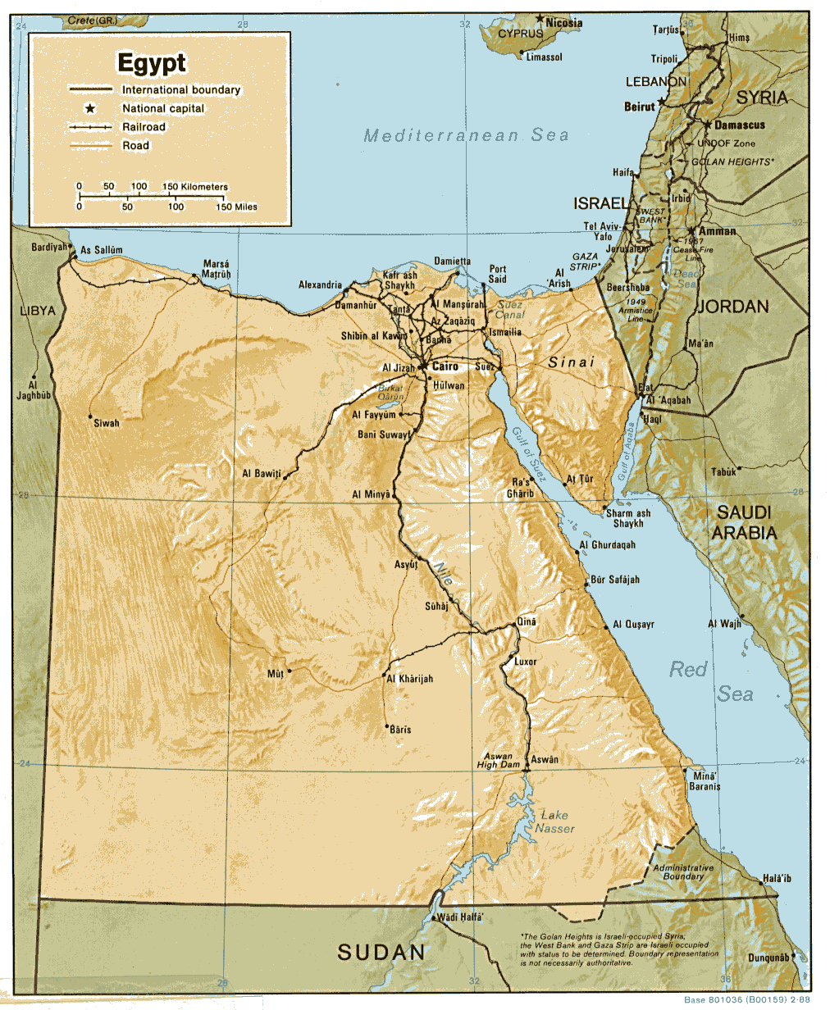
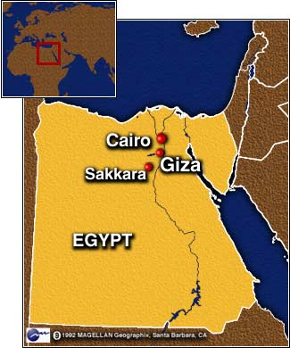

Slide 16
Geography
Nile River – 4,100 miles long, flows northward
Every year in July the river flooded REGULARLY leaving behind rich soil.
The Nile is the longest river in the world!
Forbidden Deserts on either side of the Nile = Natural barriers

Slide 17
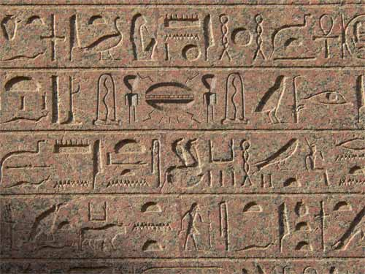
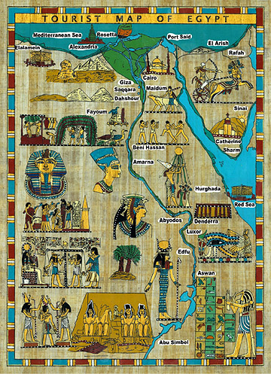

Slide 18
Pharaohs
Egyptian kings = pharaohs
The Egyptians viewed their pharaohs the same as the gods
KINGS WERE GODS
Stood as center of religion as well as government and army
Type of Government = Theocracy

Slide 19
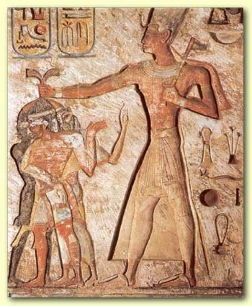
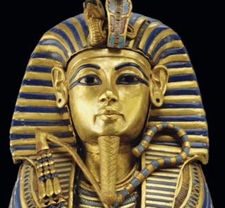

Slide 20
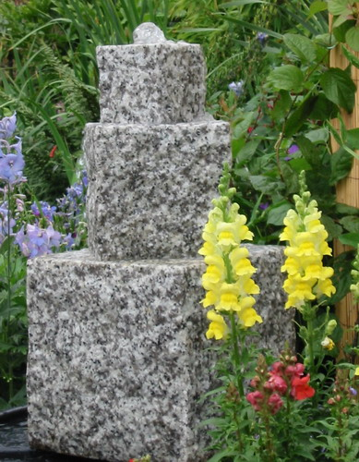
Trade
By 3200 BC, Egyptians were trading with the Mesopotamians
Also traded up and down the Nile
Gold
Ivory
Cattle
Granite blocks

Slide 21
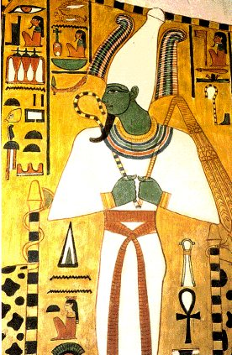
Religion
Polytheistic
2,000 gods and goddesses
Built huge temples to honor gods
Believed in afterlife
Osiris – god of the dead

Slide 22
Social
Very different from the city-states of Mesopotamia
Egypt’s united kingdom allowed
High degree of unity
Stability
Cultural continuity (staying the same)

Slide 23
Life in Egyptian Society
Pharaoh
Royal Advisor
Priests
Traders/Merchants
Ordinary Citizens
Slaves

Slide 24
Intellectual
Developed writing = hieroglyphics
Pictographic writing system
Developed written numbers for recording taxes
Addition, subtraction

Slide 26
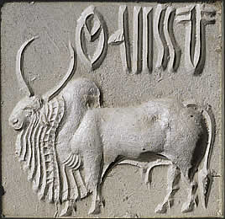
Achievements
Knowledge in math = skillful engineers
Pyramids
Palaces
Egyptian Architects first to use stone columns in homes, palaces and temples
12 month, 365 day calendar from studying the stars
So accurate it was only 6 hours off from today’s calendar year
Indus Valley

Slide 27
Geography
Wall of Mountains- sepereated India from the rest of Asia
Hindu Kush
Himalaya
Karakoram
This created an Indian Sub-Continent
Monsoons – trade winds that brought rain in the summer and dry wind in the winter
Major Rivers-
Indus
Ganges

Slide 28
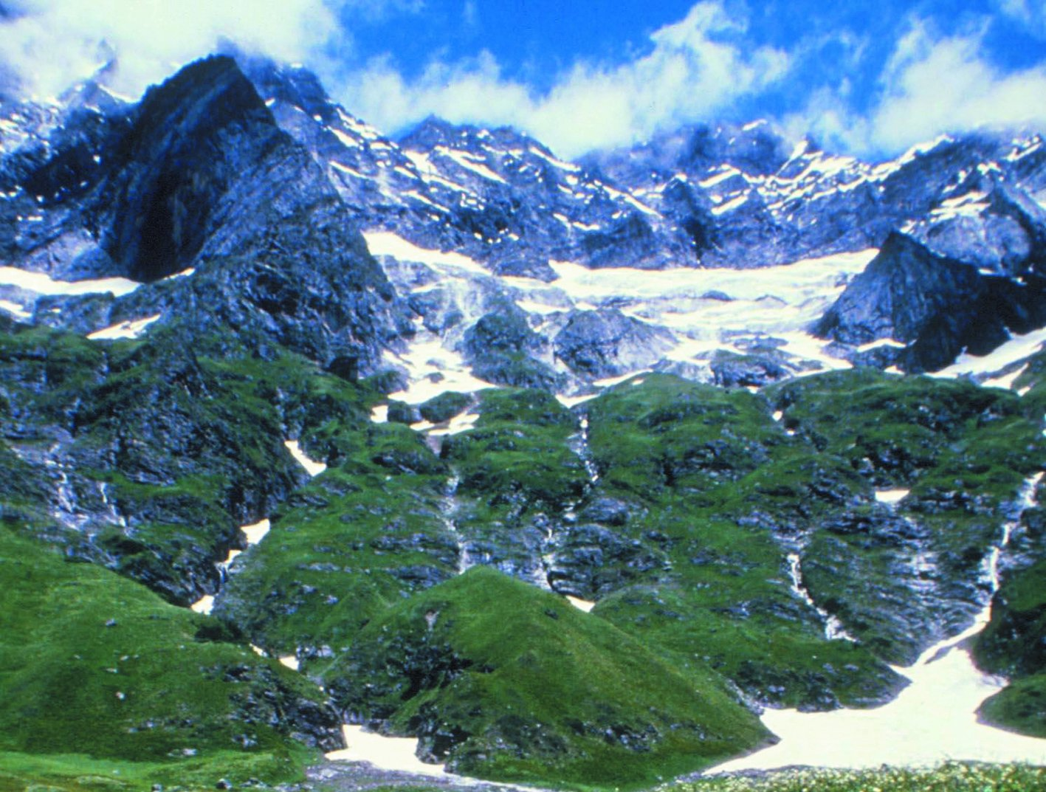

Slide 29
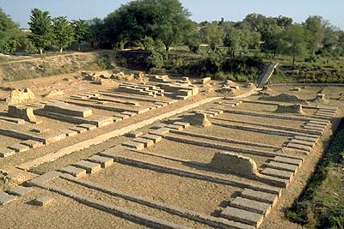
Political
Identically planned cities and construction suggests a strong central government

Slide 30
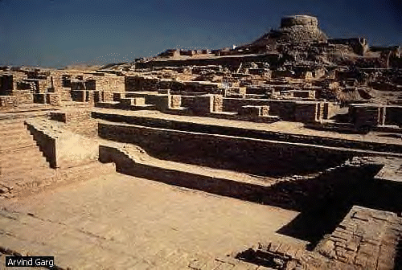

Slide 31
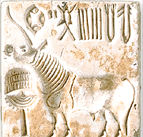
Economic
Traded long distances
Artifacts found show that Sumer and Indus traded for about 350 years

Slide 32
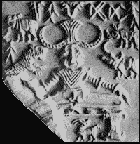
Religious
Artifacts show links to modern Hindu Culture
Shiva- is a major Hindu god
Worshipped Cows

Slide 33
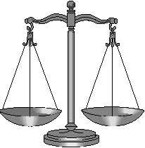
Social
Civilization was generally stable
Same kinds of houses suggests little social differences
Toys were found for children – this shows prosperity since they can make things they do not NEED to survive

Slide 34
Intellectual
Solved the problem of plumbing
Built extensive plumbing systems
Private bath and toilet for every house
Toilets made of brick with wooden seats
Pipes connected underground sewer system

Slide 35
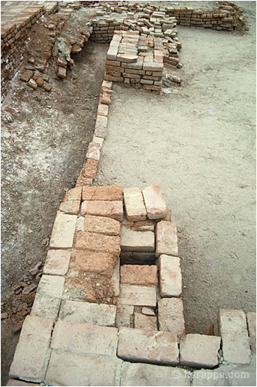
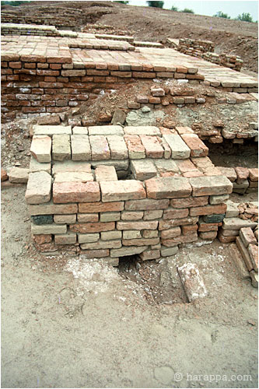

Slide 36
Achievements
Sophisticated city planning – very detailed and organized
Used a grid system
Citadel – a fortified area surrounded by a wall that protected the major buildings in the city
Public buildings, bath, granaries and religious quarters

Slide 37
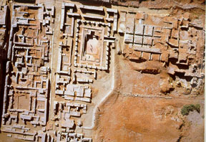

Slide 38
C
H
I
N
A
Copyright © Clara Kim 2007. All rights reserved.
Copyright © Clara Kim 2007. All rights reserved.

Slide 39
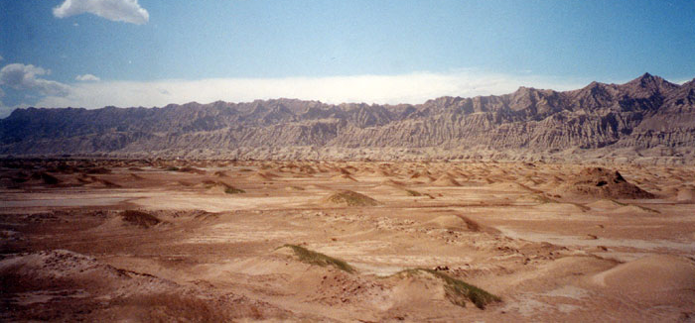
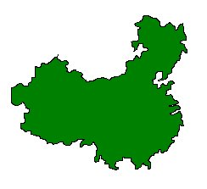
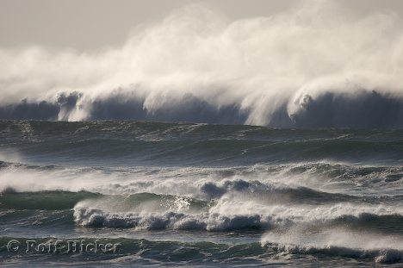
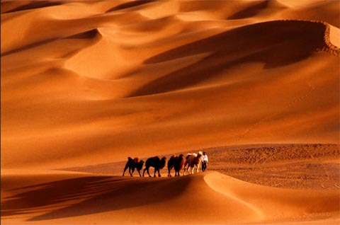
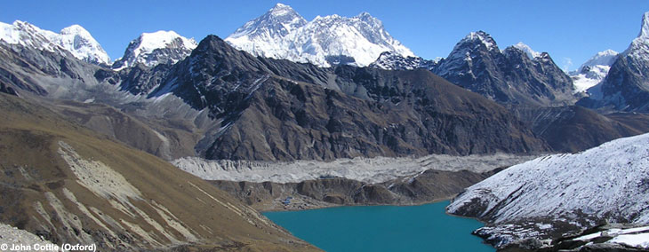
GOBI DESERT
TAKLIMAKAN DESERT
PACIFIC OCEAN
HIMALAYA MOUNTAINS

Slide 40
Geography
Surrounded by natural barriers on all cardinal directions
North: Gobi Desert
East: Pacific Ocean
South: Himalaya Mountains
West: Taklaman Desert and Plateau of Tibet

Slide 41
Geography
Fertile plain found between 2 major rivers
1. Huang He (Yellow River)
Floods left behind LOESS: yellow silt
2. Yangtze River
Flooded unpredictably

Slide 42
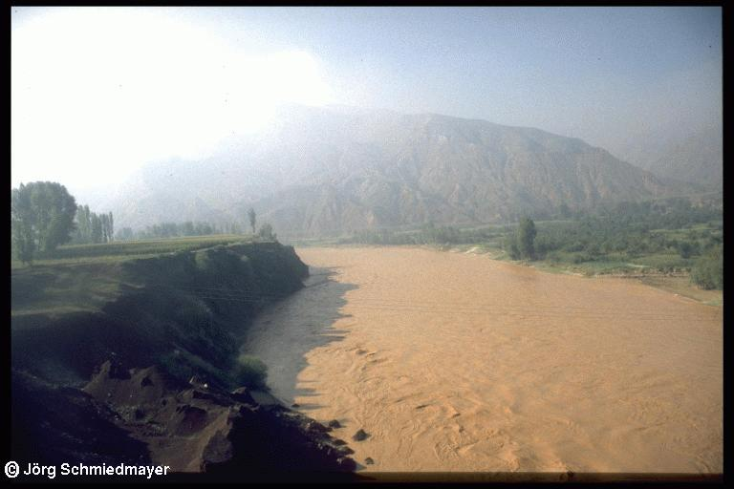
Huang He (Yellow River)

Slide 43
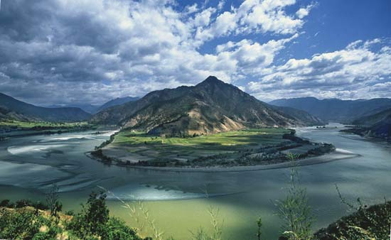
Yangtze River

Slide 44
Political
Ruled by dynasties
As Mesopotamia, Egypt and Indus were declining, Shang Dynasty in China was rising to power
Zhou Dynasty
Mandate of Heaven: Justification through right of God
Dynastic Cycle: Pattern of the rise and fall of dynasties
Feudalism: nobles have permission from Kings to own and work king’s land

Slide 46
Economic
Because of China’s isolation by natural barriers, early settlers had to supply their own goods within China
Not much trade outside of China

Slide 47
Religious
Family and Religion are closely linked
Prayed to ancestors because they thought their ancestors could bring them luck or disaster
Consulted the gods through ancestors
Shang Di – Supreme God

Slide 48
Social
Society was sharply divided between nobles and peasants
Family was central to society
Had arranged marriages
Group was more important than the individual

Slide 49
Society
Society
Society
Society
Society
Society
Society

Slide 50
Intellectual
Shang Dynasty was the first to leave written records
Oracle Bones: animal bone or tortoise shells where priests scratched questions for gods then applied heat until it cracked. Then they priests interpreted the cracks

Slide 51
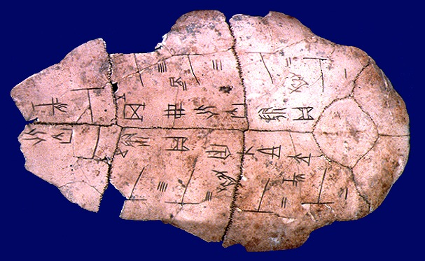

Slide 52
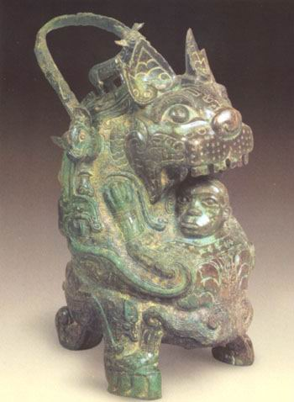
Achievements
Introduced the chariot – a major tool of war
Skilled in bronze work, silk and weapons

Slide 53
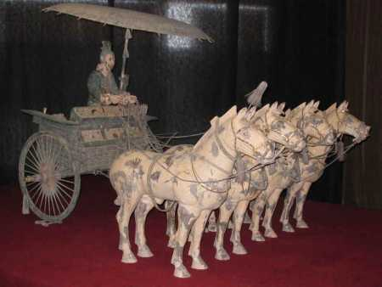

Slide 54
