Slide 1
Unit 5
See-Think-Wonder

Slide 2
See-Think-Wonder
As we go through the following images answer the following questions:
What do you see?
What do you think is going on?
What does it make you wonder?

Slide 3
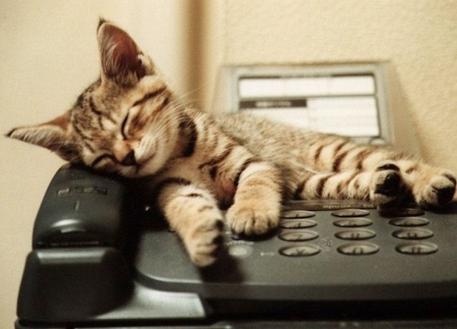
See, Think & Wonder?
SEE: The first question, “What do you see?” is asking for things you can physically point to, not what you can infer.
Example: I see a cat☺
Turn & Talk: What do you SEE?

Slide 4
See-Think- wonder
THINK: The second question asks you to make guesses about what is happening in the picture. These are inferences.
Turn & Talk: What do you SEE?
Example: Why is he so sleepy!

Slide 5
See-Think-Wonder
WONDER: The last question requires you to generate your own questions about the image.
Example: I wonder why my teacher is
Making me look a pictures of a car?
Turn and talk: wonder

Slide 6
1. See-Think-Wonder
What do you see?
What do you think is going
on in this picture?
What do you wonder
about this picture?

Slide 7
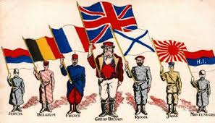
2. See-Think-Wonder
What do you see?
What do you think is going on in
this picture?
What do you wonder about this
picture?

Slide 8
3. See-Think-Wonder
What do you see?
What do you think is
going on in this picture?
What do you wonder
about this picture?

Slide 9
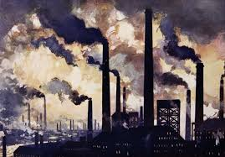
4. See-Think-Wonder
What do you see?
What do you think is going
on in this picture?
What do you wonder
about this picture?

Slide 10
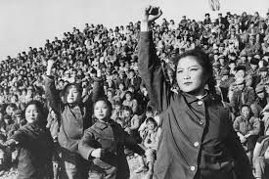
5. See-Think-Wonder
What do you see?
What do you think is going
on in this picture?
What do you wonder
about this picture?

Slide 11
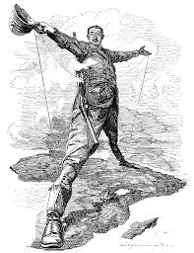
6. See-Think- Wonder
What do you see?
What do you think is going
on in this picture?
What do you wonder
about this picture?

Slide 12
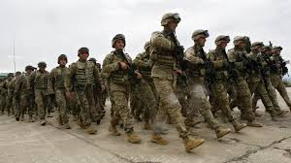
7. See-Think- Wonder
What do you see?
What do you think is going
on in this picture?
What do you wonder
about this picture?

Slide 13
As a group-annotate and determine which term applies.
“People would prefer their own bad government rather than submit to the good government of a foreign country.”

Slide 14
What is JFK saying about revolutions?
But men do not live only by fighting evils. They live by positive goals, individual and collective, a vast variety of them, seldom predictable, at times incompatible. Those who make peaceful revolution impossible will make violent revolution inevitable.

Slide 15
Worksheet Doc. 2

Slide 16
Document 3

