Slide 1
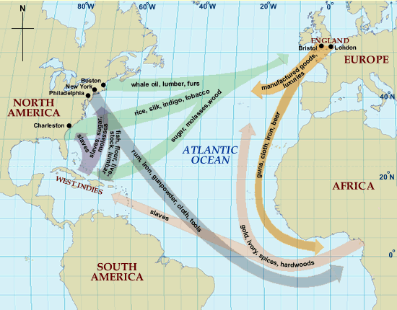
Trade in the New World
Mrs. Benda
World History
OPHS

Slide 2
Trade
As the world starts to trade (goods and ideas)more we are slowly approaching modern day.
America is now entering into picture earning the title; “New World” as opposed to the “Old World” Afro Eurasia

Slide 3
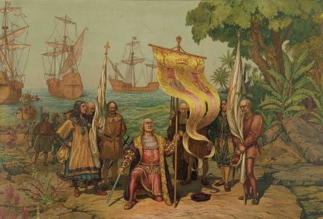
The Columbian Exchange
The global transfer of food plants and animals (and diseases) during the colonization of the Americas is know as the Columbian Exchange.
Crash Course on the Columbian Exchange: http://www.youtube.com/watch?v=HQPA5oNpfM4

Slide 4
The Columbian Exchange
Columbian Exchange describes the global transfer of food, plants and animals!
This is HUGE! This leads to an increase in the world’s population.
BECAUSE…….
America is able to send over food back toe the Old World like corn, potatoes, tobacco, etc
Meaning people will not starve to death and therefore will live longer

Slide 5
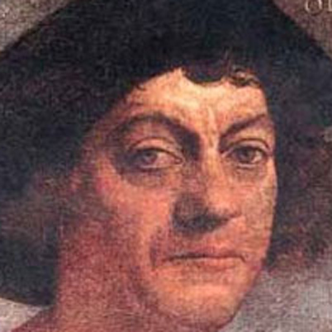
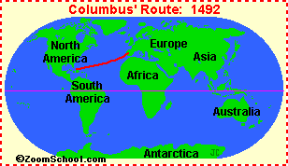
Columbus
“...all the trees were as different from ours as day from night, and so the fruits, the herbage, the rocks, and all things.”
-- Christopher Columbus
In fourteen hundred and ninety-two Columbus sailed the ocean blue ☺

Slide 6
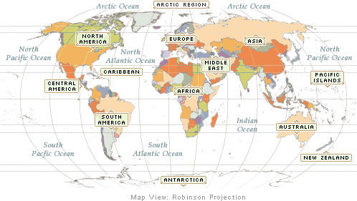
Before 1492 When Columbus sailed the ocean blue ☺
Two sets of culturally diverse people.
Two different eco systems
Two different disease pools
Two sets of plants and animals

Slide 7
The Columbian Exchange
America benefitted by receiving livestock in exchange for crops such as horse (new form of transportation!), cattle, sheep, pigs etc
There as also missionaries that come over to America to spread ideas/ convert the Native Americans into Christians.
European culture had a great influence on both North and South America

Slide 8
The Columbian Exchange
This brought about mercantilism which is a economic and political policy where nations tried to increase their wealth by obtaining large amounts of gold and silver for trade items.
This changes the world we live in as we know it today-Explorers go off and travel the world for their nation and led to capitalism.
Basically a simple idea for a country to have power they needed wealth!

Slide 9
Columbian Exchange
Old World (Europe) to New World (Americas)
Plants:
rice melons
wheat olives
barley dandelions
oats daisies
coffee ragweed
sugarcane Kentucky bluegrass
bananas

Slide 10
Columbian Exchange
New World (Americas) to Old World (Europe)
Plants:
Avocados
Pumpkins
guavas
Peanuts
Pineapple
squash
corn (maize)
tobacco
potatoes (white / sweet)
beans (snap / kidney, lima)
cacao (source of chocolate)
chicle (source of gum)

Slide 11
Columbian Exchange
Old World (Europe) to New World (Americas)
Animals:
horses
cattle
pigs
sheep
goats
chickens

Slide 12
Columbian Exchange
New World (Americas) to Old World (Europe)
Animals:
llamas
alpacas
guinea pigs

Slide 13
But it wasn’t all good…
However one thing America did not benefit from was the diseases that the traders brought over like small pox and measles wiped out million of native Americans. The new dieses were something the natives had no natural immunity to so it literally destroyed their society and made it very easy for Europeans to conquer them
Not to mention it was just goods and ideas being traded but people……

Slide 14
Columbian Exchange
Old World (Europe) to New World (Americas)
Disease:
measles
chicken pox
smallpox
yellow fever
Malaria
influenza (flu)
common cold

Slide 15
Columbian Exchange
New World (Americas) to Old World (Europe)
Disease
Syphilis
Hepatitis
Polio
Tuberculosis

Slide 16
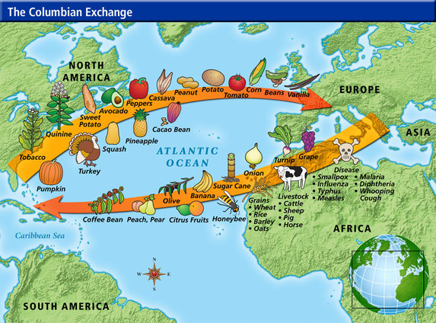

Slide 17
The Columbian Exchange
According to historian Alfred Crosby, the exchange of plants, animals and pathogens between the two hemispheres was biologically “the most spectacular thing that has ever happened to humans," and he coined the phenomenon the Columbian Exchange.

Slide 18
What was the Effect of the Columbian Exchange?
What was the effect of the Columbian Exchange?
a. Both hemispheres were introduced to new foods and animals that changed entire societies.
b. Potatoes and corn became major food sources for Europeans allowing populations to increase greatly.
c. The introduction of pigs, cows, and horses gave new food sources and new animals for the Native Americans to use.

Slide 19
What was the Effect of the Columbian Exchange?
d. The diseases the Europeans brought with them killed up to 90% of the Native Americans in the New World. European conquest of the Native Americans was made easy by the effect disease had on the Natives.
e. The Native Americans had never been exposed to these diseases so their bodies could not fight them. Europeans had lived with these diseases for thousands of year and were not as likely to die from them.

Slide 20
Colonies Trade
Colonies exported raw materials, such as wood and furs
European nations were able to make goods out of raw materials
Colonies then bought finished goods from Eruope

Slide 21
Economic Revolution!
Spurred growth of towns
Many merchants became very wealthy
Most people still lived in rural areas
Mainly only traders and merchants gained social mobility
Mercantilism started to create national identity
Effects of Globalization?!

Slide 22
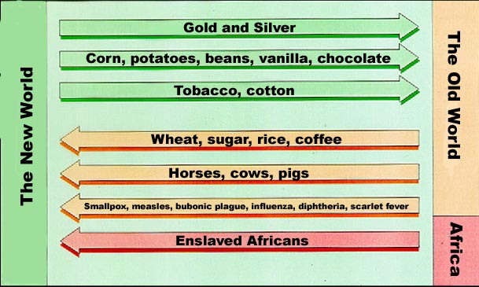
The Columbian Exchange

Slide 23
But it wasn’t all good…
Not to mention it was just goods and ideas being traded but people……
Enter the slave trade… A system that was started in Africa but was totally warped by greed of other nations trying to get rich on slave labor by having them grow the profits (crops).

Slide 24
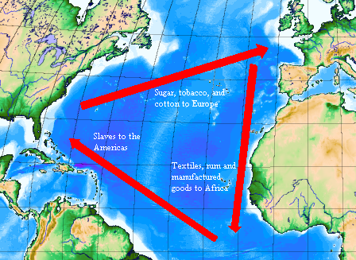
Triangle of Trade
Triangular Trade:
Trade routes between Africa, Europe and the Americas during the Atlantic Slave Trade.
Making the three areas
interdependent

Slide 25
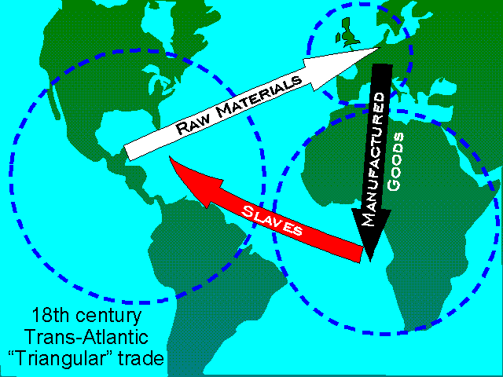
Map of the Triangle of Trade

Slide 26
Stage One
Ships left Europe loaded with goods, such as guns, tools, textiles & rum.
Crews with guns went ashore to capture slaves.
Slaves were obtained by:
1. Kidnapping
2. Trading
3. People were given by chiefs as tributes (gifts)
4. Chiefs would send people who were in debt
5. Chiefs would send criminals through judicial
process
6. Prisoners of tribal wars were also sent.

Slide 27
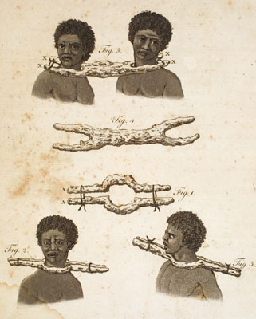
Goree, or Slave-Stick
A French naval officer, in the Angola region in the late eighteenth century, describes how slave traders used "a forked branch which opens exactly to the size of a neck so the head can't pass through it. The forked branch is pierced with two holes so that an iron pin comes across the neck of the slave . . ., so that the smallest movement is sufficient to stop him and even to strangle him”

Slide 28
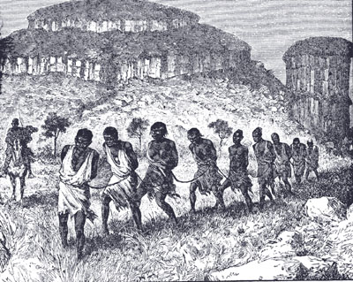
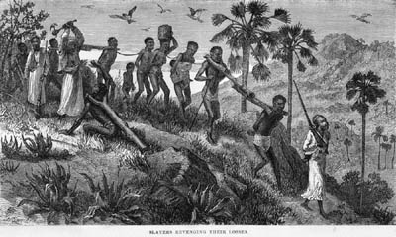

Slide 29
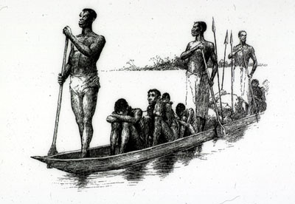
Forced Participation
African Chiefs did resist in the beginning; however, they needed weapons for defence.
The Europeans were too powerful; therefore, any effort to resistance was unsuccessful
If chiefs did supply slaves, they were threatened to be taken as slaves.

Slide 30
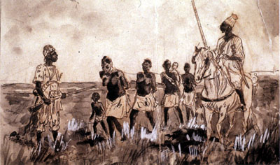
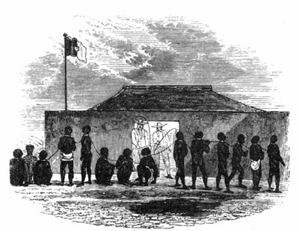
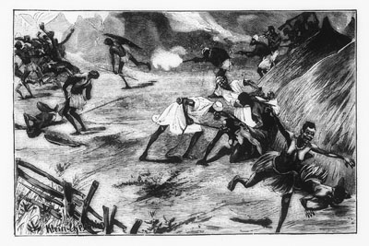
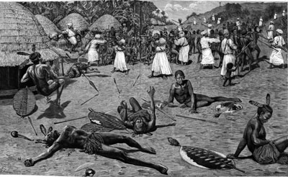

Slide 31
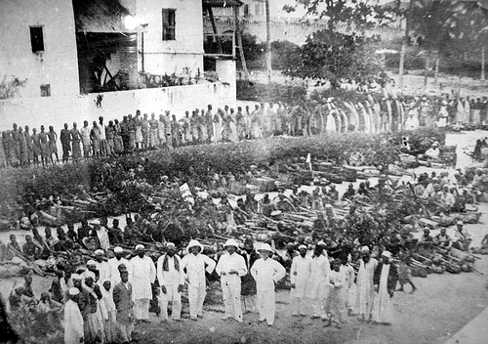
Slaves were held in prisons along the west coast of Africa.
They were waiting to put on slaves ships.
Those that journeyed from the interior and were not fit for the ship were left on the shores to die

Slide 32
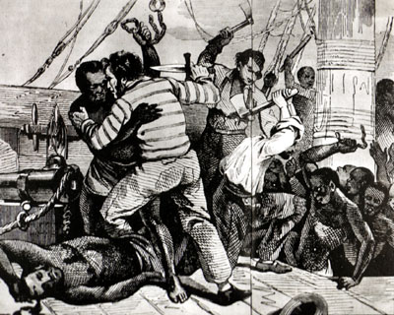
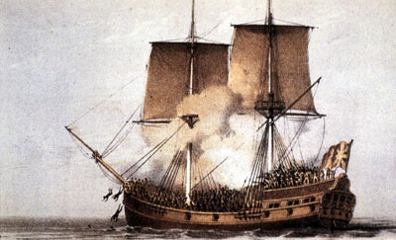
Stage Two: The Middle Passage
Ships sailed across the Atlantic Ocean to the Americas
The journey took 8-10 weeks
Some Africans tried to jump ship, refused to eat and rebelled.
Loss of a slave’s life was a loss of $ for the sailors.

Slide 33
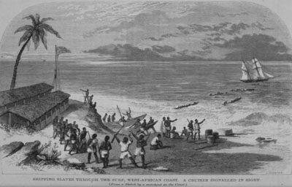
Stage Two
“Loose packing” meant that the captains would take on board fewer slaves in hope to reduce sickness and death.

Slide 34
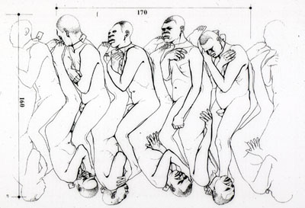
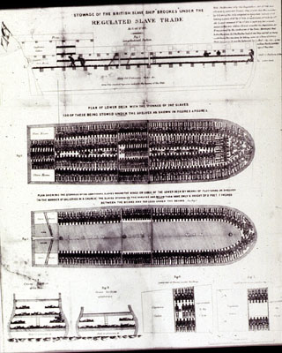
Stage Two
“Tight packing” meant that the captains would carry as many slaves as their ship could hold, as they believed that many blacks would die on the voyage anyway

Slide 35
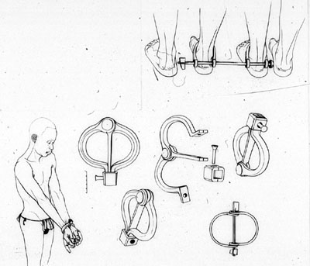
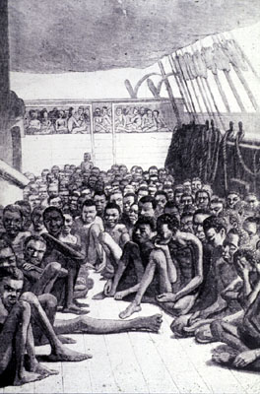
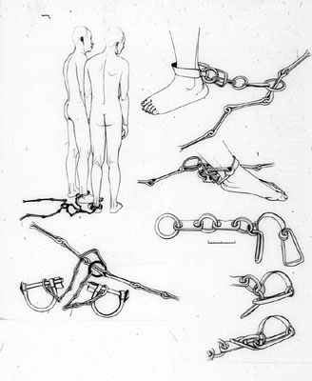
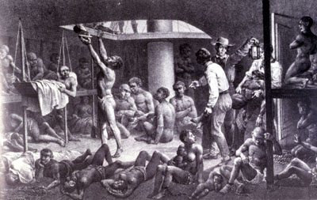

Slide 36
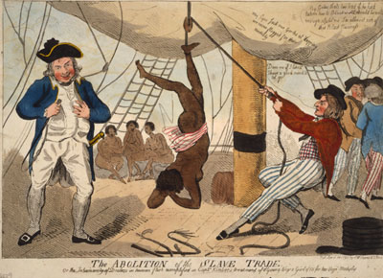
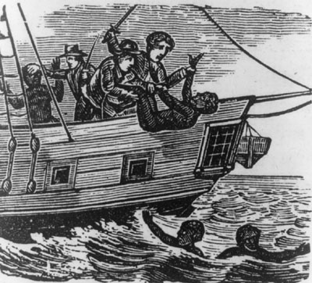
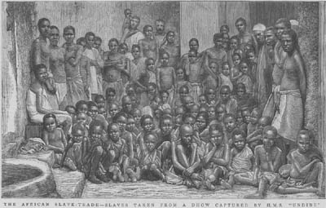

Slide 37
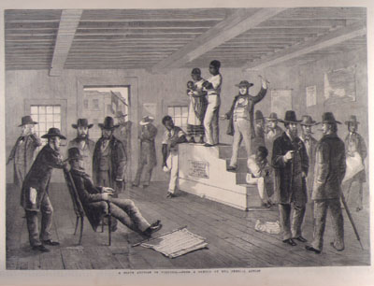
Stage Three
Africans would be sold at auctions in the Americas

Slide 38
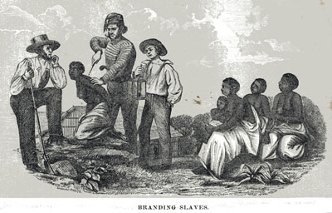
Stage Three
The ships’ captains would use the $ from their sale to buy a 3rd cargo of raw materials: sugar, spices or tobacco.

Slide 39
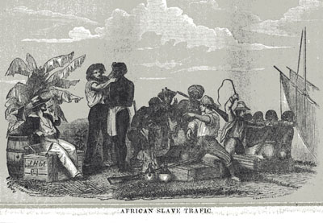
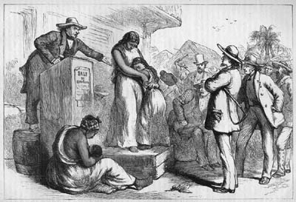
Stage Three
They sold this for a further large profit in Europe.
In Europe, they would convert the raw materials into finished product.

Slide 40
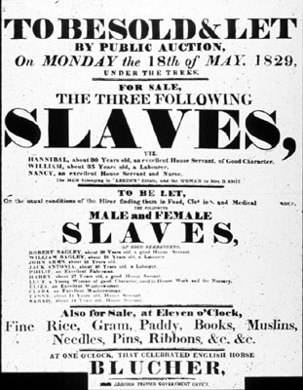
Auctions
There were 3 ways slaves were auctioned off:
Public Auction
Private Auction
A Scramble

Slide 41
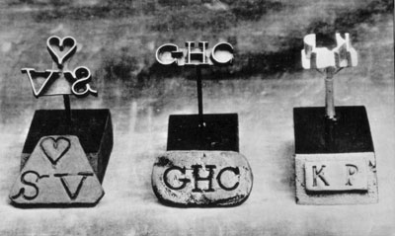
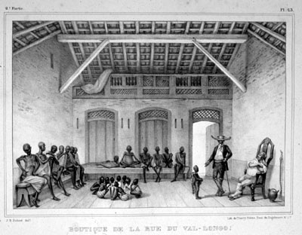
Public Auctions
- They put tar on the slaves to hide any sores and cuts
- Slaves were inspected
- An auction to took place and the higher bidder would get to purchase the slave.
- Bids were taken as long as an inch of a candle burned.
- Slaves were branded
- Families were separated
- They were given a European name.

Slide 42
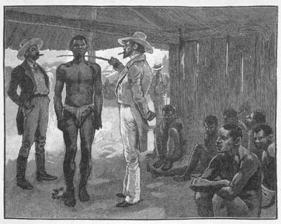
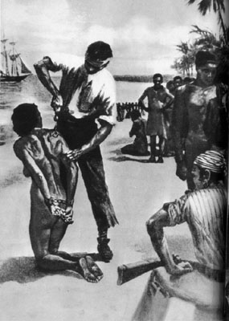
Private Auctions
Similar to public auctions
They were indoors and red markers would be placed on the door to indicate an auction.

Slide 43
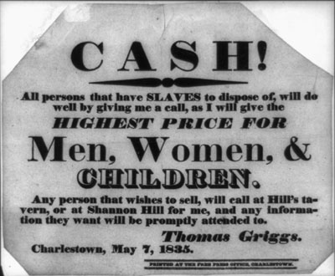
Auctions (A Scramble)
They would take place on the docks or on the deck of the ship
There would be a fixed price per head
Slave owners would go in and grab who they wanted to purchase.

Slide 44
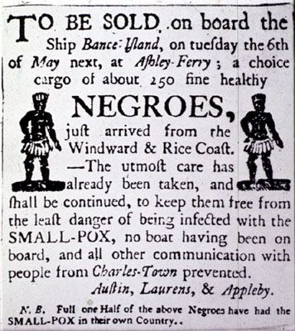
Auctions
American born slaves who had skills were the most expensive
African born slaves were less $, as they had to be “broken in”
Age, sex and skills determined the cost
Slaves with a lot of scars were considered too rebellious

Slide 45
Slavery Abolished in the Britain Empire
1807 = The slave trade was abolished in the British Empire, which meant that no slaves would be carried from Africa in British ships.
1834 = Emancipation Act stated that slaves under 6 years old were freed; field hands over 6 had to work for their owners for 6 more years; house slaves had to work for 10 more years.
Britain gave 20 million pounds in compensation to former slave owners and slaves received nothing.
1838 all slaves were given complete freedom
Slavery in the USA was not abolished until 1865

