Slide 1
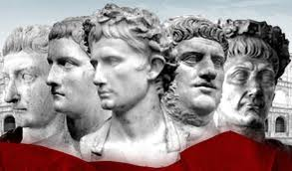
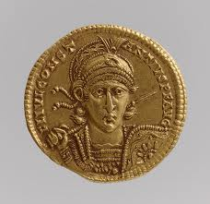
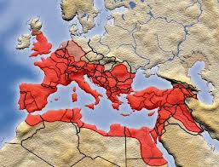
The Roman Empire
OPHS World History

Slide 2
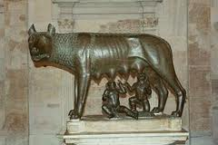
Romulus and Remus
Rome was founded in 753 B.C by twin son’s Romulus and Remus as legend goes and was near the Tiber River (in Italy)

Slide 3
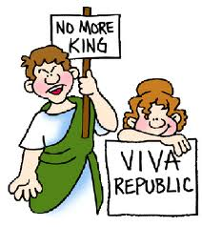
The Creation of a Republic
After Rome last king (Tarquin the Proud) a harsh leader they vowed never again to be ruled and created a Republic. Allowing citizens rights and freeborn males the right to vote.

Slide 4
Early Republic Power Struggles
In early republic days two groups struggled for power:
The Patricians (wealthy landowners who held most of the power)
The Plebeians (farmers/merchants) who had the majority of the population.

Slide 5
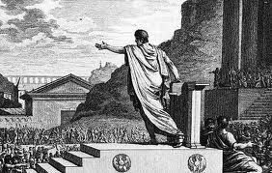
Plebeians were allowed to form their own assembly called the Tribunes; they protected their rights from unfair treatment.

Slide 6
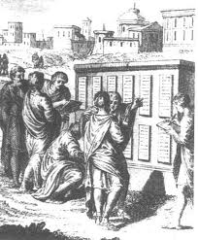
A victory for the Plebeians was a set of written laws the twelve tables; giving them protection from the law.

Slide 7
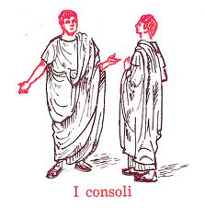
Roman Government
In their government they had a consuls, like a king that controlled the army and government but limited terms, a senate with 300 members creating policy/laws and it times of crisis they could appoint a dictator with absolute power only lasting 6 months.

Slide 8
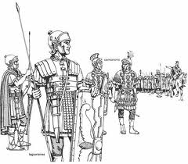
Greatness of Rome
Great value was placed on their military; land ownership was required to serve; organized into legions; key factor to their rise to greatness!

Slide 9
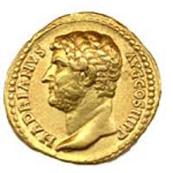
WEALTH
The Roman Empire grew to increase their wealth! There location in the Italian peninsular helped them develop; because of its location it helped the Roman’s control the Mediterranean region $$$
Mmmm….gold coins….

Slide 10
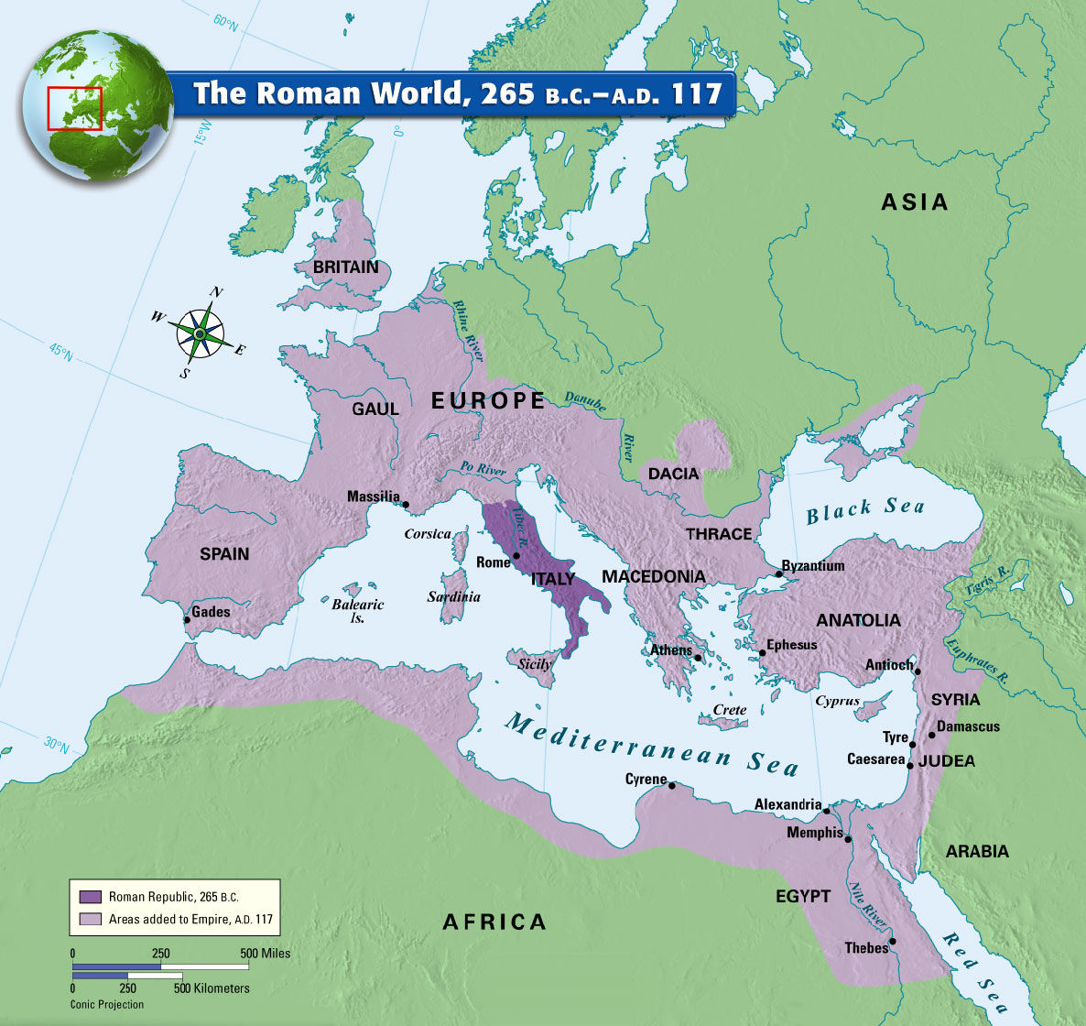
Rome Expands
Rome
sought to
expand and
by 265 B.C
they had
nearly all of
Italy.

Slide 11
Rome Expands
With the conquered land the conquered received full citizenship, some got all but the vote and the new allies needed to supply troops and be loyal to Rome for Rome to leave them alone.
This is the policy that created their successful empire.

Slide 12
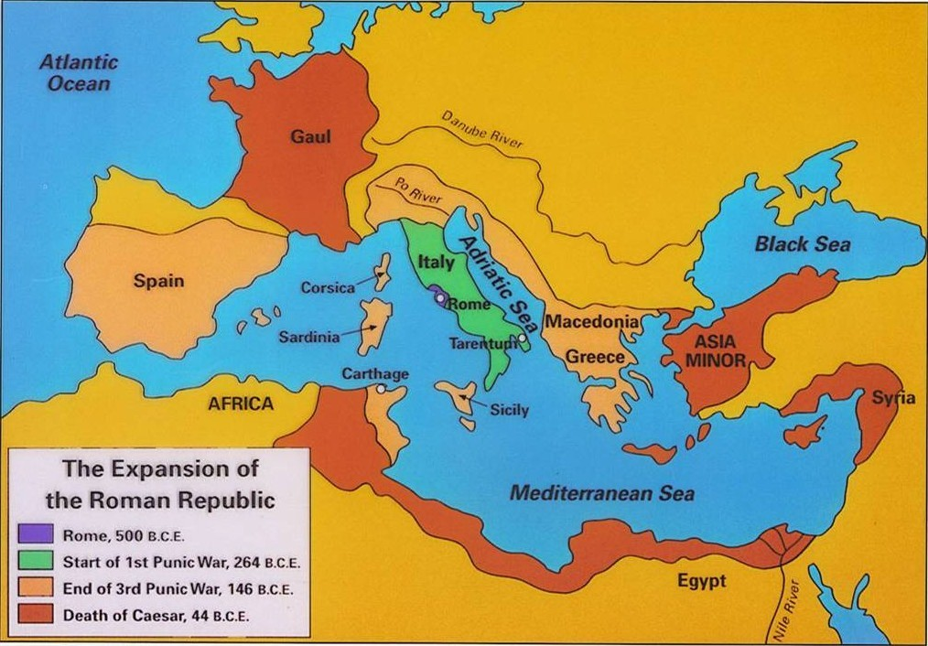
Rome Expands

Slide 13
Punic Wars
Since The Romans were located by the Mediterranean Sea this helped trade but brought them into direct conflict with the city of Carthage. In 264 B.C the Punic Wars started ending in 146 BC Finally a new general was able to defeat Hannibal’s (Carthage brilliant leader) After Rome set Carthage afire and sold the people into slaves; their territory became a Roman providence.

Slide 14
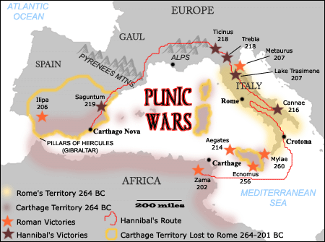
Punic Wars

Slide 15
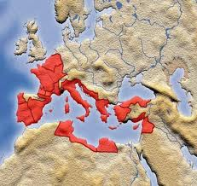
Roman Empire 70 BC
By 70 B.C. with the addition of Spain the Roman Empire was huge.

Slide 16
Roman Problems
AS Rome grew the gap between rich and poor grew wider; two tribunes tried to aid the poor but were killed. Military started to weaken by picking up paid soldiers only loyal to their commander.

Slide 17
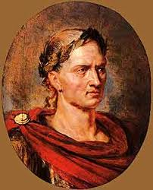
Julius Caesar
60 B.C. Julius Caesar joined forces with Crauss and Pompey and for the next ten years they ruled Rome as a triumvirates (group of 3 rulers). He then after a year appointed himself Governor of Gaul and after a gruesome campaign conquered all and earned his men’s loyalty by fighting besides them.

Slide 18
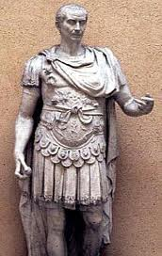
Julius Caesar
After Pompey ordered Caesar to return home (fearing his power) Caesar disobeyed him and drove him out of Roman and became dictator for life in 46 B.C.

Slide 19
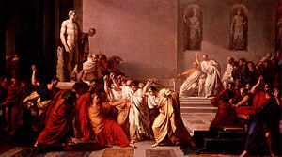
Julius Caesar
Caesar was an absolute ruler BUT he:
granted citizenship, expanded the senate, helped poor (jobs), and paid soldiers more. Fearing his power and popularity, 2 senators stabbed him to death. = Civil War.

Slide 20
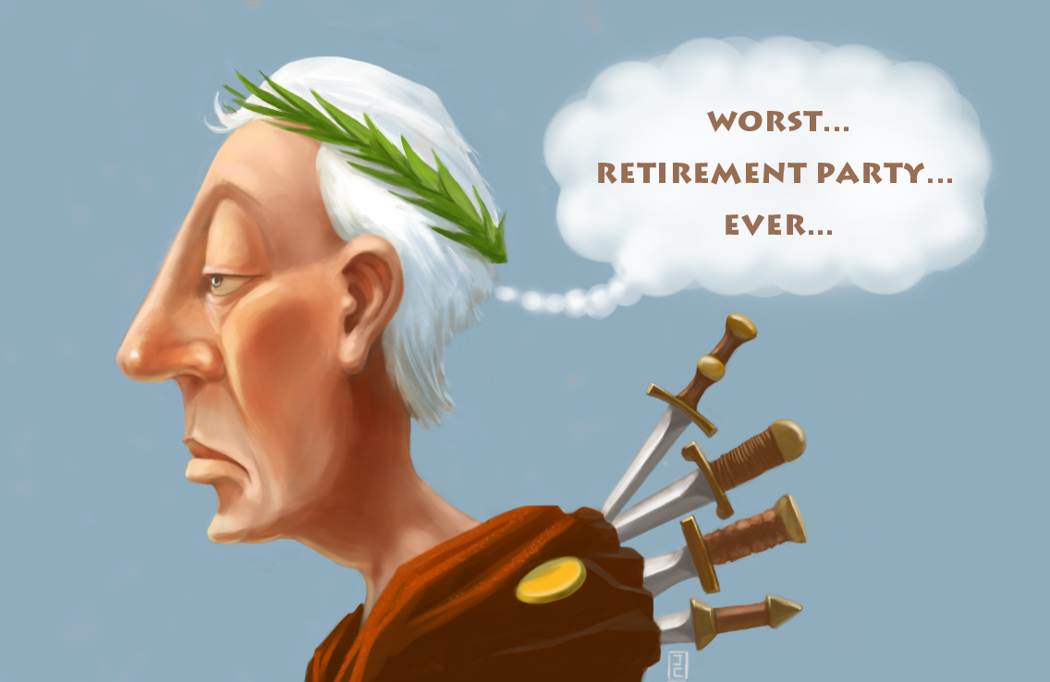

Slide 21
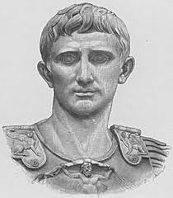
After the death of Caesar
Three of Caesars supporters took control of Rome = 2nd triumvirate. Although there alliance quickly turned to war with Octavian (Caesar’s adopted son) winning and being renamed AUGUSTUS (derived from emperor)

Slide 22
Rome was at the peak of their power during 27 BC –180 AD which is known as Pax Romana: 60-80 million people living in peace! This was due to Augustus stabilizing the government and creating civil service jobs.

Slide 23
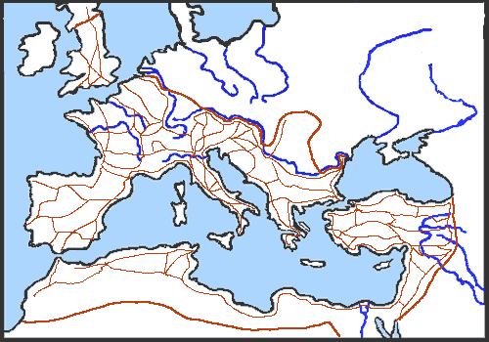
All Roads Lead to…ROME!
90% of Romans engaged in agriculture and trade was huge in Roman thanks to the roads the military built.

Slide 24
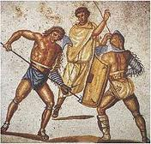
Roman Life
They valued discipline, strength and loyalty. (Very practical people)
Slaves were a big part of the culture possibly 1/3 of their population
Gladiators!

Slide 25
God and Goddess were worshipped and so was worshipping the emperor (official religion)

Slide 26
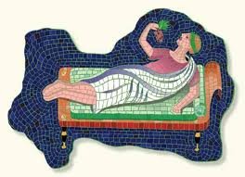
Distribution of Wealth
The rich lived extravagantly, however most barely had enough to survive.

Slide 27
Christianity and Rome
Christianity rose through the Roman Empire; Jewish people who believed Jesus was the Messiah. Pontius Pilate the Roman governor accused him of defying Rome’s authority = crucified.

Slide 28
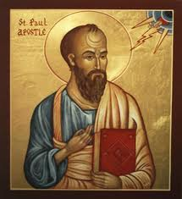
Christianity and Rome
The religion Christianity was created and spread thanks to Paul (apostle), common language (Latin and Greek), and easier travel. Twice the Jews rebelled and died in fighting. Christians were also killed for going against Rome and persecuted (killed/exiled)

Slide 29
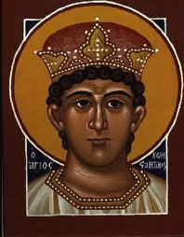
Constantine
In 313 a Roman emperor Constantine ended the conflict when after praying saying he says an image of a cross and therefore now approved of the religion and by 380 A.D it was the official religion of the Roman Empire.

Slide 30
The Decline of Rome
After Pax Romana Rome begin to decline:
Economy weakened because hostile tribes, limited expansion, no new resources, raised taxes, created inflation by making coins with less silver and farms hurt (soil and destroyed during war)
Military/political turmoil: soldiers not as loyal and citizens not as loyal. (Pg. 174 chart)

Slide 31
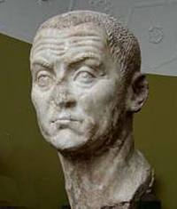
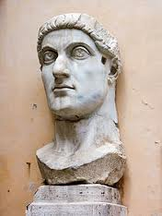
Rome Holds On
Although Rome still lasted for another 200 years due to reform minded emperors like Diocletian and Constantine.

Slide 32
Diocletian
Diocletian: ruled with an iron fist but double the army, set prices which fixed inflation, claim his ancestors were Gods, divided the empire into east and west. Sadly after he retired civil war broke out.

Slide 33
Constantine
Constantine was able to regain control over west and then east restoring order to Rome: he moved the capital to Byzantine which was in the middle of east and west and later rename Constantinople. After his death the empire would be divided again with the west crumbling

Slide 34
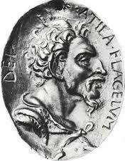
Fall of Rome
Why did the Western Empire crumble?
German invading; due to the Huns (Mongols)
Attila the Hun became a direct threat waging war but never able to take Constantinople 3) No emperor to rule. Pg. 177

Slide 35
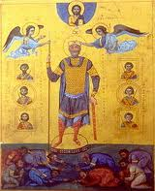
Fall of Rome
The East on the other hand became known as the Byzantine and did great until 1453 when they fell to the Ottoman Empire Turks, Arabs, and European Crusades.

Slide 36
What Rome Left Us…
Roman’s last impact on the world: Art, mosaics, paintings, aqueducts (brought water into towns) literature, philosophy, government (509 B.C influenced us in 1776) Latin language, Christianity, Architectural structures and bridges, (Coliseum) system of laws (equality, need to be proved guilty etc)

Slide 37
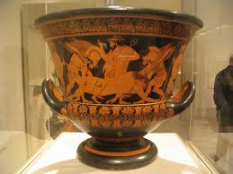
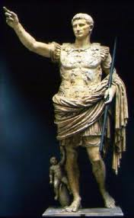
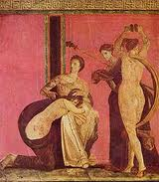
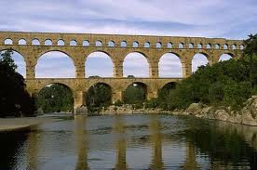
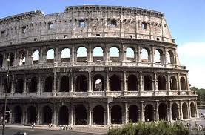
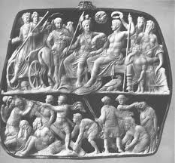
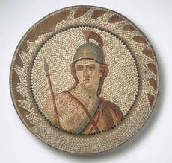
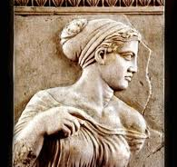

Slide 38
