Slide 1
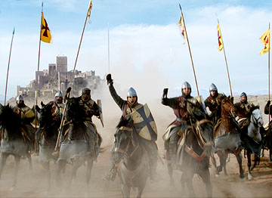
The Crusades!
Christian Holy War
Copyright © Clara Kim 2007. All rights reserved.

Slide 2
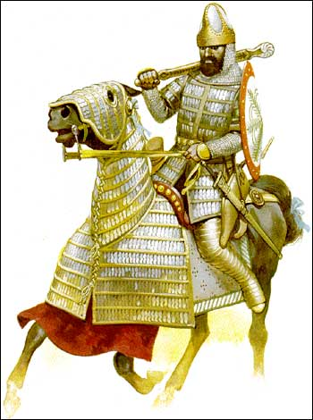
The Invaders
In 1093, Byzantine Emperor named Alexius Comnenus ask for help against invaders
THE INVADERS: The Muslim Turks aka Ottoman Turks
The Muslim Turks were trying to take over the Byzantine capital of CONSTANTINOPLE

Slide 3
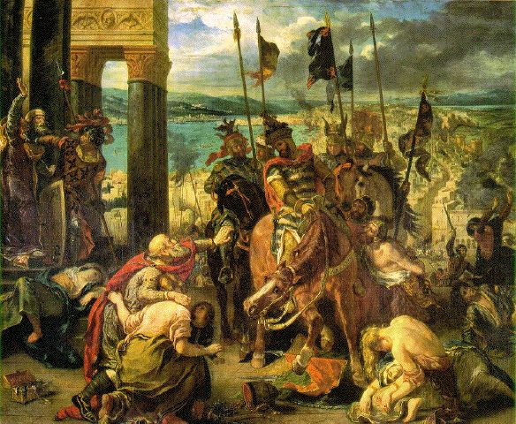
The Invaders

Slide 4
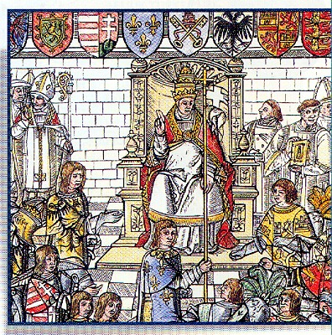
Pope Urban II
Pope Urban II read the letter asking for help and called for a “holy war” or CRUSADE
He said those who fought and died in the Crusades would be promised a spot in Heaven with all sins forgiven
Remember the head of the Church is the Pope ☺

Slide 5
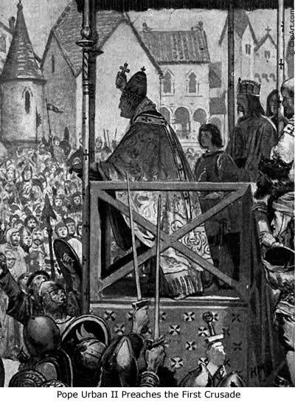
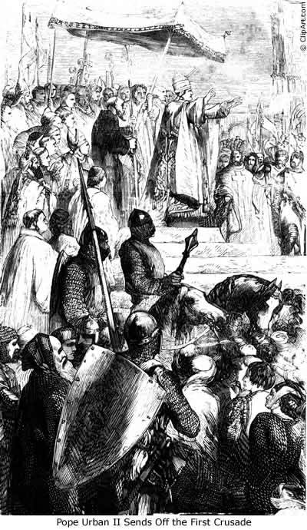

Slide 6
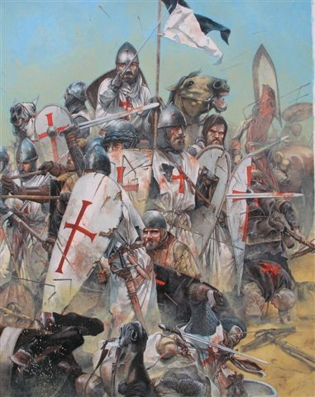
THE GOAL
The goal of these Christian soldiers were to recover
1. Jerusalem and
2. Holy Land
They wanted it back from the Muslim Turks

Slide 7
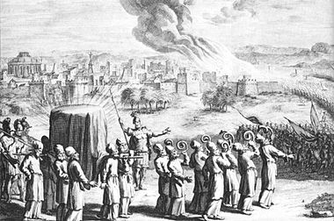
Why was Jerusalem so important?
Jews:
Their religion built a temple which housed the “Ark of the Covenant”. After two temple destructions (war) the western facing wall is all that’s left. It is their most holy site.

Slide 8
Why was Jerusalem so important?
It was where Muhammad is said to have ascended to heaven to speak directly with God.
Muslims wanted to keep Christians out of their empire.
Muslim religious officials felt that Christ was a false prophet

Slide 9
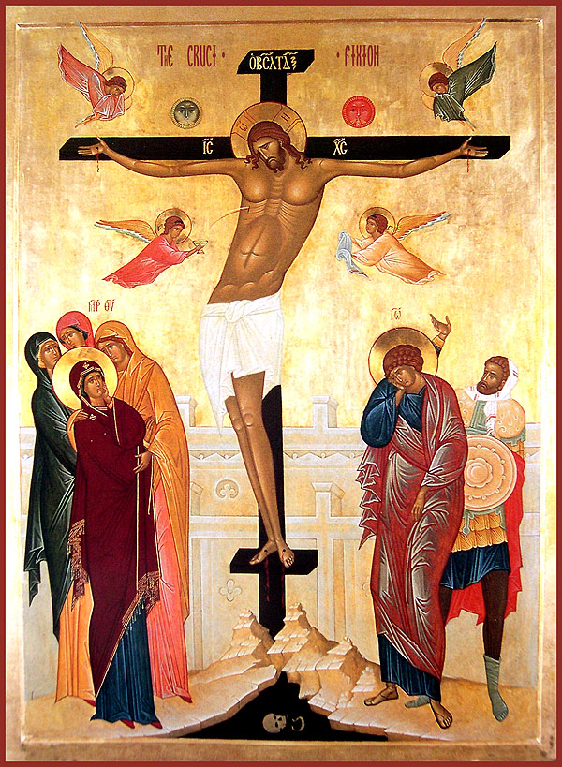
Why was Jerusalem so important?
Christians:
They recognized that it is where Christ was born, preached, and was crucified.

Slide 10
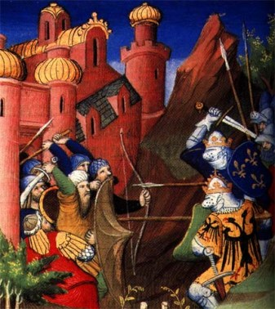
Crusader Spirit
There were economic and religious motives for the Crusades
Kings and the Church: A way to get rid of knights who always fought each other and threatened the peace of the kingdom
Younger Sons: A way to gain land and position in society since the oldest son gets everything
Knights and Commoners: fired by religious zeal (passion)

Slide 11
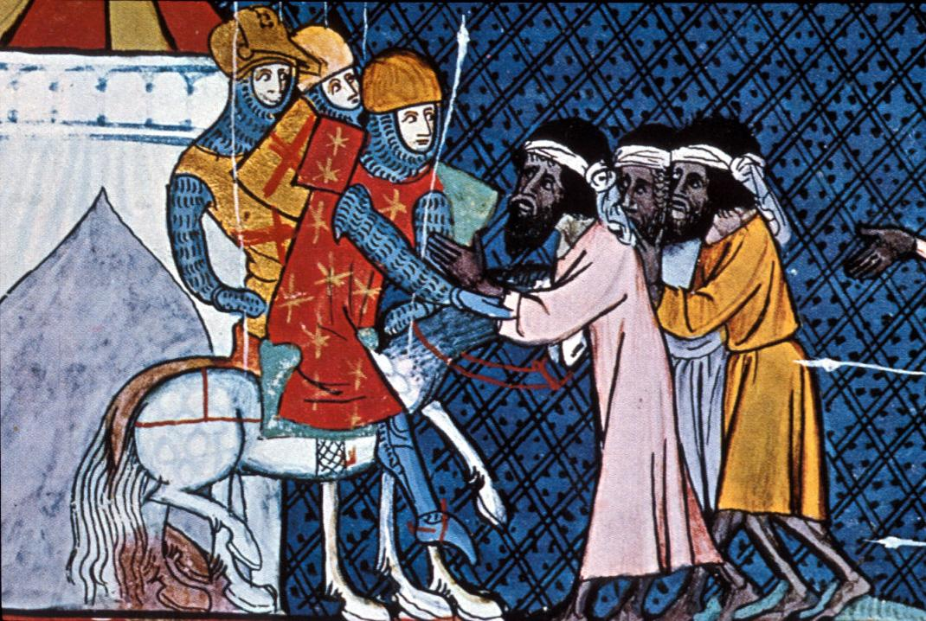

Slide 12
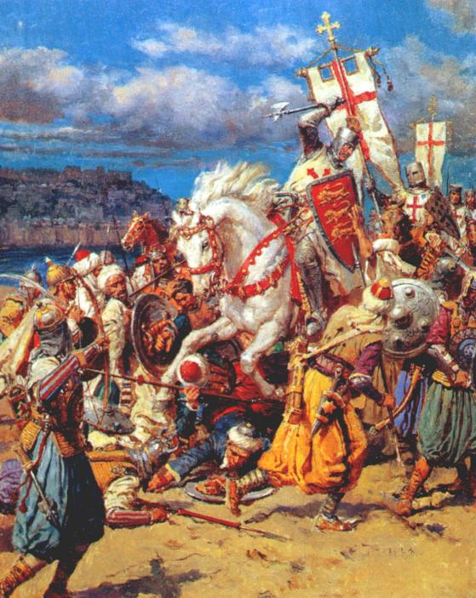
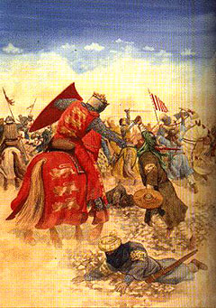
First Crusade
CALL BY CHARLAMENGE
Unprepared troops
No strategy
Captured Jerusalem
Carved in up into 4 Crusader states

Slide 13
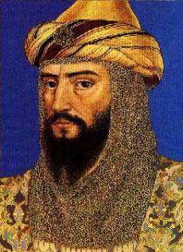
Second Crusade
Muslim leader Saladin takes control of Jerusalem
Muslim Turks re-conquer the city
Saladin is described to be honest and brave

Slide 14
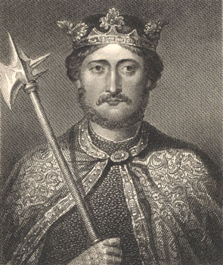
Third Crusade
Richard the Lion Hearted = English King and two other leaders recapture Jerusalem
He and Saladin respected each other

Slide 15
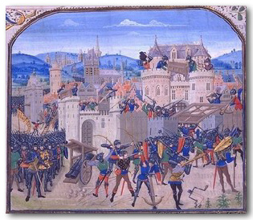
In the End
The Christians are finally pushed out of Jerusalem
Muslim Turks are the victors and take over the Byzantine in 1453

Slide 16
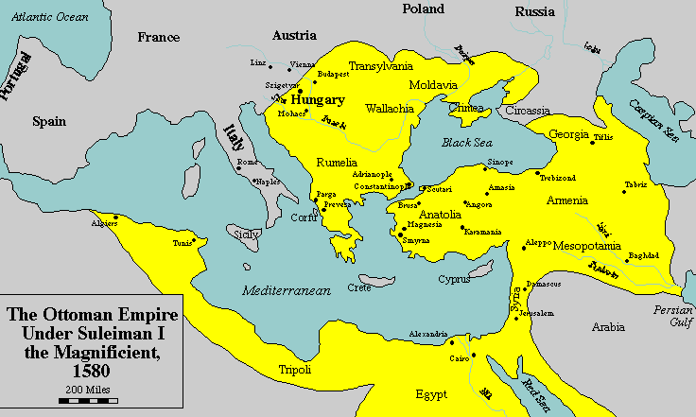
Effects of the Crusades
This means that Europe now has control over JERSALEM!
HUGE

Slide 18
Effects of the Crusades
Negatives:
Weakened the Byzantine Empire, the Pope and nobles
Kings become stronger
Leaves a legacy of bitterness between the Christians, Jews and the Muslims
Positives:
Stimulated trade throughout the Mediterranean and Middle East by cloth and spices brought back = TRADE INCREASED!!
Europe learns much from the Muslims and this increased their education and thoughts

