Slide 1
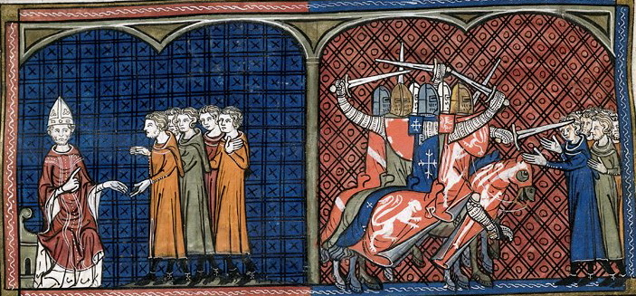
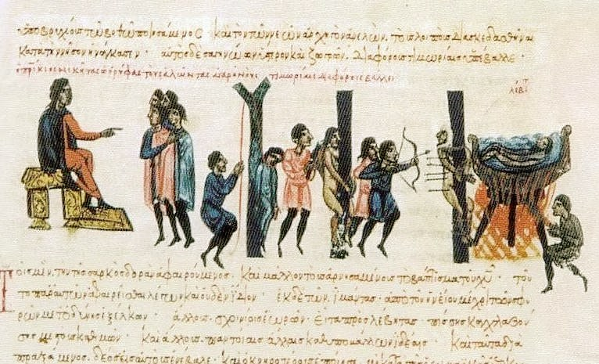
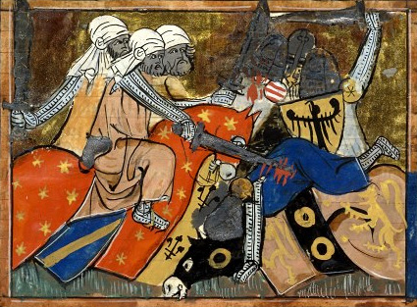
The Crusades
Holy Wars

Slide 2
The Crusades
Series of military campaigns sanctioned by the Roman Catholic Church during the Middle Ages
Intended to stop Muslim expansion in the 10th century
Muslim Turks attacked Constantinople, capital of the Byzantine Empire, in 1093
Muslims also controlled the Holy Lands in Palestine

Slide 3
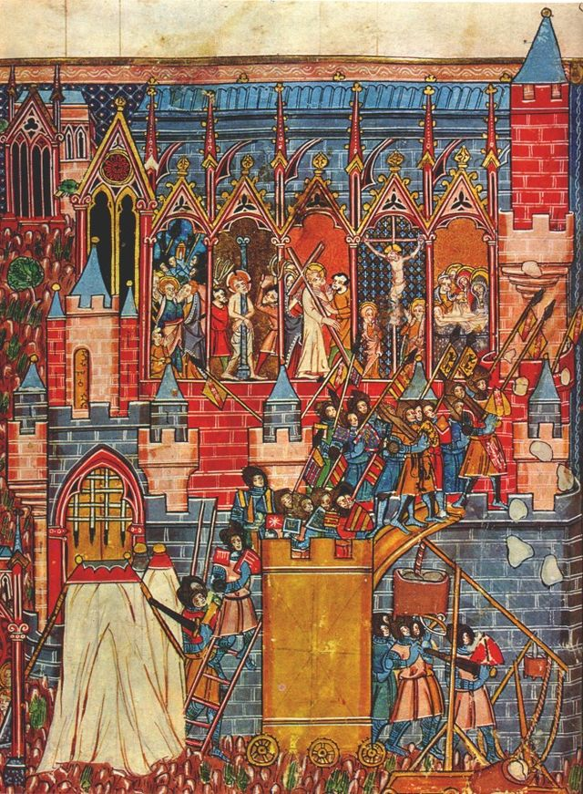
The First Crusade (1096-1099)
Started by Pope Urban II in 1096
Main goals
Repel Muslim attacks in Constantinople
Reclaim the Holy Lands for Christians
Started as a mass pilgrimage from France and Germany
Crusaders sought land, fortune, and adventure
Merchants wished to reclaim key trade routes controlled by Muslims
In 1099, Christians succeeded in reclaiming Jerusalem
Approximately 12,000 Crusaders fought in the siege
Christians now controlled land from Edessa in the North to Jerusalem in the South

Slide 4
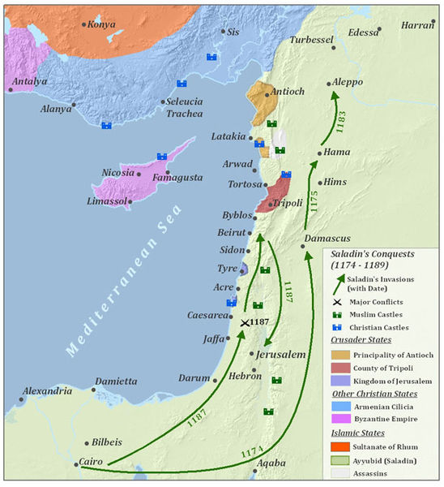
Later Crusades
Second Crusade (1145-1149)
Campaign to recapture Edessa, which fell to the Turks in 1144
Considered a failure
Leads to Muslims recapturing Jerusalem in 1187 under Saladin
Third Crusade (1189-1192)
Campaign to recapture Jerusalem from Saladin, founder of the Ayyubid dynasty (Kurdish Muslims)
Agreement: Jerusalem remained under Muslim control, but unarmed Christians were free to visit the city’s holy places

Slide 5
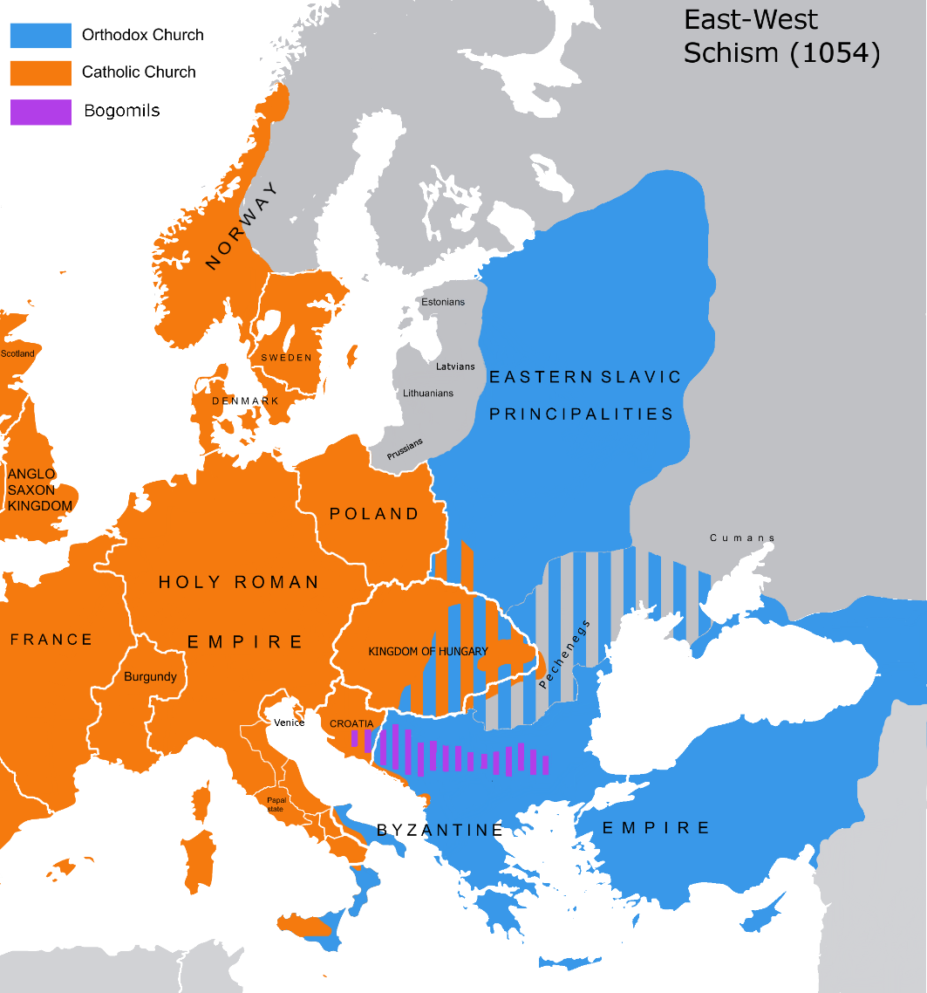
Fourth Crusade (1202-1204)
Another failed attempt to recapture Jerusalem in 1204
Crusaders ended up sacking Constantinople instead, increasing tensions between the Roman Catholic Church and the Eastern Orthodox Church
This split is known as The Great Schism
Last of the major Crusades

Slide 6
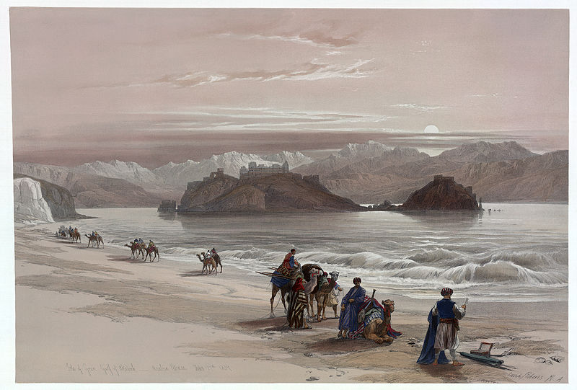
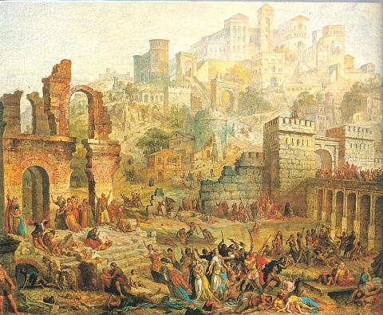
Lasting Effects of the Crusades
Expanded trade between Europe and Southwest Asia
Spices, fruits, and fabrics from Asia
Weakened the power of feudal lords and increased the power of kings
Failure of the later Crusades weakened the power of the Pope
At least one million deaths
Rhineland Massacres: the slaughter of at least 2,000 Jews by Christians in France and Germany during the First Crusades

Slide 7
Islamic Golden Age (800-1100)
Period of political unity and cultural achievement
Math and science
Al-jabr – algebra
Astronomy
House of Wisdom
Library, academy, and translation center
Opened by Caliph Al-Ma’mun in the early 800s
Scholars of different cultures and beliefs translated texts into Arabic
Texts from Greece, India, Persia, and elsewhere
Preserved knowledge from the Roman Empire
Suffered under the chaos and violence of the Crusades

Slide 8
