Slide 1
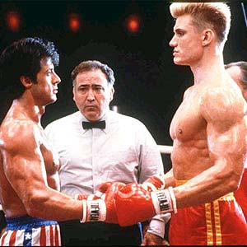
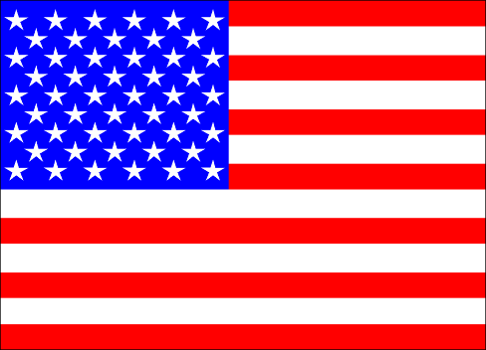
The Cold War 1945-1990 US vs. Union of Soviet Socialist Republics Democracy vs. Communism Capitalism vs. Socialism

Slide 2
So what exactly is a cold war?
Brainstorm?
What just ended? How did it end? Who was left standing with a government? Power?
What would lead those two countries into a different style of war?

Slide 3
The Cold War
A cold war is a struggle over political differences carried on by means short of military or war! (so basically no fighting)
The two “superpowers” U.S. and Soviet Union (S.U.) left standing fought in the cold war from 1949-1991
The U.S experienced the largest rapid growth whereas most countries like Great Britain were no longer powerful because they were trying to rebuild their war-torn nation.

Slide 4
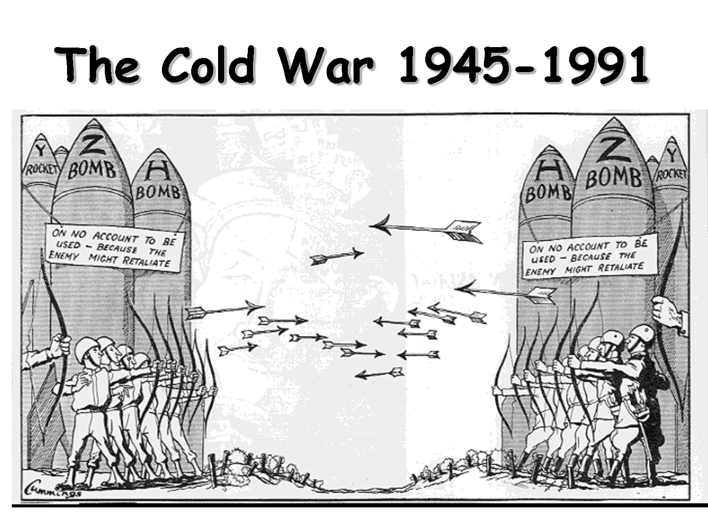

Slide 5
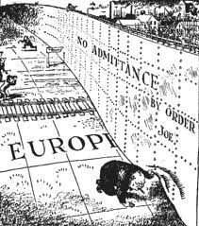
The Iron Curtain Picture
Splitting the world into two groups democracy v. communism aka the iron curtain
The iron curtain refers to the division between communist and democratic states

Slide 6
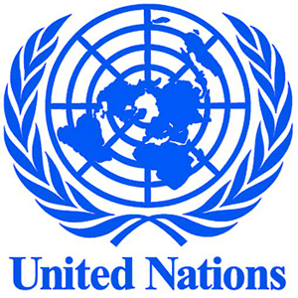
Post WWII
At the Yalta conference the Big 3 (U.S., U.S.S.R. and G.B) divide Germany up into zones
The United Nations was created to ensure world peace and the stop of WWIII by 50 nations joining together

Slide 7
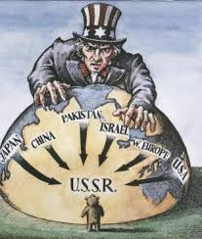
However...
With two different views on how to lead a country things start to heat up between the two super powers.
The U.S. has a policy called “containment” were we trying to stop (contain) the spread of communism which aiding countries to support their country to become democratic

Slide 8
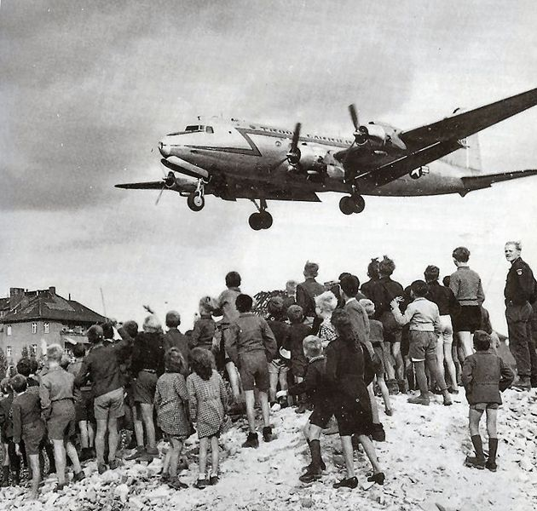
Berlin Airlift
With Germany divided into 4 zones, cold war heats up because the allies join their 3 sides together. Soviet Union responds by cutting off their chunk of Berlin (leaving the citizens without food and supplies) the U.S. responds by airlift supplies to the people.
All of this is an attempt to grab power and a chance to change Germany’s government

Slide 9
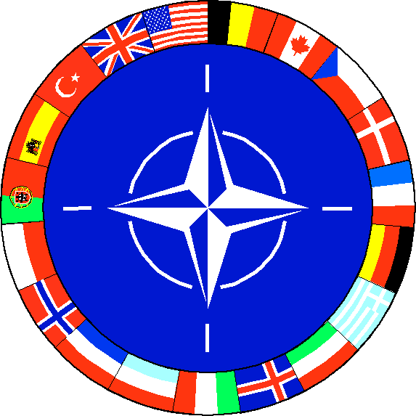
Enter NATO
Creation of NATO (North Atlantic Treaty Organization) and the Warsaw Pact. The U.S. creates NATO alliance so in return the S.U. creates Warsaw. Basically both state an alliance so if one side is attacked the other will join.

Slide 10
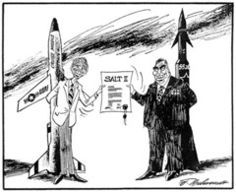
The threat of nuclear war
A huge chunk of the cold war is both sides building up their nuclear warfare just in case of war. The creation of the H- bomb (hydrogen) happened which both sides and that was 1,000x more power than the atomic bomb

Slide 11
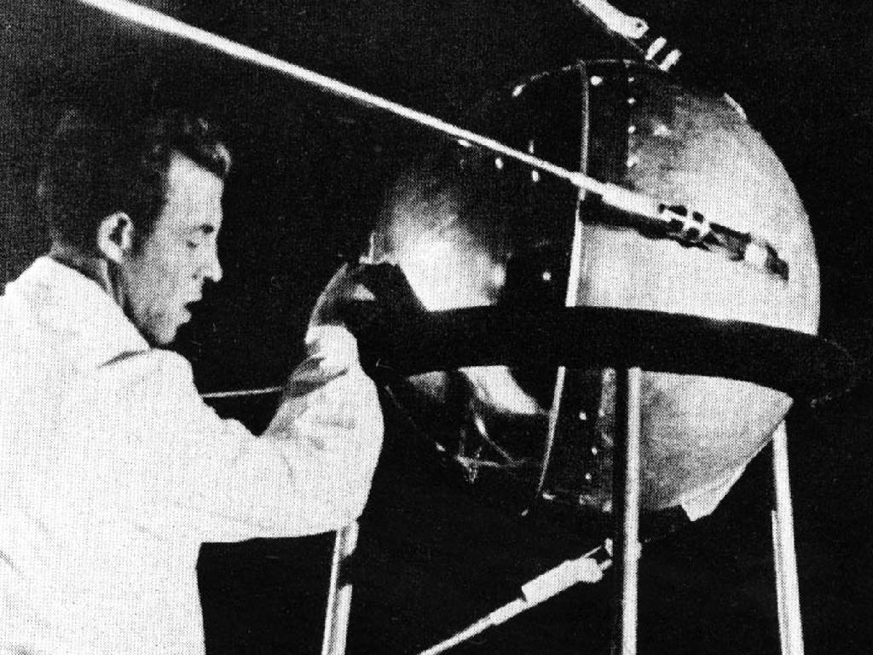
Race to the Moon
There was also a technology race to “prove” who was smarter. When the S.U. launched a satellite called “Sputnik” into the air, the U.S. had to follow suit accelerated their space program.

Slide 12
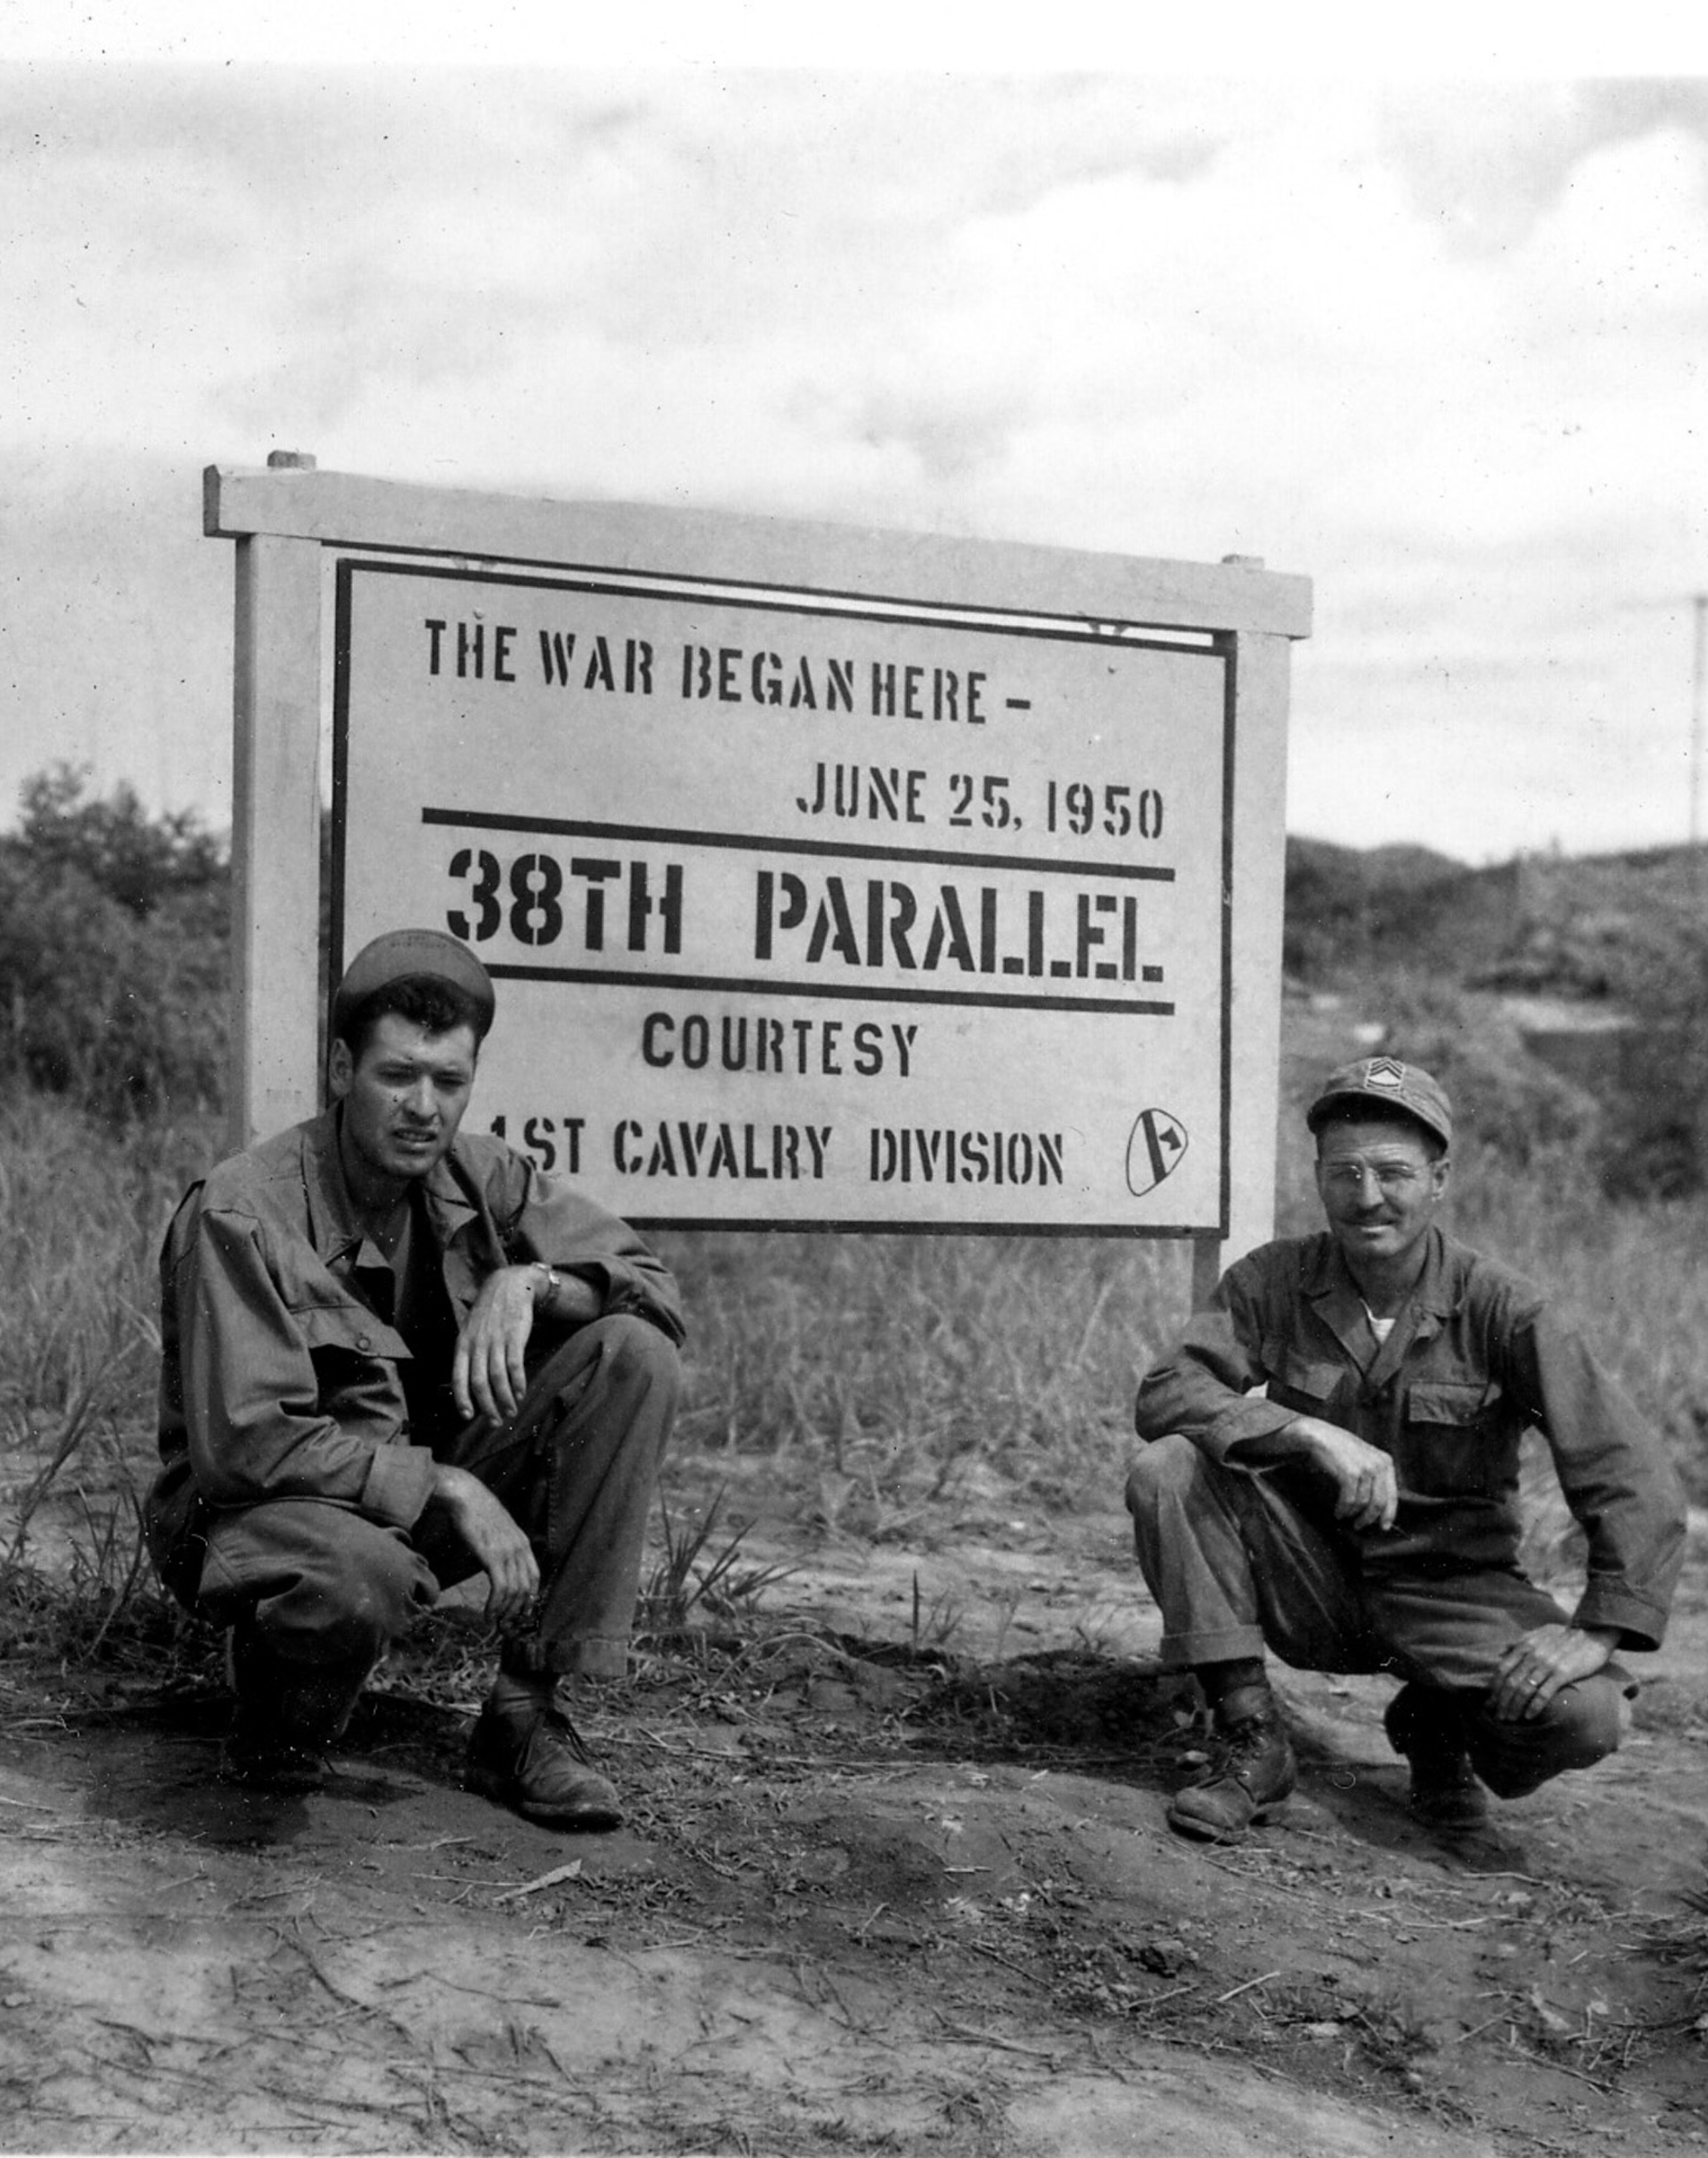
Korean War
South Korea underwent a civil war with North Korea after WWII supported by the S.U. and south by U.S.
North Korea is about to successful unite Korea when the U.N. (basically the U.S.) steps in and then very quickly the south is about to win.
However China who is now communist under Mao Zedong join in on the fight and push the fighting back to the middle (38th parallel) which is where it is still divided today!

Slide 13
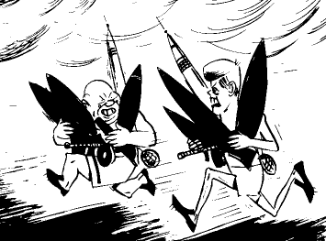
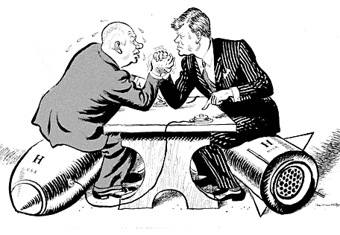
Cuba
Fidel Castro was able to unite the peasant farmers and their country became communist! Oh No! So the U.S. tries to have him killed (Bay of Pigs) and then Fidel with help from the S.U. have nuclear missile pointing at us! Thank goodness the Cuban Missile Crisis was successful and the two countries were able to talk things out (U.S. and S.U.)
1.

Slide 14
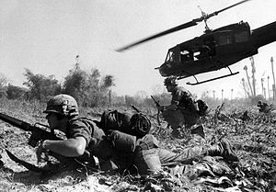
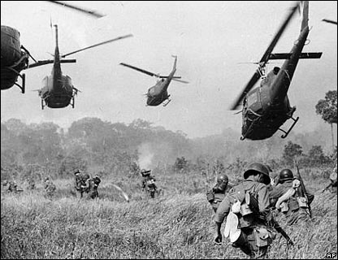
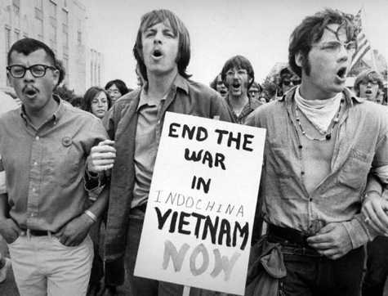
Vietnam War
Ho Chi Minh wants to bring communism to Vietnam (and the French out)
The U.S. believes in the domino theory (which is if one nation falls to communist they all will)
So we join France in fighting Vietnam which turns into our longest and bloodiest fight, with us pulling out and both Vietnam and Cambodia are communist today! We are not ☺

Slide 15
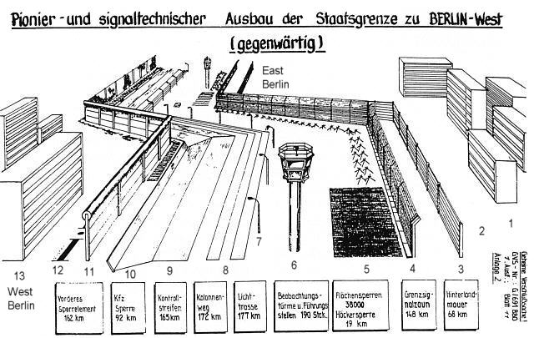
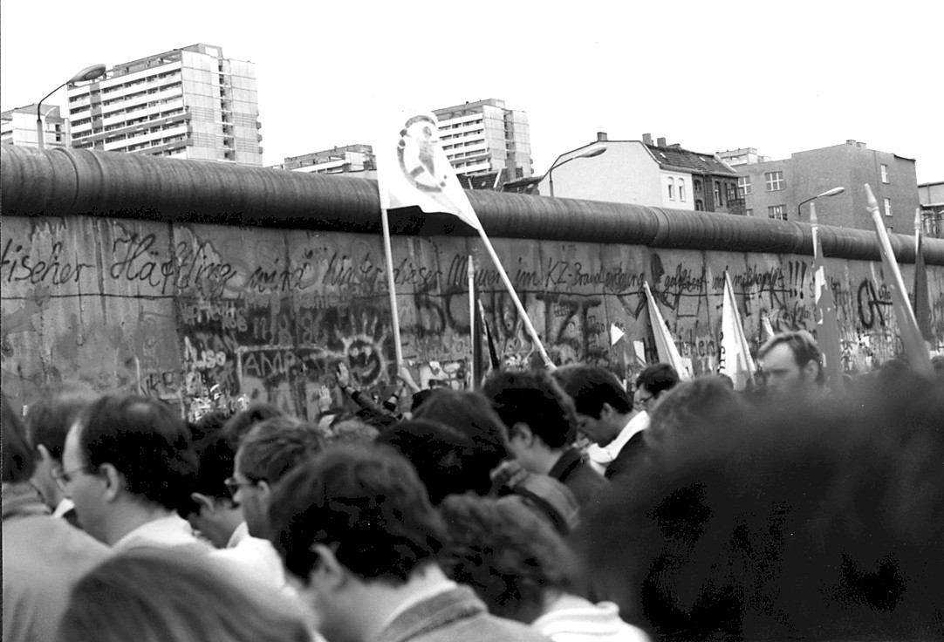
Berlin Wall Falls!
The Berlin Wall surrounded communist West Berlin (controlled by the U.S.S.R.) “protecting” it from the democracy of the rest of the world…but in reality it kept the residents from defecting to East Berlin…and the rest of Germany.
During the Cold War the event that occurred last was the fall of the Berlin wall.

Slide 16
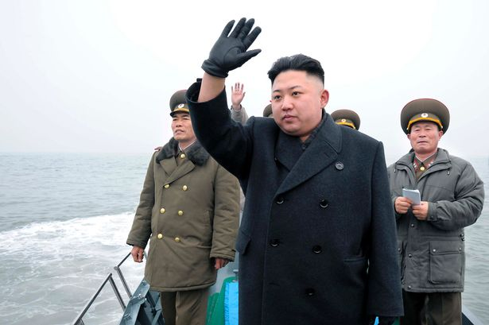
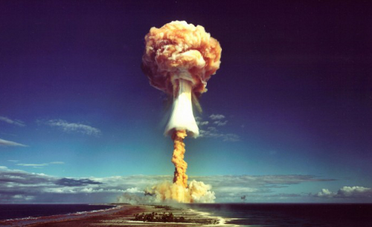
Nuclear Weapons Today
Afghanistan, North Korea and Iran all have nuclear weapons today…why is this scary?

Slide 17
Video
http://www.history.com/topics/cold-war/videos#cold-war
Lots of mini videos on cold war topics

