Slide 1
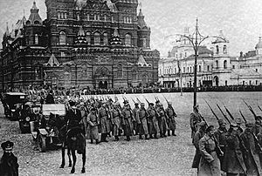
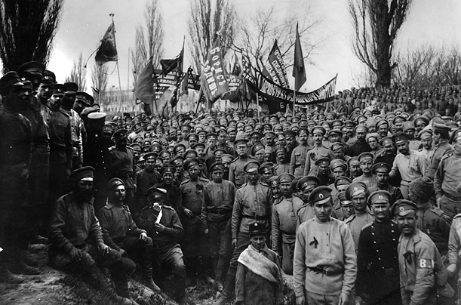
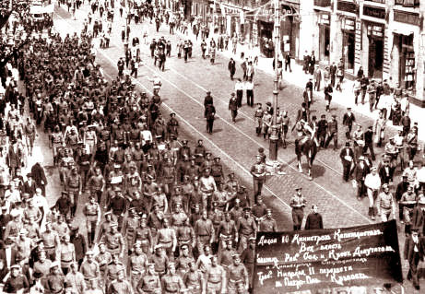
Russian Revolution

Slide 3
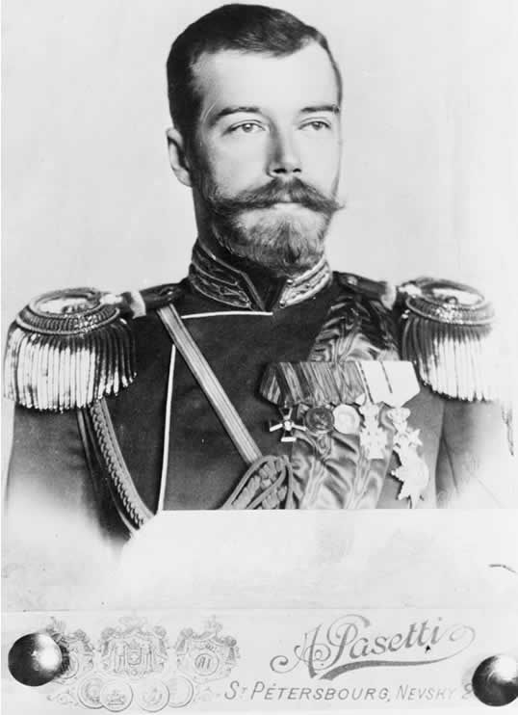
How did it start?
Although started in 1917 due to the hatred of the Czars in Russia and their autocracy (government = total power) citizens had been planning a revolution for a long time.

Slide 4
Why did it happen?
To end revolutions the new czar (Russian leader) Alexander III used censorship, spying, jail, nationalism. When Nicholas II came to power he tried to do the same.
As Russia increased their industries (steel) this brought about more disconnect with citizens (working conditions in factory life)

Slide 5
Lenin organizing the workers
“A lie told often enough becomes the truth.”

Slide 6
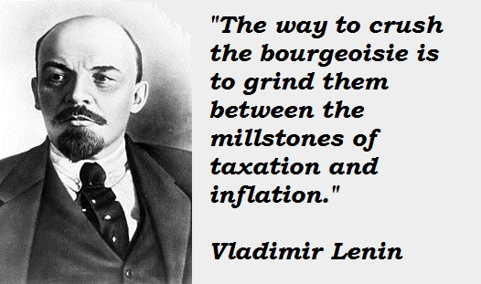
Marxism
Marxist (Karl Marx) Communism: believed workers should overthrow the government and run it = proletariat. This group split into 2 the Bolsheviks (radical) led by Vladimir Lenin!

Slide 7
The Red Army fighting

Slide 8
Things that weakened the Czars control
1) Russo-Japan War (over control of Korea)
2) Bloody Sunday Revolt: worker who wanted better working conditions were ordered by Nicholas II to be fired on
3) WW1: unprepared to fight = 4 million deaths = wild inflation
4) Nicholas left his wife in charge and she allowed Rasputin (ras;PYOO;tihn) a self describe holy man run the control =corruption = murdered

Slide 9
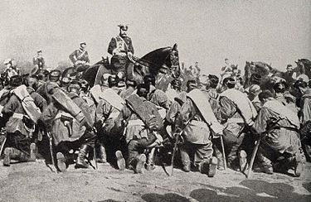
March Revolution
March Revolution 1917 led to Nicholas II leaving the throne and being executed along with his family a year later. They set up a provisional government which didn’t help the working conditions and Lenin returned to Russia after being in hiding!
Pg 870 Map! “Peace land and bread”

Slide 10
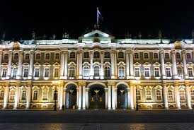
Storming of the Winter Palace
November 1917 without warning armed factory workers stormed the winter palace (Bolvseki Red Guards) and took over the government. Within days land was given to the peasants, gain workers control of the factories and created peace with Germany by serenading a large piece of their land.

Slide 11
October Revolution

Slide 12
WAR!
This lead to enemies from within (The white army) which led to a civil war, leading to a 3 year struggle with many deaths and the red army winning.
War and revolution destroyed Russia’s economy which led to Lenin to out state controlled economy on hold for a capitalist New Economic Plan (NEP) allowing peasants to sell their surplus of crops and encouraged foreign investments. Government did run big industries. Regain by 1928!

Slide 13
THE USSR
1922 Lenin reorganized Russia into small republic renaming the control Union of Soviet Socialist Republic (USSR) renaming their government communist (a classless society) although really a dictatorship not a true Marxist idea.
After Lenin passed away a man named Joseph Stalin (changed his last name to mean man of steel) took over and had absolute power, something Lenin feared on his death bed. Leon Trotsky was his biggest threat of leading Russia, so he was exiled in 1929.

Slide 14
Key Players

Slide 15
Joseph Stalin
Stalin changed the USSR into a totalarian state by using police terror, indoctrination (controlling education) propaganda and censorship and religious and ethnic persecution.
Police Terror=Great Purge in 1934= 8-13 million people killed and sent to labor camps for being so-called traitors
Propaganda/Censorship: controlled newspaper, radio etc no creativity,

Slide 16
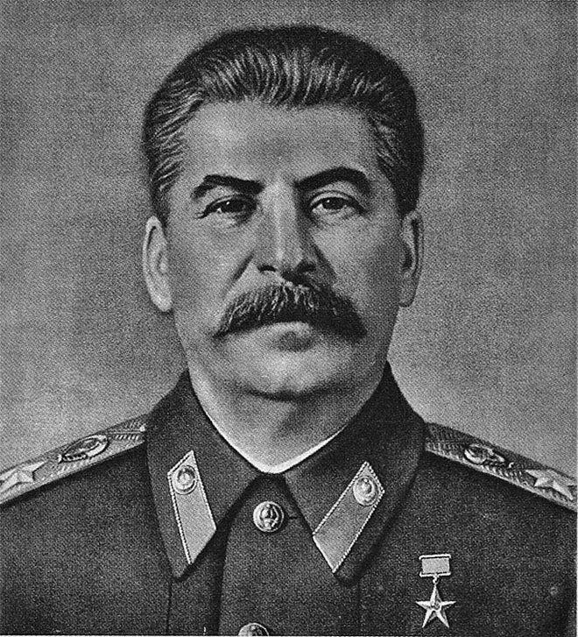
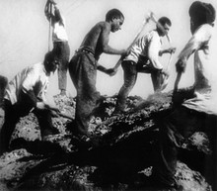
The Great Purge

Slide 17
Joseph Stalin
Education/ indoctrination: learned about how great communism is
Religious Persecution: attacked any religion especially Russian Orthodox Church
Goal to eliminate personal rights and freedoms in favor of power of the state.

Slide 18
Joseph Stalin
Stalin switch to a command economy (government controls every aspect of business) and outlines his 5-year plan which have high quotas, + output of steel, coal and limits production of consumer goods = shortage! Overall plan a success!
Government seizes farm land to create a government own farm= collective farming. Although peasants protested and destroyed form goods and lands = 5-10 million killed; Stalin collective farms were highly successful.

Slide 19
Not so good things about the USSR
Although women had greater roles, education expanded; soviets had to give up personal freedoms, limited goods and couldn’t even complain/question it!

