Slide 1
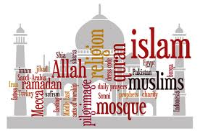
Rise and expansion of Islam
Take notes on a separate piece of paper, paying close attention to Titles and words in BOLD
Chapter 10

Slide 2
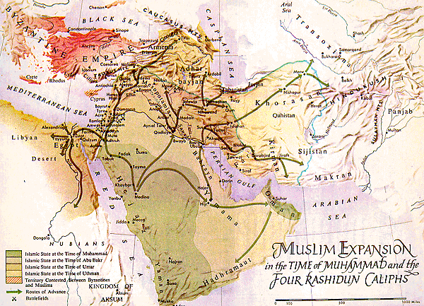
Muslim Expansion

Slide 3
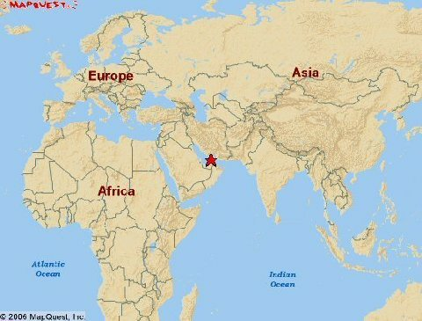
Where?
Arabs settled in 600 AD in a desert on the Arabian Peninsula.
Arabia

Slide 4
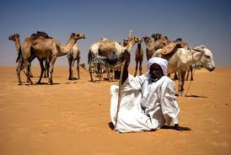
Trade
Bedouins (Bee’oo’ihnz)and were organized in clans. They sent up trade routes carrying goods and ideas from the world outside of Arabia…they believed in loyalty to family and courage and valued warrior skills…this became part of the Islamic way of life.

Slide 5
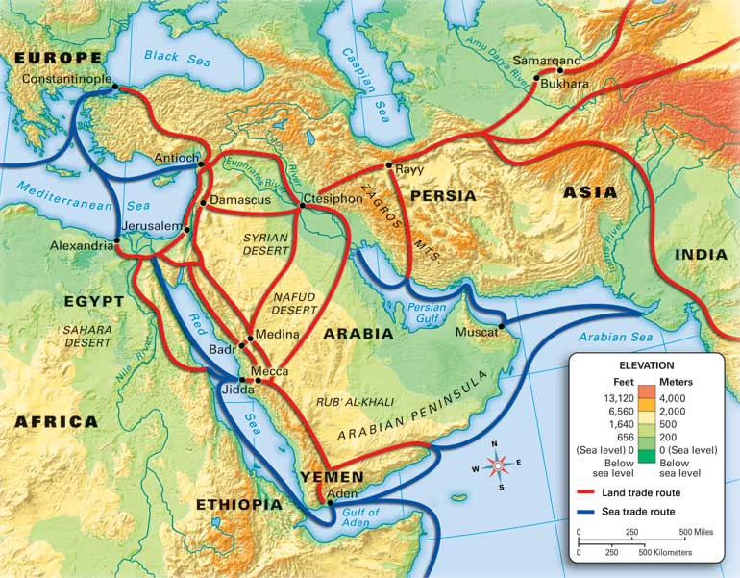
Trade
Mecca was a trade stop: spreading….Religions

Slide 6
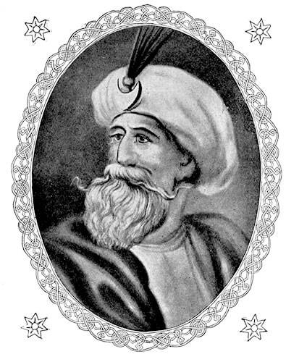
Religion: Muhammad
Revelation by a man, born in Mecca, named Muhammad stated the angel Gabriel told him about Allah.
Islam: Submission to the will of Allah.

Slide 7
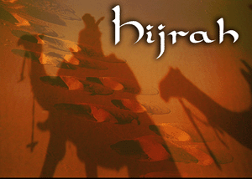
Religion: Muhammad
He began to spread the message yet was forced to leave Mecca in 622 with his followers; migration known as HIJRAH!
In 630 they return with 10,000 followers and the leaders surrender …many Meccans converted to Islam.

Slide 8
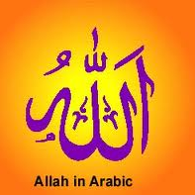
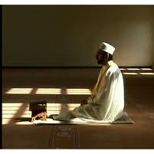
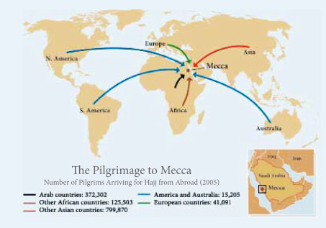
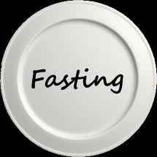
Belief and Practice of Islam: The Five Pillars
Faith: 1 God
Prayer
Alms
(Charity)
Pilgrimage to Mecca: Hajj
Fasting

Slide 9
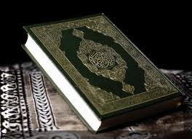
Belief and Practice of Islam
Believe in one authority (Allah) and study the Qur’an (Koran)
Believe the Sunna (SOON uh) Muhammad example is the best model for life
Assembled laws based on Qur’an and Sunna called SHARI’A

Slide 10
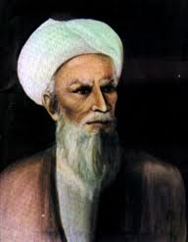
Spreading...
Abu-Bakr became the 1st CALIPH a titling meaning successor (of Muhammad)

Slide 11
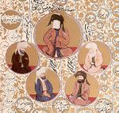
Spreading...
The “Rightly Guided Caliphs” knew Muhammad personally.
After Muhammad death some abandoned the faith and Abu-Bakr invoked Jihad (means striving; inner struggle against evil…or nonbelievers)
The next three Caliph expanded area thus expanding their religion. People saw this as a sign from Allah…they were known as the “rightly guided caliphs”

Slide 12
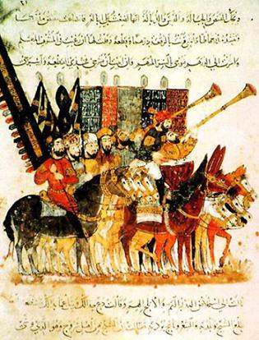
Spreading…
Although the Islamic army was also disciplined and the two empires they attacked were weakened prior (Byzantine and Sassanid)…which contributed to their success.

Slide 13
Spreading…
Also the people of their country didn’t support their previous religion and liked the idea of equality and Christians and Jews had to pay a poll tax each year to be exempt from military service.
Conquered people could worship what they wanted however rights were limited and they were not allowed to spread their religion. They could be officials, scholars and bureaucrats.

Slide 14
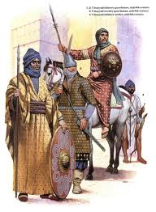
Internal Conflicts
Leader killed (Uthman) which led to a civil war…there was no more electing caliphs.
A family known UMAYYADS came to power; moved away from Mecca to be closer to newly conquered land…they also valued wealth and ceremony…

Slide 15
The Split
This split the Muslim’s into 3 groups:
Sunni: Followers of Muhammad’s example (did not resist the Umayyads rule) (83% of the population)
Shi’a: “Party” of Ali (believe that Ali should have been the prophet, doesn’t recognize authority of Sunni) (16% of the population)
Sufi: Rejected the luxurious life, and pursued a life of poverty and devotion to a spiritual path.
Both Sunni and Shi’a claim each other distort the Qur’an

Slide 16
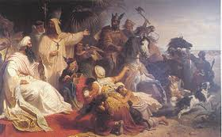
Fall of the Umayyads
The Umayyads were overthrown in 750 and taken over by Abbasids.

Slide 17
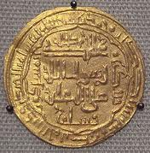
Control extended by Abbasids
Expanded territory after killing off rest of Umayyad family, set up trade routes (2 seaports, single Lang and currency), strong government, and army
However difficult to control large piece of land and small groups sprung up

Slide 18
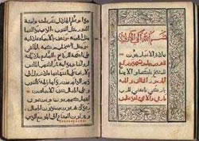
Muslim culture
HUGE population!
Gifted in math, astronomy(PRAYER),created the House of Wisdom (library/school), literature, art, medical advancements, and philosophy
Calligraphy: art of beautiful handwriting

