Slide 1
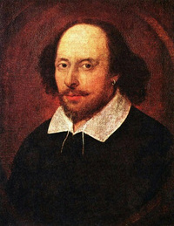
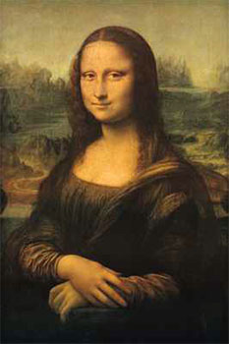
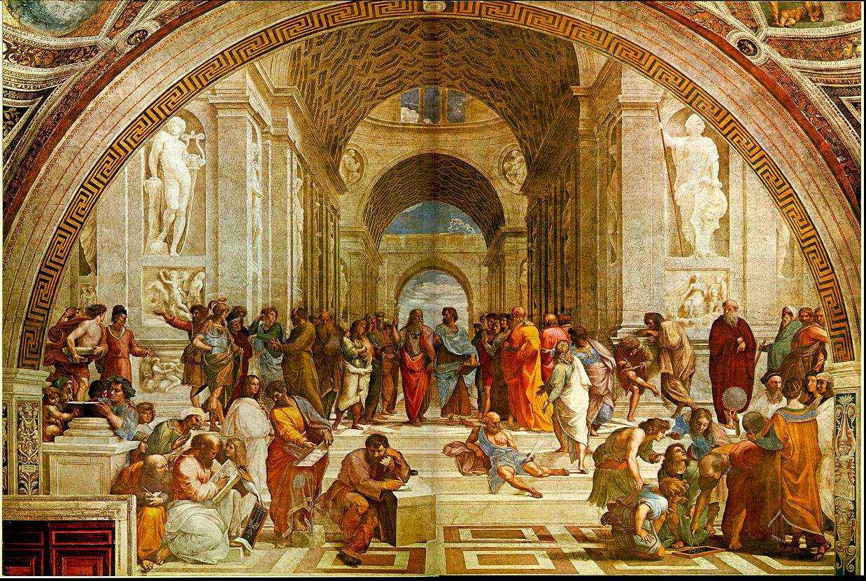
Renaissance Art and Learning
Today we will look at pictures and readings to determine the elements of renaissance art and literature ☺
Shakespeare
Mona Lisa
School of Athens

Slide 2
Renaissance Art and Learning
The Renaissance in western Europe is best described as a period marked by Great Intellectual and artistic creativity. During the renaissance, the arts flourished across Europe.
Take Notes!

Slide 3
Renaissance Art and Learning
The Renaissance is referred to as a “rebirth of art” because the world had not seen such a large mass of art creation since Greek and Roman times.
Take Notes!

Slide 4
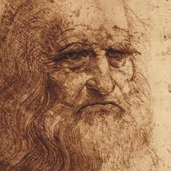
Humanism Approach
Self Expression: Value placed on the individual and worldly matters (problems)
Some element of Religion (Christianity)
Leonardo da Vinci’s self portrait.
Take Notes!

Slide 5
Paintings might have…
Subject relates to classical culture (ancient Greece or Rome)
Biblical/Religious theme is expressed in realistic Renaissance-era setting or classic Greek-Roman setting
Reflects patronage of a wealthy merchant
Depicts a realistic landscape
Portrait reveals individual personality or individual achievement
Depicts peasant life, life of everyday people
Includes exceptionally realistic details
Shows a balanced use of space
Includes rich colors, vivid details
Glorifies the human body
Shows person(s) with natural posture and natural expression
Uses perspective and shading

Slide 6
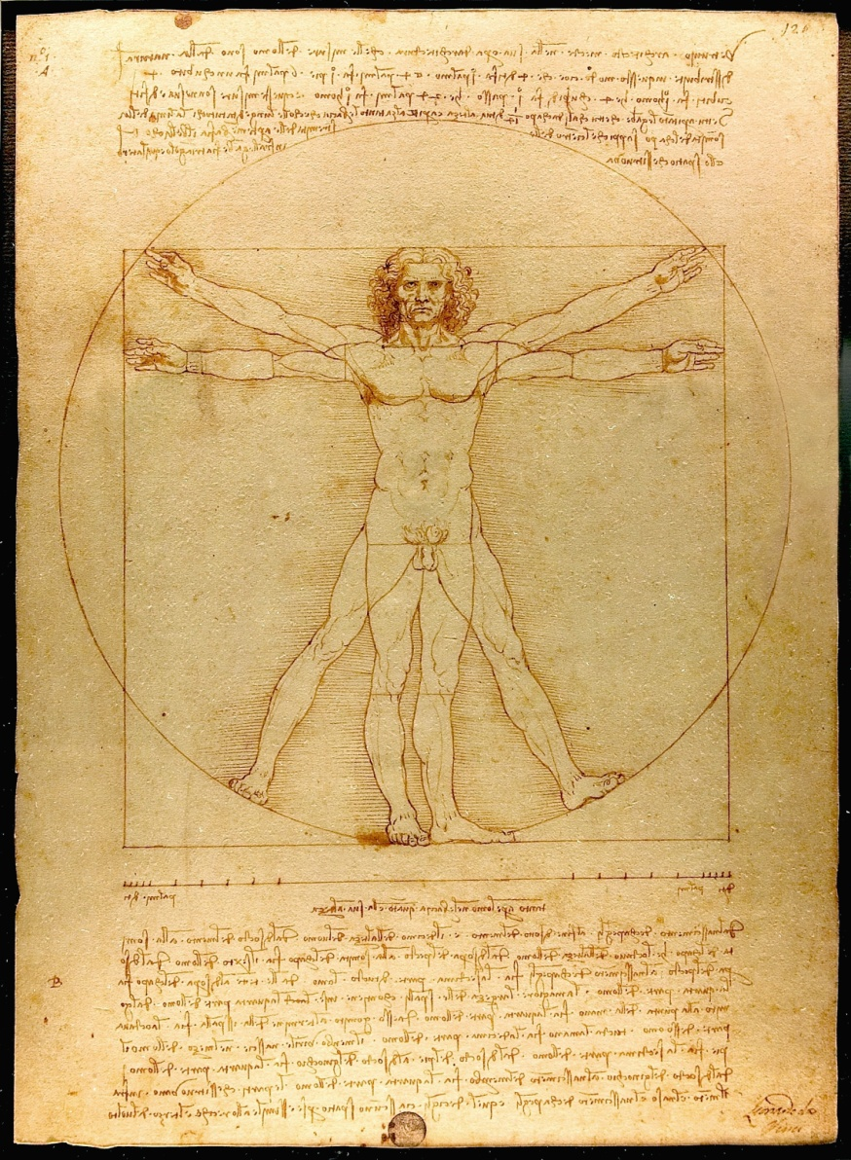
Leonardo da Vinci
Leonardo da Vinci's Vitruvian Man
shows clearly the effect writers of Antiquity had on Renaissance thinkers. Based on the specifications in Vitruvius's De architectura around 1500 years before, Da Vinci tried to draw the perfectly proportioned man.

Slide 7
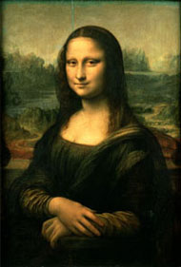
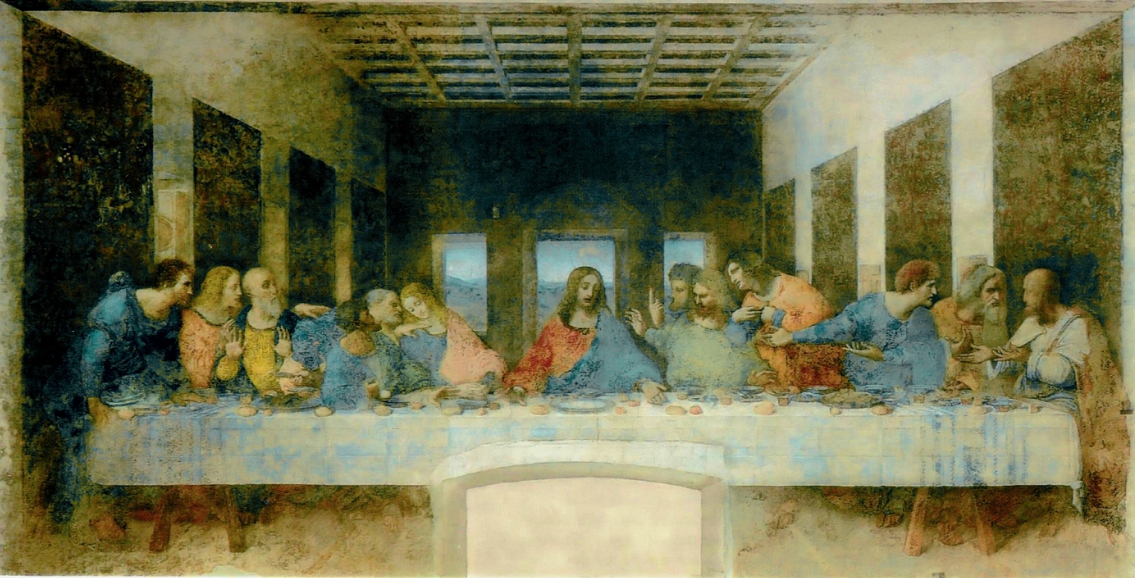
Leonardo da Vinci
Take Notes!
Two most famous works:
The Last Supper
The Mona Lisa

Slide 8
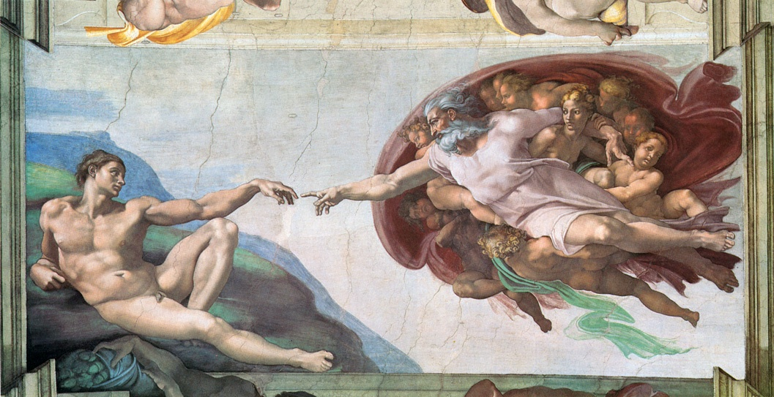
The Creation of Adam by Michelangelo

Slide 9
Elements in the painting
Subject relates to classical culture (ancient Greece or Rome)
Biblical/Religious theme is expressed in realistic Renaissance-era setting or classic Greek-Roman setting
Shows a balanced use of space
Includes rich colors, vivid details
Glorifies the human body

Slide 10
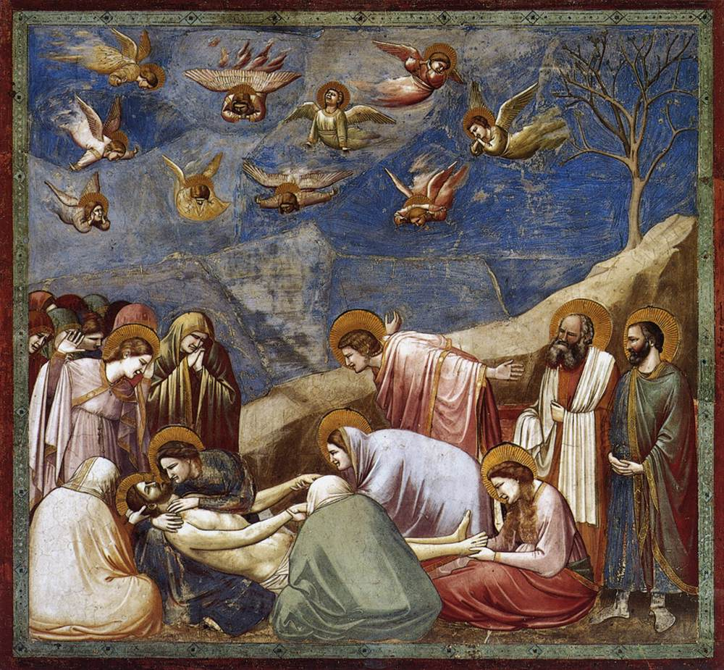
Giotto, The Lamentation of Christ

Slide 11
Lorenzo de' Medici, ruler of Florence and patron of arts

Slide 12
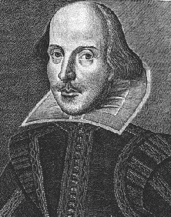
All the World’s a Stage: Shakespeare
Shakespeare: The greatest writer of all time.
April 23, 1564-April 23, 1616
Wrote:
37 Plays
154 Sonnets
Several epic poems

Slide 13
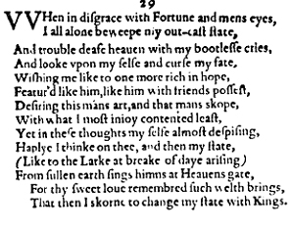
All the World’s a Stage: Shakespeare

Slide 14
Legacy of the Renaissance
Changes in Art: portrayed individuals and nature more realistic and praised individual achievement
Change in Society: printing gave information available and cheaper for all in society, published books, maps, and laws, changed view on how people should live their life, and started people to question political and religious practices
Take Notes!

