Slide 1
Meme Project
World History: Semester one

Slide 2
Purpose
Your jobs is to go on http://memegenerator.net/ and create meme for 6 different time periods we have covered this semester. We are doing this to review for our final and to create a class meme wall. Your meme needs to be something we covered from unit 1-4 and demonstrate something we have learned in class about the topic.

Slide 3
Requirements:
Includes 6 meme with accurate knowledge; specific historical knowledge | Yes! | Somewhat; missing meme or facts | Barely Missing more than 3 meme or 2 or more missing facts | No
Demonstrates understanding of topic/ person by explaining your meme | Yes | Somewhat | Barely | No
Time Effort and Creativity were demonstrated (title & GRADE sheet included) | Yes | Somewhat | Barely | no

Slide 4
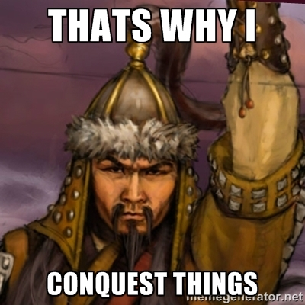
Samples: what’s wrong with this one?

Slide 5
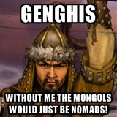
Better☺ The point of this meme is to point out the fact without Genghis Khan uniting the Mongols they may have never had the largest empire and remained pastoralist

Slide 6

You need to explain your knowledge to make sure you are not vague: During the middle ages serfs were at the bottom of the feudal system and were forced do all the hard work for protect from the knights.

