Slide 1
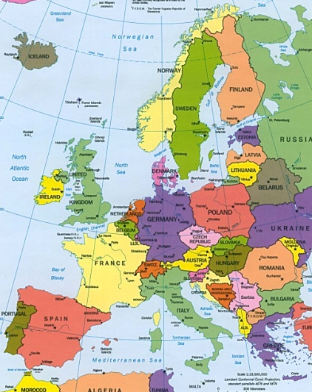
Introduction to the impact education has on Europe
OPHS
World History

Slide 2
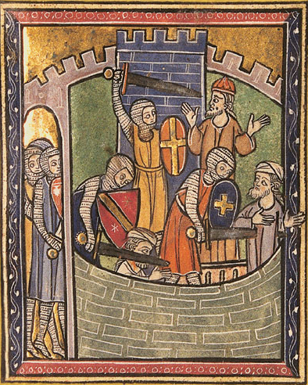
Crusades=New Ideas!
Thanks to the Crusades people were exposed to ideas and thoughts from the Muslim, which lead to an increase in desire for education!
This changes Europe and the world forever!!!
Leading to some key events in history

Slide 3
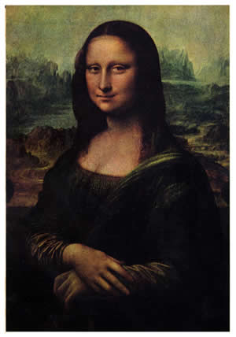
The Renaissance
Meaning “Rebirth” referring to the revival of art and learning. (1300-1600)
Started in Italy and focused Art and literature on humanism.
Realistic paints of humans, stories about what it was like to be a individual.
Don’t forget the printing press was invented in 1452 which help spread all these ideas and thoughts

Slide 4
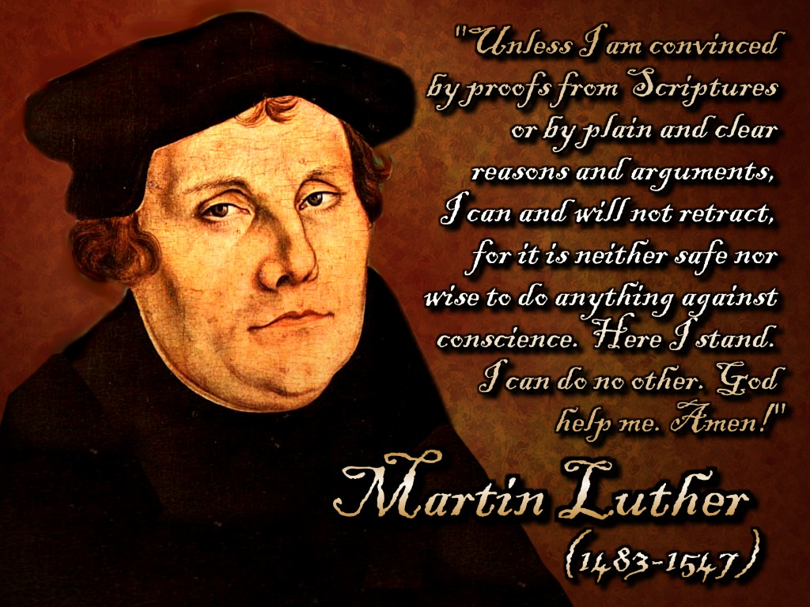
The Reformation
Refers to the movement for Religious reform
This is huge because large groups of people are now questions the church and their actions being too concerned with worldly powers and riches
Martin Luther, John Calvin and Henry VII all fought for reform!
This would have never happened under the Feudal System right? What’s the difference?

Slide 5
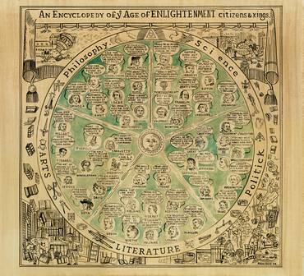
The Enlightenment
A new intellectual movement that stressed reason and thought and the power of individuals to solve it. 1600’s
This created the idea of philosophy and has a HUGE impact on changing government structures.
Famous philosopher like Rousseau, Voltaire and Montesquieu influence political reform
Created applied reason, religious tolerance and fueled democratic revolutions!!

Slide 6
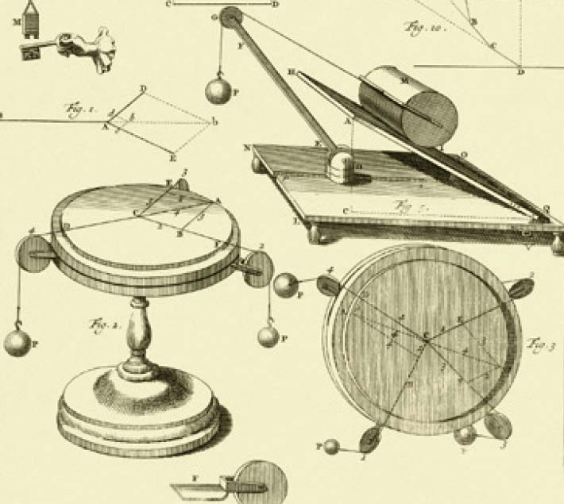
The Scientific Revolution
This was a new way of thinking about the natural world. It focused on observation and willingness to question accepted beliefs.
Enter SCIENCE: theories about world, creating scientific instruments, medicine, and human body
They believed in applying reason and laws of nature to society (just like the enlighteners)

