Slide 1
How and to what effect did interregional contact and exchange increase during this era?
Brainstorm your thoughts on what you could include on this essay.

Slide 2
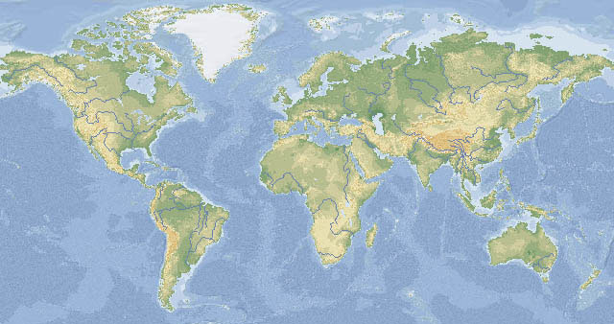
Microsoft®Encarta®Reference Library 2002. ©1993-2001 Microsoft Corporation. All rights reserved.
During this time period (300–1500 CE) many connections were established among regions. These formed interregional patterns of unity.

Slide 3
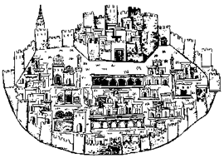
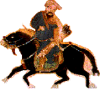

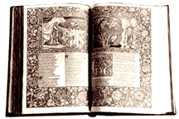
Cultural exchange had many aspects.
Population increased
and people migrated.
Trade networks expanded
and cities grew.
Huge empires brought many different groups of people together.
People shared ideas
across regions.

Slide 4
So how did
Contact and exchange
Change during this
Timeperiod??
Trade
Population
Ideas
Empires

Slide 5
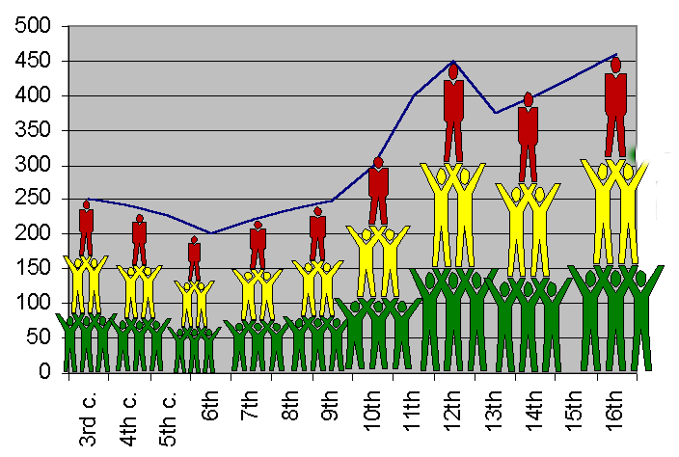
Population
World population
grew from about
250 million to
460 million
between
200 CE
and 1500 CE.

Slide 6

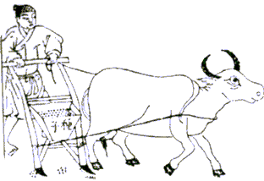

Population growth in Afroeurasia affected the environment.
Deforestation happened when cities and farming expanded. (SLASH AND BURN)
Population

Slide 7
Due to higher population, land was destroyed causing groups to migrate (move)
Migrating groups introduced new plants and animals into their new homes.
Technologies for farming, warfare, and crafts spread as people moved.
Languages, styles of living, and arts also spread.

Slide 8
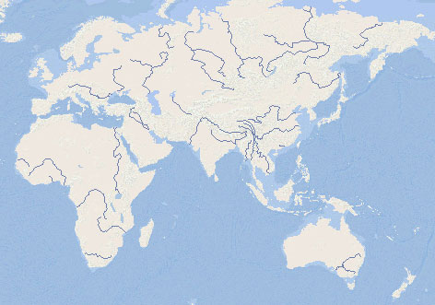








Vikings
Population
Germanic Tribes
Mongols
Turkic Groups
Chinese
Arabs
Bantu-Speaking People of Africa
People of Oceania
People migrated to new places in (and out) of Afroeurasia.

Slide 9

When people came in contact they also spread
Disease!!!!
Thanks to the Mongols trading and conquering they help spread the deadly disease, The Black Plague, that wiped out at least 1/3 of the world’s population!!

Slide 10
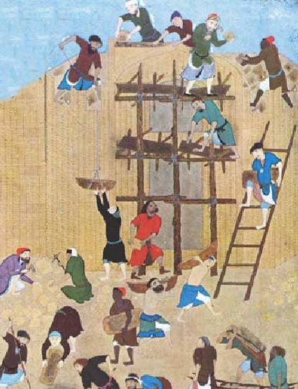
Empires
Empires changed…New ones formed using the foundations of old empires.

Slide 11
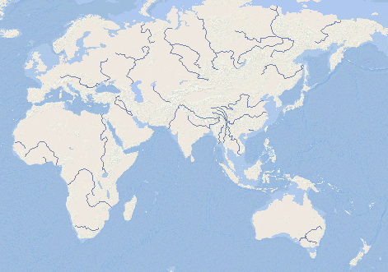
Frankish
Kingdoms
Avar Kingdom
Parhae
Byzantine Empire
Sassanid
Empire
Yamoto
Japan
Sui China
Silla
Harsha’ Empire
Ghana
Chalukya
Axum
States and Empires in 600 CE

Slide 12
Carolingian
Cordoba Caliphate
Byzantine
Parhae
Gurjara-Pratihara
Tang China
Silla
Abbasid Caliphate
Heian Japan
Ghana
Axum
Srivijaya
States and Empires in 800 CE

Slide 13
Scandanavian Kingdoms
Russia
England
H.R.E.
Poland
France
Mongol Empire
Spain
Hungary
Portugal
Rum
Koryo
Almohad Caliphate
Sung China
Kamakura Japan
Ayyubid Caliphate
Delhi Sultanate
Mali
Ethiopia
Angkor
Oyo
Benin
Zimbabwe
States and Empires in 1237 CE

Slide 14
Union of Kalmar
Russian States
Scotland
England
Holy Roman Empire
Poland-Lithuania
Khanate of the Golden Horde
Jagatai Khanate
France
Hungary
Portugal
Castile
Ottoman Emp.
Korea
Granada
Timurid Empire
Ming China
Ashikaga Japan
Marinids Hafsids
Mamluk Sultanate
Mali
Oyo Benin
Ethiopia
Vijayanagara
Siam
Zanj City-States
Majapahit
Zimbabwe
States and Empires in 1400 CE

Slide 15
How did states and empires stimulate cultural exchanges in Afroeurasia?
Large states brought together many ethnic, language, and religious groups.
Wars led to destruction but produced new inventions.
Strong governments protected trade routes and stabilized currencies.
Royal courts were patrons of science, religious institutions, and arts.

Slide 16
The number of cities grew, as well as trade networks between them.
Trade
Trade was also closely linked to cultural exchange.
Empires supported trade in Afroeurasia. Merchants traveled great distances in search of wealth…Remember the Silk Roads?

Slide 17
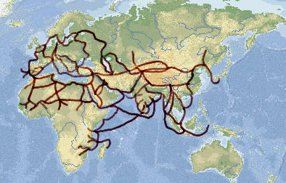
Trade
Microsoft®Encarta®Reference Library 2002. ©1993-2001 Microsoft Corporation. All rights reserved.
From 300-1500 CE, trade routes extended farther and were used by more travelers.

Slide 18
How did expanding trade networks bring about cultural exchanges in Afroeurasia?
Trade
Trade helped spread religions, languages, ideas, and arts. The more people talk to and come into contact with others…the more they learn and the smarter they get!
Trade stimulated use of natural resources.
Cities and manufacturing centers grew bigger.
Banks, credit, and money systems encouraged regional and long distance trade.

Slide 19
Ideas
Buddhism
Christianity
Hinduism
Islam
The spread of major religions from 300-1500 CE :90 second video

Slide 20
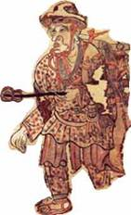
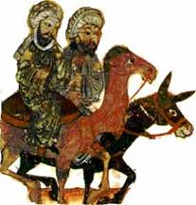
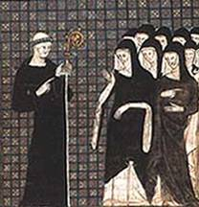
Who spread these major
religions across Afroeurasia?
Ideas
Monks spread Buddhism.
Traders and Sufi orders spread Islam.
Missionaries
spread Christianity.

Slide 21
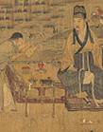
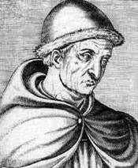
Scholars studied and spread knowledge in many institutions of learning.
Ideas
Sung scholar
Korean library
European astronomer
Muslim astronomers

Slide 22
Natural sciences developed in
many places.
Ideas
Chinese
Muslim
Indian
European

Slide 23
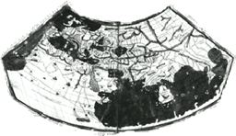

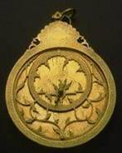
Transport and communication
technologies improved.
Ideas
Stern-rudder
Books & paper
Mapmaking
Lateen sail
North Arabian camel saddle
Stirrup
Astrolabe

Slide 24

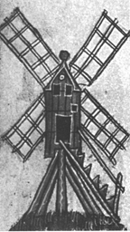
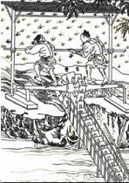
Water & energy technologies were
transferred across Afroeurasia.
Ideas
Hydraulic systems carried water where expanding cities needed it.
Wheels lifted water to irrigate crops and drain swamps.
Waterwheels, windmills, and trip-hammers provided energy for pumping, grinding, milling, and pounding.

Slide 25
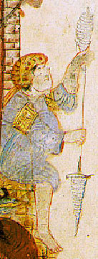


Crops also spread across Afroeurasia. Travelers and migrants introduced plants into new regions. People began to grow, eat, and sell these crops
Ideas
Sorghum fattened up folks when this cereal crop spread from eastern Africa to China.
Citrus fruits rolled from Southwest Asia to Spain, celebrated in garden and song.
Cane sugar sweetened a path from India to the Mediterranean.
Cotton wove its way from India to North Africa, Central Asia, and China.
Veggies like spinach, asparagus, and broccoli stirred vitamins into meals across the hemisphere.

Slide 26
Due to Increased Trade
The pace of innovation increased.
Knowledge accumulated more quickly.
Manufacturing and farming productivity increased.
People’s diets and health improved.
Sea travel and transport webs became thicker (there were more of them).
Disease was also spread wider and quicker.

Slide 27
Silk Road Video
Add 5 additional facts to your note sheet from the video. Remember you need to support your claim with specific facts/details
Silk Road

Slide 28
Thinking about today’s notes
Construct a thesis to answer the below question with 3 reasons to support your claim
(talking points)
How and to what effect did interregional contact and exchange increase during this era?

Slide 29
Class Examples
“Exchange and contact increased dramatically leaving a __________ (effect) on the world due to
1,2,3. “(How)
Remember this whole presentation addresses the question so go back and highlight your specific facts you can include in your paper to SUPPORT your CLAIM/THESIS

