Slide 1
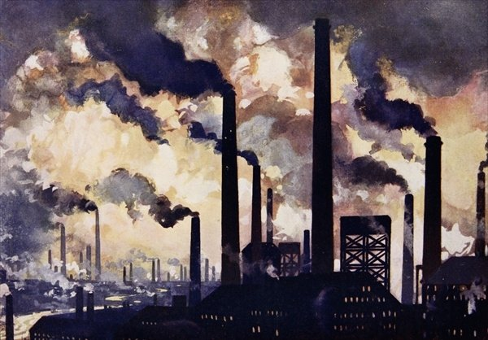
Industrial Revolution
How the Industrial Revolution changed the world we live in today!

Slide 2
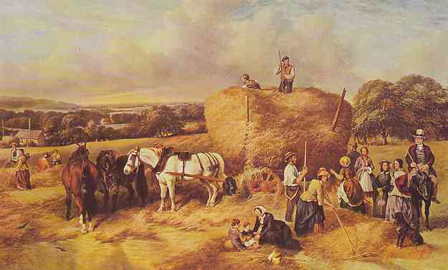
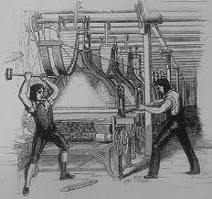
Beginnings
Began in England due to the increase of output due to machines.
A change in lifestyle
From farms to factories
It started in England because that had a small island with lots of natural resources ( water, coal, iron ore etc)

Slide 3
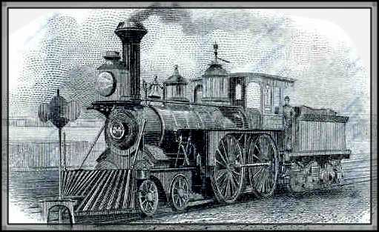
Increases
So because England had the factors of production (land, labor and capital ☺ ) this spurred people to be creativity and make more money by creating new inventions to make items quicker = more $$$

Slide 4
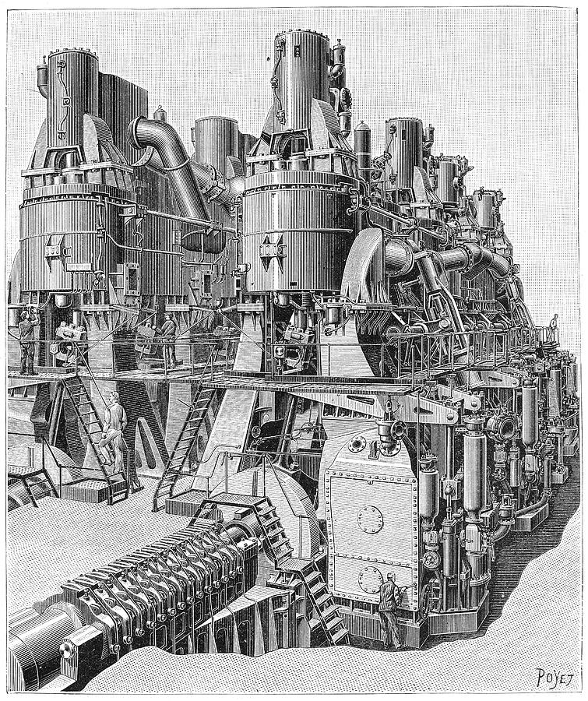
Innovation
This leads to more inventions in transportation to make more $
Steam Engine
Steam boats
Building Roads
Railroads = get goods someplace quicker and allowed people living in the country to go to the city for work

Slide 6
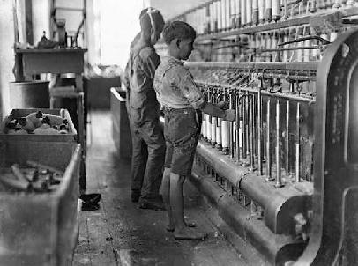
This all leads to lots of negative effects!!
Urbanization – city building and moving to the cities quickly
unhealthy working conditions, pollution, child labor and class tension between the working class and the middle class

Slide 7
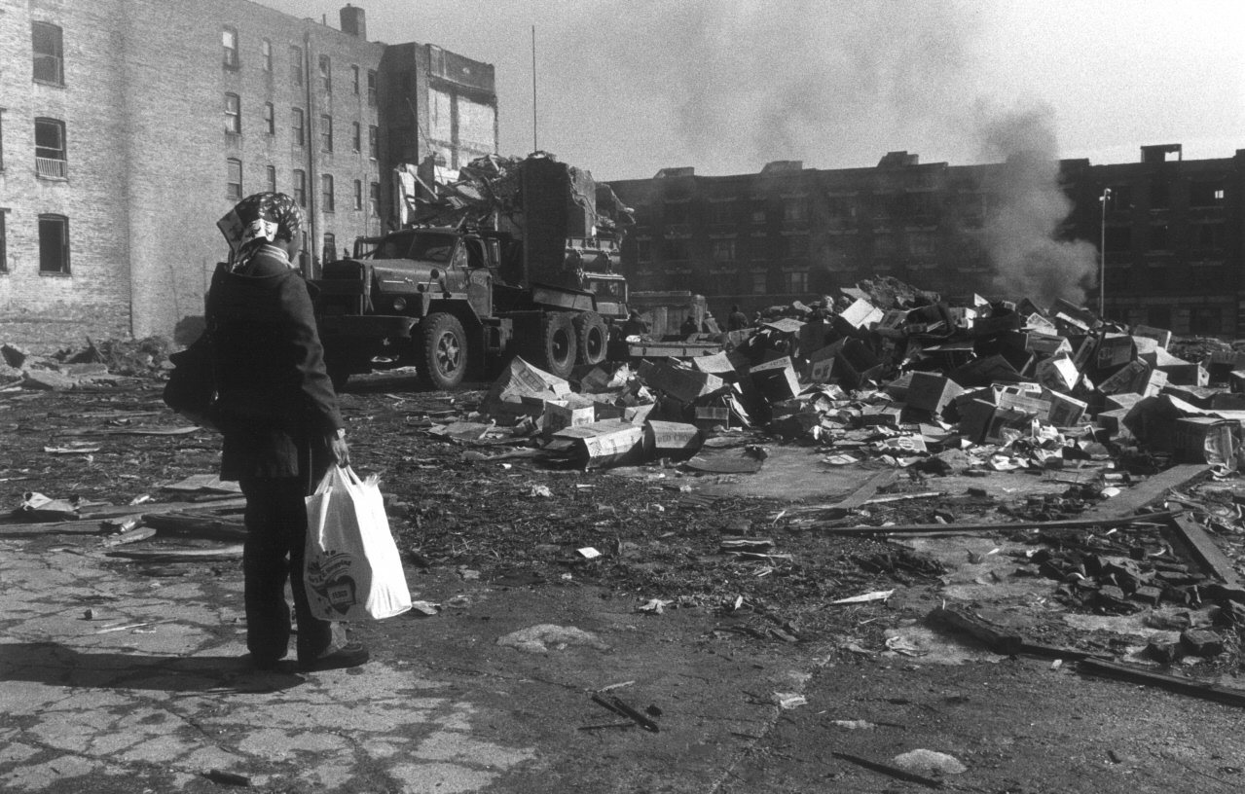

Slide 8
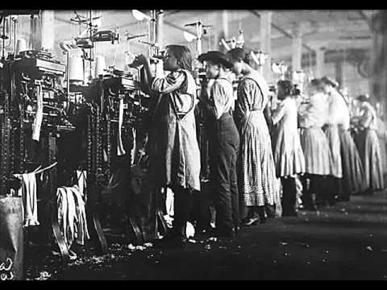

Slide 9
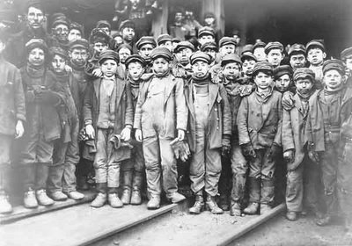

Slide 10
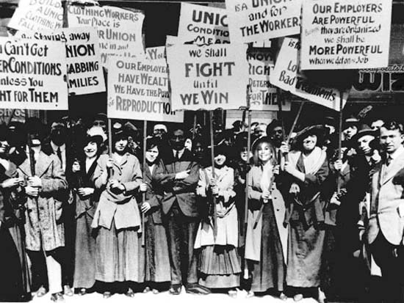

Slide 12
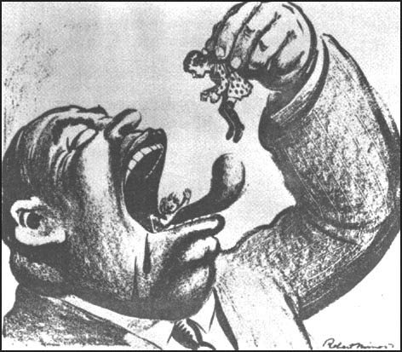

Slide 13
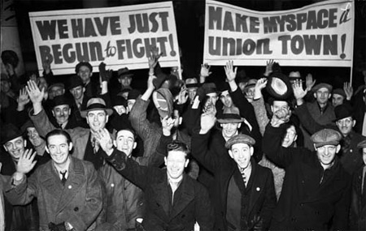
And positive
Created jobs, added to nations wealth, increased inventions, raised the standard of living, and provided the hope one could improve their life! Also the creation of labor unions that fought for better wages, hours etc!

Slide 14
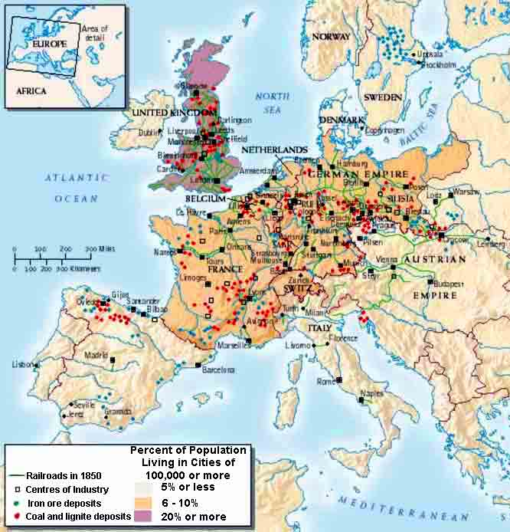
Spreading…..
It of course spreads to America and throughout Europe.
In fact this time period is sometimes referred to as the European movement because it increased their population so much between 1800-1914 and their wealth
Bringing with it the birth of a corporation and buying stocks.

Slide 15
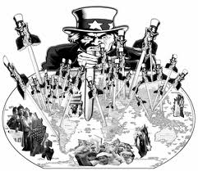
However….
With industries growing and producing this leads to huge global inequality, not to mention the need for more raw materials (resources)
Hmmmmmmm who has lost of nice natural resources….

Slide 16
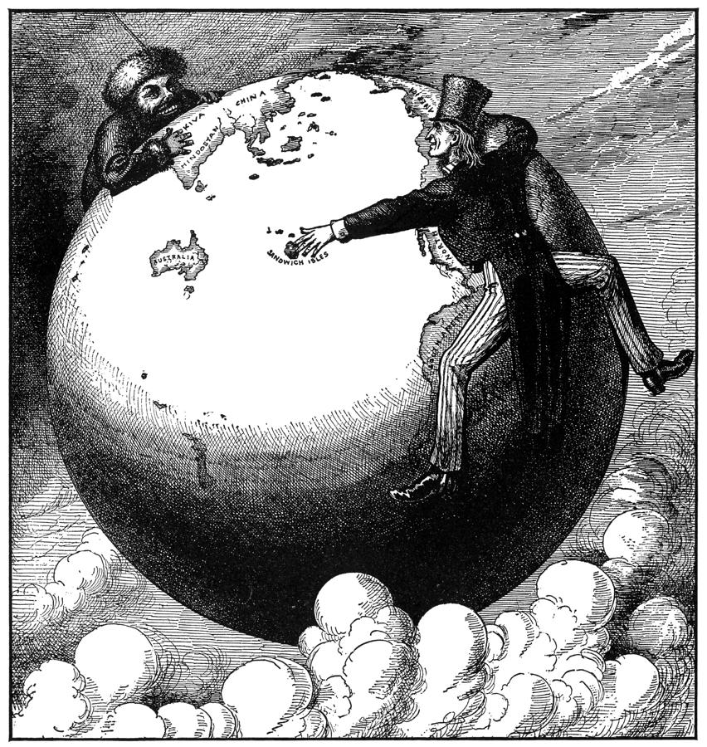
Enter Imperialism!!
Industrialism creates imperialism
Imperialism- seizure of a country or territory by a stronger country

Slide 17
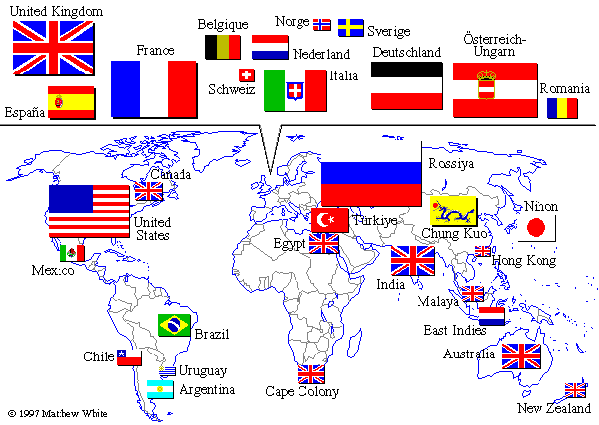

Slide 18
