Slide 1
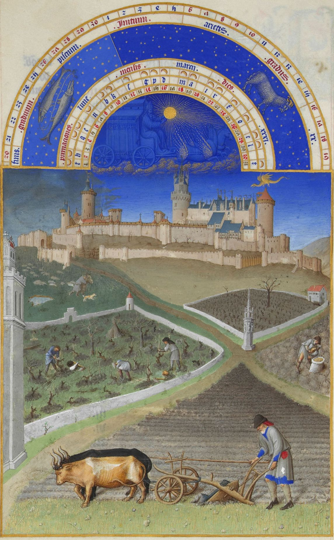
Feudalism

Slide 2
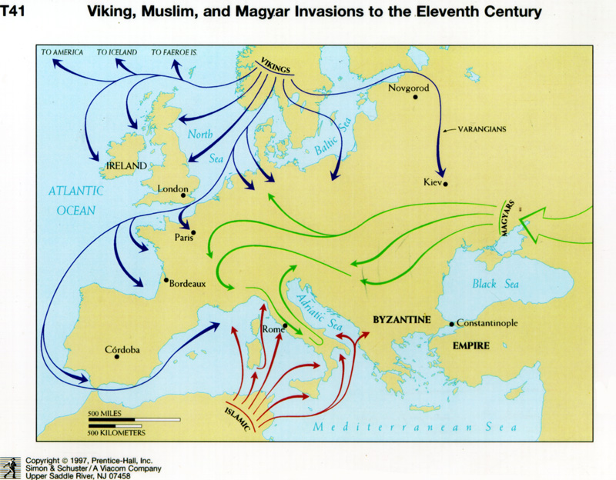
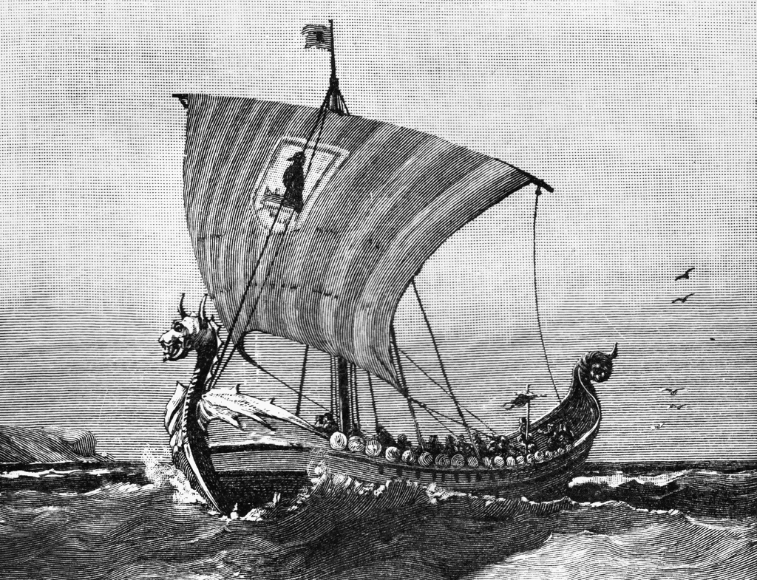
Origins of Feudalism
European society thrown into chaos due to constant invasions
Muslims from the South
Magyars from the East
Vikings from the North

Slide 3
Origins of Feudalism, cont.
Constant invasions weakened the power of central leaders
A new, decentralized system known as feudalism emerged
Feudalism is a political system based around land ownership and protective alliances
Feudalism is hierarchical, meaning that feudal society was divided into social classes with unequal power
Hierarchy: Any system of persons or things ranked one above another.

Slide 4
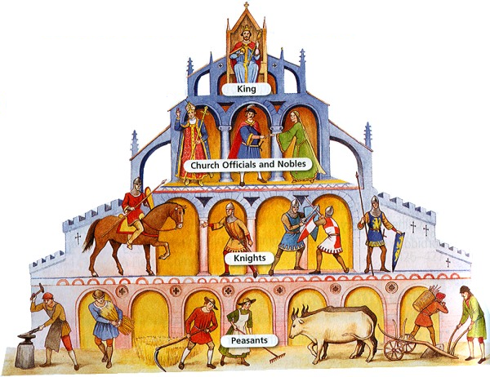
Feudal Society

Slide 5
Kings and Nobles
Kings struggled to maintain control over their land
Kings granted land to nobles in exchange for protecting the land and paying tribute
The person granting the land was called a lord
The person receiving the land was called a vassal
The land granted was called a fief

Slide 6
Knights and Serfs
The noble, in return, allowed knights to stay on their land in return for military protection
Landless peasants, or serfs, farmed the noble’s land in exchange for shelter and protection
Not allowed to leave the noble’s land
Had to give up a portion of their crops to the noble
In addition, they had to give up 10% of their income to the Church

Slide 7
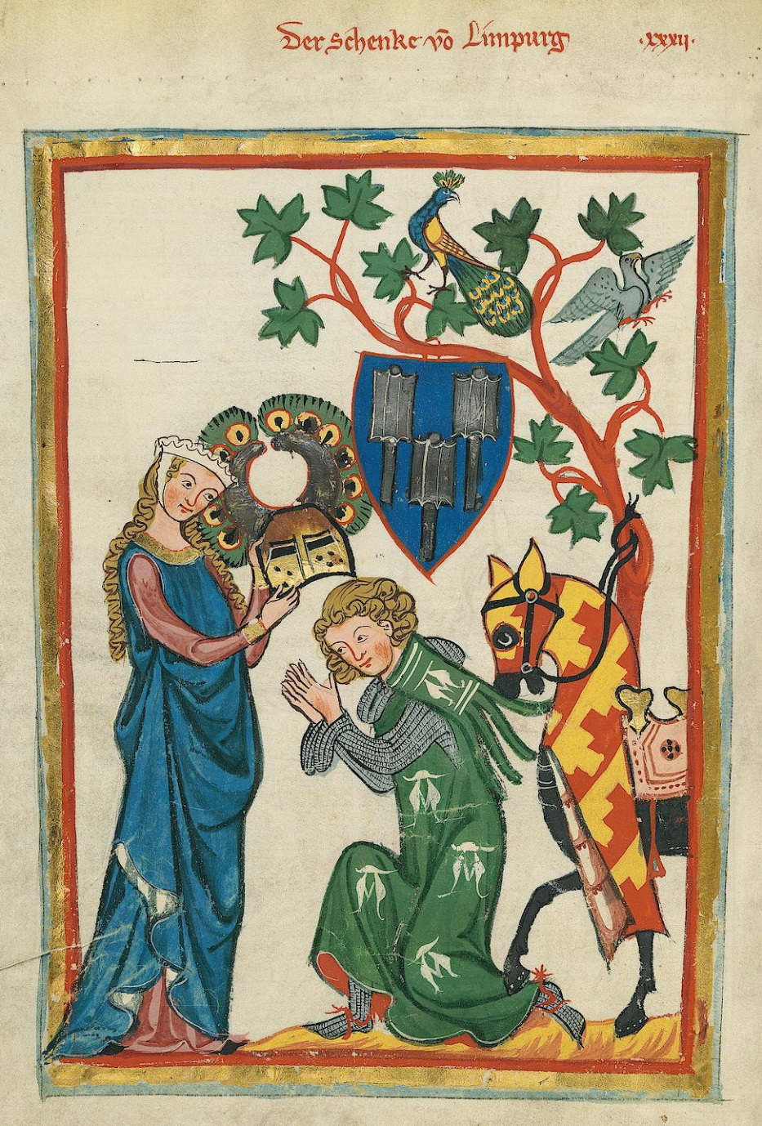
A Knight’s Life
Knights followed a code of conduct known as chivalry
Emphasized traits such as loyalty, honor, and bravery
Inspiration for literature, love poems, and songs
Training to become a knight
Age 7: Sent to train at another castle
Age 14: Became a squire (servant to a knight)
Age 21: Became a knight
Practiced combat in tournaments

