Slide 1
Enlightenment
A look at the different views that were created when you value human reasoning

Slide 2
Enlightenment
The Age of Enlightenment (or simply the Enlightenment or Age of Reason) was a cultural movement of intellectuals in the 17th and 18th centuries
By placing value on human reasoning it created….

Slide 3
The Effects
*Applied reason to the human world
*Stimulated Religious tolerance
*Fueled world-wide democratic revolutions (huge)

Slide 4
Let’s take a look at a couple of the major philosophers and their ideas on the world that have influenced us even today,

Slide 5
John Locke
widely known as the Father of Classical Liberalism, was an English philosopher and physician regarded as one of the most influential of Enlightenment thinkers.
“ I have always thought the actions of men the best interpreters of their thoughts.”

Slide 6
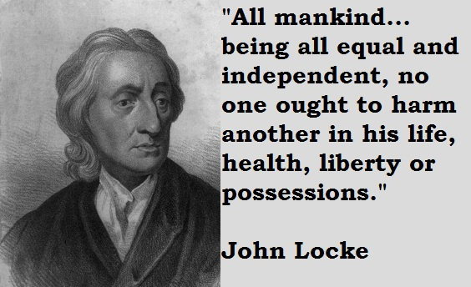

Slide 7
Voltaire
Voltaire was a French writer, historian and philosopher famous for his wit, his attacks on the established Catholic Church, and his advocacy of freedom of religion, freedom of expression and separation of church and state.
“Anyone who has the power to make you believe absurdities has the power to make you commit injustices.”

Slide 8
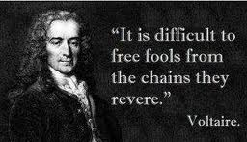

Slide 9
Jean-Jacques Rousseau
His political philosophy influenced the French Revolution as well as the overall development of modern political, sociological, and educational thought.
“Absolute silence leads to sadness. It is the image of death.”

Slide 11
Montesquieu
A French social commentator and political thinker who lived during the Enlightenment. He is famous for his articulation of the theory of separation of powers, which is taken for granted in modern discussions of government and implemented in many constitutions throughout the world
“In most things success depends on knowing how long it takes to succeed.”

