Slide 1
Cartoon PowerPoint
Looking for details to help find a meaning and discover the opinion of cartoonists!

Slide 2
Your job in class today…
Is to create a document that examines the ten pictures around the classroom and addresses these three points
1) time period and term (if applicable)
2) Describe the Cartoon: What do you see?
3) Meaning of cartoon with Author’s Bias (opinion) underlined

Slide 3
Helpful Reminders
Terms/events: militarism, urbanization, industrial revolution, nationalism, Imperialism, Russian revolution, French Revolution
Identify key words that focus the search for information in the text
Reread the text and identify details that provide an idea or fact

Slide 4
Review: Meaning of a cartoon
Symbols – Pig = fat, greedy or a $ = money
Size- large or small..short or tall ETC
Shading- Dark or Bright
WORDS…WORDS…WORDS
Objects in the Cartoon
In the end you need to recognize what the cartoonist is trying to get you to think on the topic!

Slide 5
Document to create
Cartoon # term Description opinion ___________________________________
7 urbanization ….. …..

Slide 6
Let’s try one together……
Lenin, the new Brush That Sweeps Clean

Slide 7
Ready?!?
You will be given a number 1-10 that is the number you place on the first cartoon slot and where you and your partner will be starting. You will get three minutes with each cartoon before the class moves on together to their next cartoon. Questions???

Slide 8
Cartoon 1

Slide 9
Cartoon 2

Slide 10
Cartoon 3

Slide 11
Cartoon 4

Slide 12
Cartoon 5

Slide 13
Cartoon 6

Slide 14
Cartoon 7

Slide 15
Cartoon 8

Slide 16
Cartoon 9

Slide 17
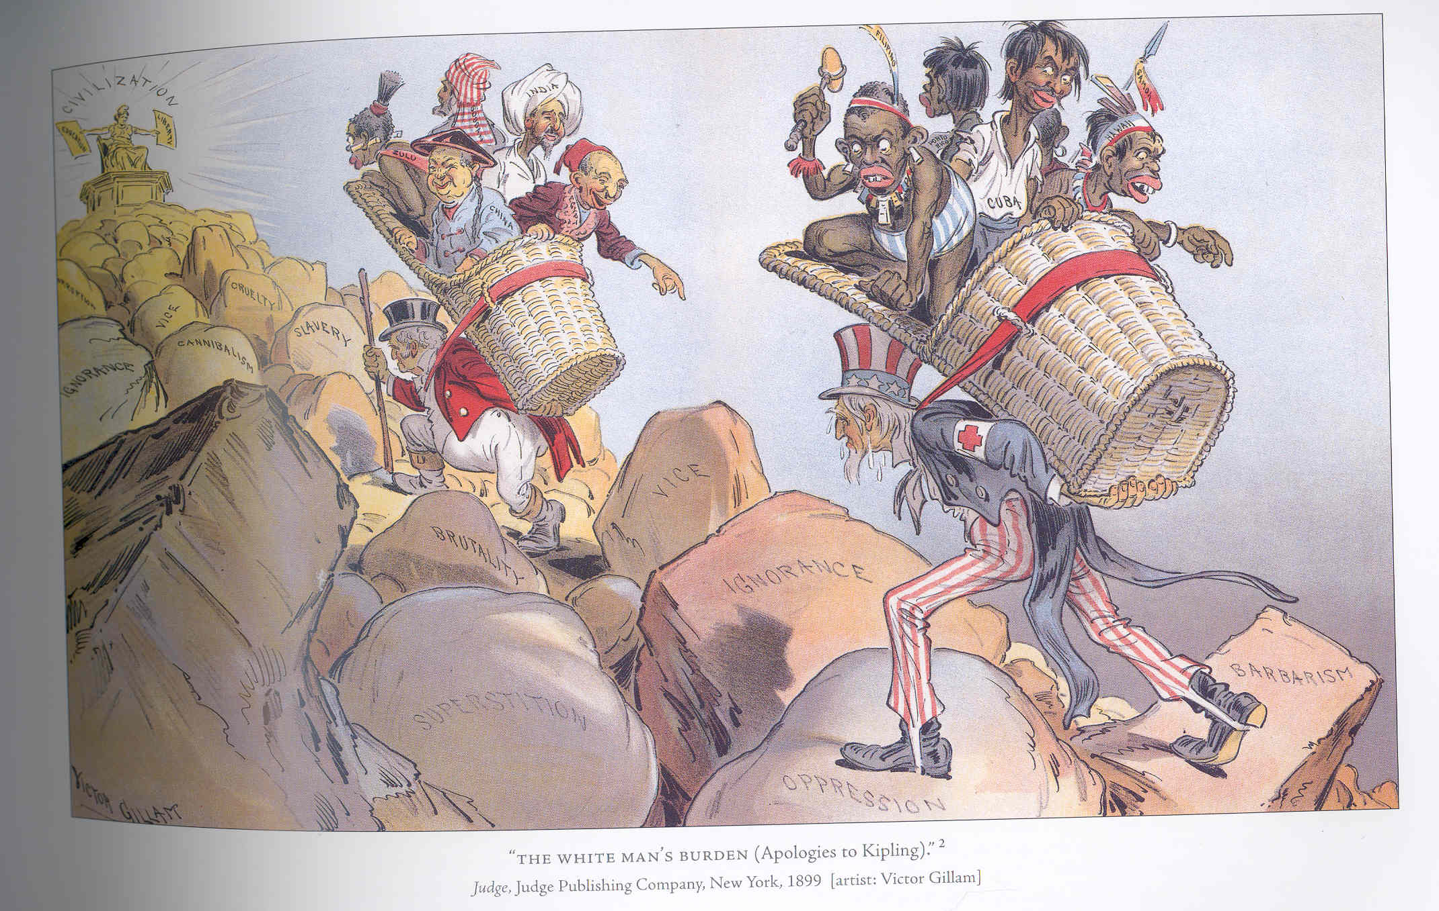
Cartoon 10

