Slide 1
A.P Black history month

Slide 2
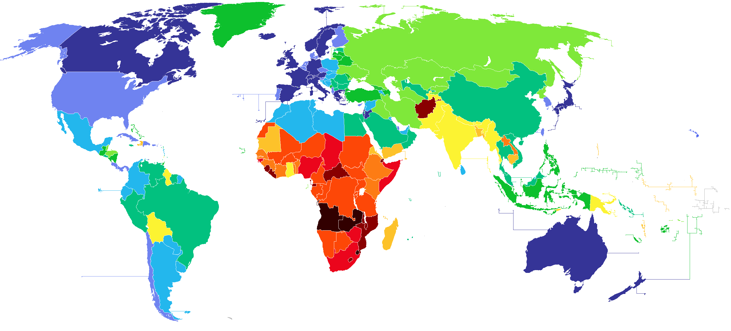
Select a region of the World

Slide 3
Select an Eras/Time periods
Era 1: 80,000 BC to 500BC agricultural revolution to civilizations
ERa2 500BC-500 CE classical empire
Era 3 500 ce-1450 CE post classical empire
Era 5 1450-Bc to 1750: early modern world Columbian exchange
Era 6 1750-1914: industrial revolution (European moment)
Era 7 1914-1945 world at wars
Era8 1945-present Post war/cold war to present

Slide 4
Social (Development and transformation of social structures)
Examples : Gender roles Family and kinship Race/ethnicity Social classes
This theme is about relations among human beings. All human societies develop ways of grouping their members, as well as norms that govern interactions between individuals and social groups. Social stratification comprises distinctions based on kinship systems, ethnic associations, and hierarchies of gender, race, wealth, and class. The study of world history requires analysis of the processes through which social categories, roles, and practices were created, maintained, and transformed. It also involved analysis of the connections between changes in social structures and other historical shifts, especially trends in political economy, cultural expression, and human ecology.

Slide 5
Political (State-building, expansion and conflict)
Examples Political structures Forms of governance Empires Nations/nationalism Revolts/revolutions
This theme refers to the processes by which hierarchical systems of rule have been constructed and maintained and to the conflicts generated through those processes. In particular, this theme encourages the comparative study of different state forms (for example, kingdoms, empires, nation-states) across time and space, and the interactions among them. Continuity and change are also embedded in this theme through attention to the organizational and cultural foundations of long-term stability on one hand, and to internal and external causes of conflict on the other. Students should examine and compare various forms of state development and expansion in the context of various productive strategies (for example, agrarian, pastoral, mercantile), various cultural and ideological foundations (for example, religions, philosophies, ideas of nationalism), various social and gender structures, and in different environmental contexts. This theme also discusses different types of states, such as autocracies and constitutional democracies. Finally, this theme encourages students to explore interstate relations, including warfare, diplomacy, commercial and cultural exchange, and the formation of international organizations.

Slide 6
Interaction between humans and the environment
Demography Disease Migration Patterns of settlement Technology
The interaction between humans and the environment is a fundamental theme for world history. The environment shaped human societies, but, increasingly, human societies also affected the environment. During prehistory, humans interacted with the environment as hunters, fishers and foragers, and human migrations led to the peopling of the earth. As the Neolithic revolution began, humans exploited their environments intensively, either as farmers or pastoralists. Environmental factors such as rainfall patterns, climate, and available flora and fauna shaped the methods and exploitation used in different regions. Human exploitation of the environment intensified as populations grew and as people migrated into new regions. As people flocked into cities or established trade networks, new diseases emerged and spread, sometimes devastating an entire region. During the Industrial Revolution, environmental exploitation increased exponentially. In recent centuries, human effects on the environment - and the ability to master and exploit it - increased with the development of more sophisticated technologies, the exploitation of new energy sources and a rapid increase in human populations. By the twentieth century, large numbers of humans had begun to recognize their effect on the environment and took steps toward a "green" movement to protect and work with the natural world, instead of exploiting it.

Slide 7
Cultural (Development and interaction of cultures)
Religions Belief systems Philosophies Ideologies Science/technology Arts and architecture
This theme explores the origins, uses, dissemination, and adaptation of ideas, beliefs, and knowledge within and between societies. Studying the dominant belief system(s) or religions, philosophical interests, and technical and artistic approaches can reveal how major groups in society view themselves and others, and how they respond to multiple challenges. When people of different societies interact, they often share components of their cultures, deliberately or not. The processes of adopting or adapting new belief and knowledge systems are complex and often lead to historically novel cultural blends. A society's culture may be investigated and compared with other societies' cultures as a way to reveal both what is unique to a culture and what is shares with other cultures. It is also possible to analyze and trace particular cultural trends or ideas across human societies.

Slide 8
Economics (Creation, expansions and interactions of economic systems)
Agriculture Pastoral production Trade and commerce Labor systems Industrialization Capitalism/Socialism
This theme surveys the diverse patterns and systems that human societies have developed as they exploit their environments to produce, distribute, and consume desired goods and services across time and space. It stresses major transitions in human economic activity, such as the growth and spread of agricultural, pastoral, and industrial production; the development of various labor systems associated with these economic systems (including different forms of household management and the use of coerced or free labor); and the ideologies, values, and institutions (such as capitalism and socialism) that sustained them. This theme also calls attention to patterns of trade and commerce between various societies, with particular attention to the relationship between regional and global networks of communication and exchange, and their effects on economic growth and decline. These webs of interaction strongly influence cultural and technological diffusion, migration, state formation, social classes, and human interaction with the environment.

Slide 9
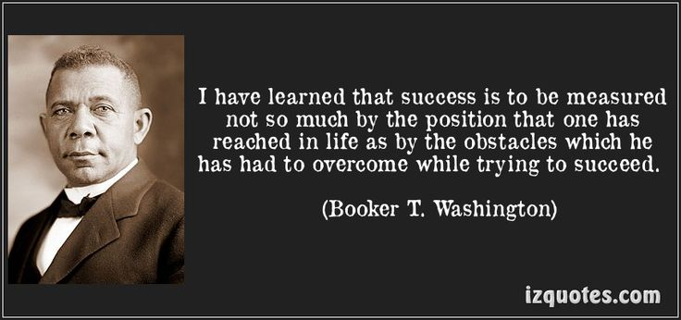
Points of PRIDE
What are the amazing things that happened in your area that everyone walking down OPHS A wing should know about?

Slide 10
Global Context
How does your country fit into the global TRENDS of y0ur unit?

