Slide 1
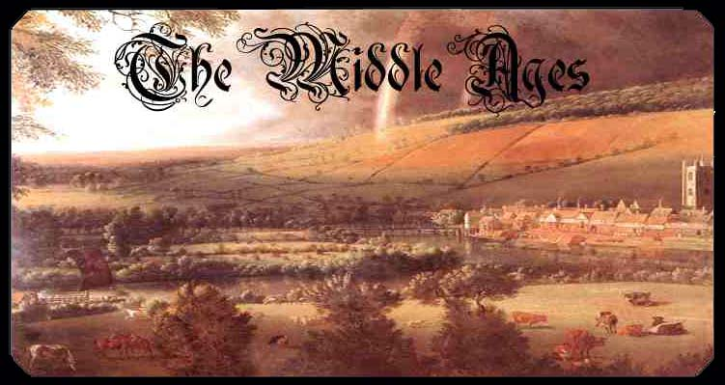
Age of Charlemagne
Copyright © Clara Kim 2007. All rights reserved.

Slide 2
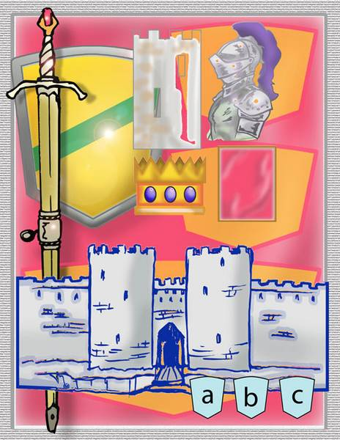
What are the ‘Middle Ages’?
The time after the Roman Empire declined
Medieval Europe was fragmented after the Germanic Tribes took over

Slide 3
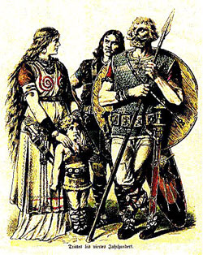
Germanic Customs
Germanic invaders could not read or write so learning declined
Germanic tribes did have a rich oral tradition of songs and legends but NO WRITTEN language
No common language since Latin began to change from region to region

Slide 4
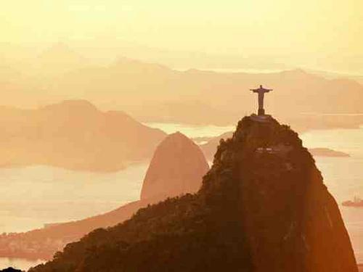
Christianity
Germanic tribes adopted Christianity
Monasteries – communities of nuns and monks who were servants of God
  They were Europe’s best educated
  They opened schools

Slide 5
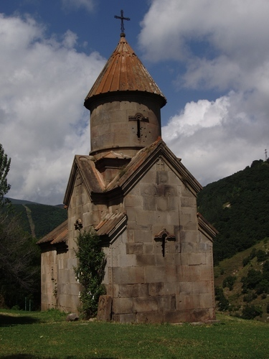
Christianity
  Maintained libraries
  Copied important books: this preserved Greco-Roman cultural achievements

Slide 6
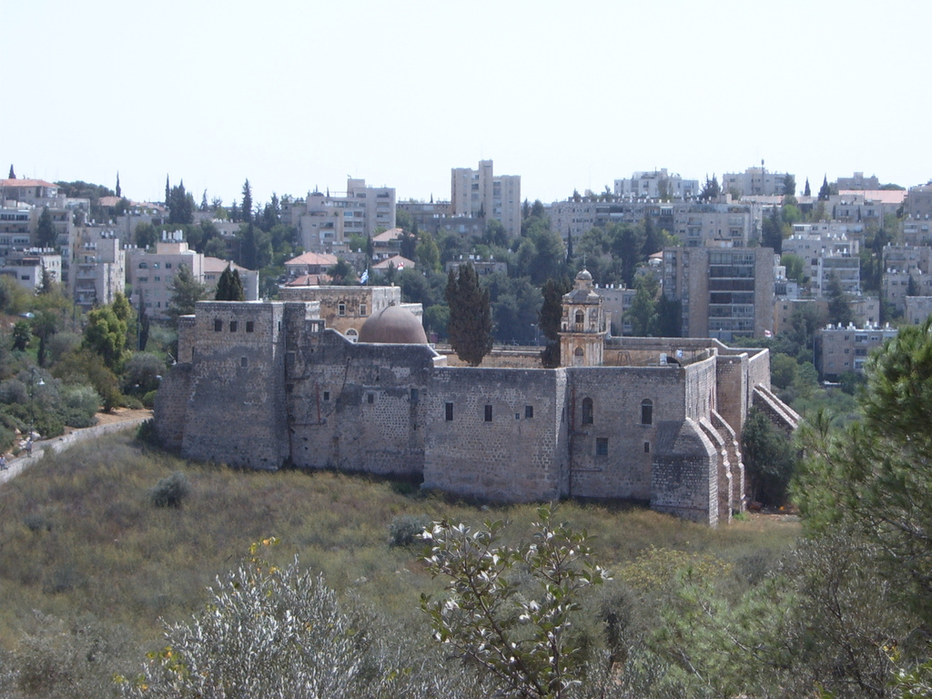
Monastery of the Cross

Slide 7
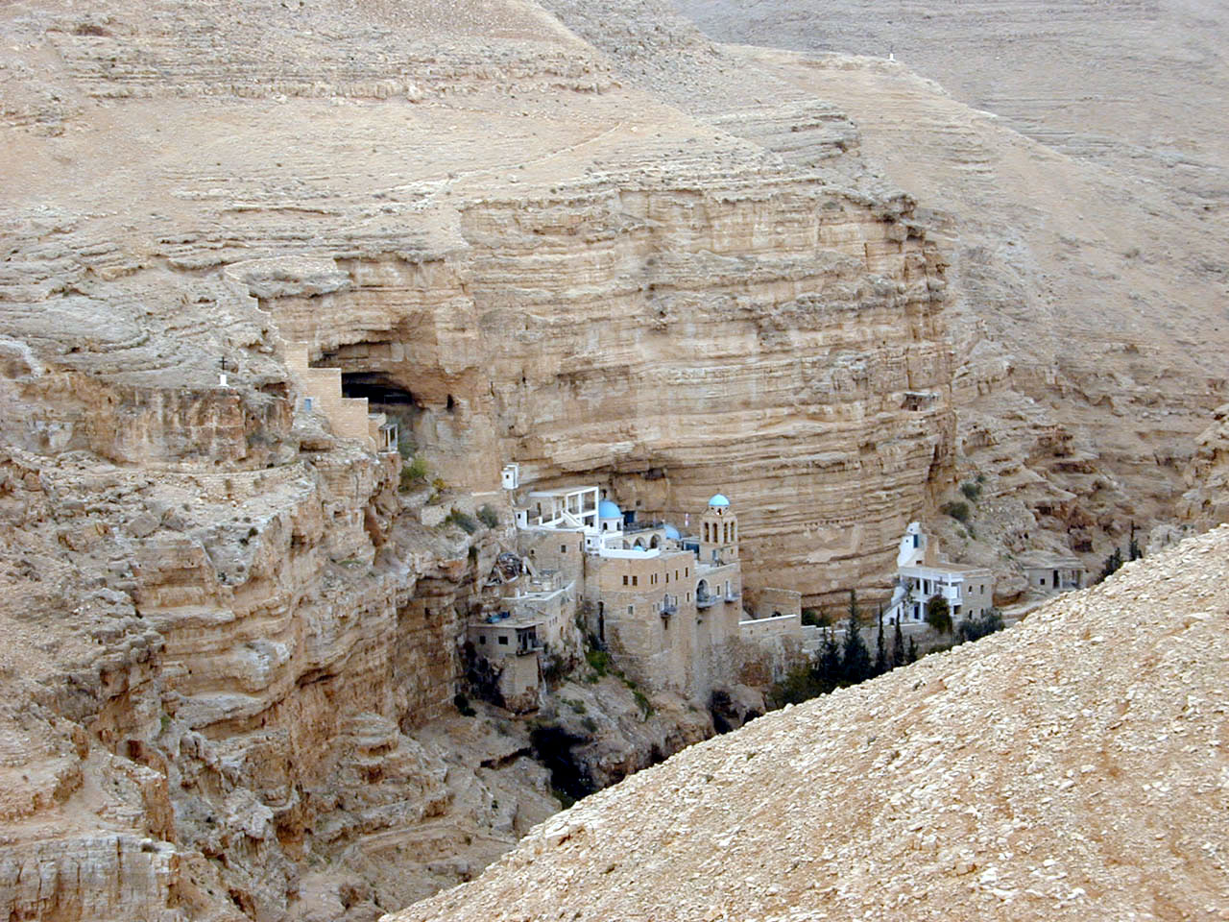
Saint George Monastery

Slide 8
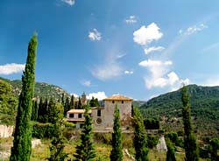

Slide 9
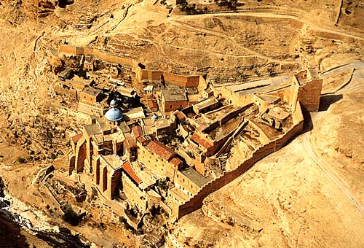

Slide 10
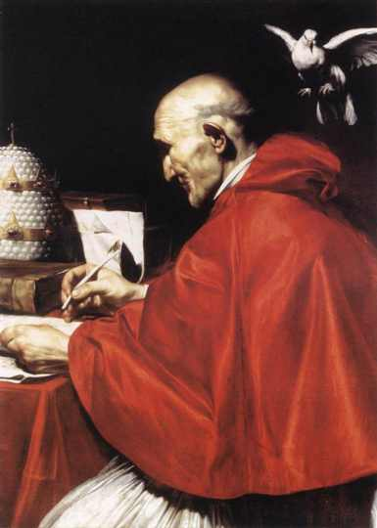
Gregory the Great
Missionaries carried Christianity and the Latin alphabet to Germanic tribes
Gregory the Great = Pope who expanded the pope’s power to be involved in politics.
  He used church revenues (money) to:
    Raise armies
    Repair Roads
    Help the Poor

Slide 11
The Carolingian Dynasty
Charles Martel – Expanded Frankish power and became more powerful than the king
His son Pepin the Short was anointed by the Pope as king by the grace of God
This began what is known as the reign of the Carolingian Dynasty = time of Frankish rulers

Slide 12
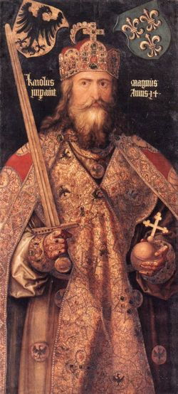
Charles the Great
He was 6ft 4inches = taller than many in Europe
AKA Charlemagne
Becomes king of the Francs
Quickly controlled the entire kingdom of the Francs
Spread Christianity and reunited western Europe for the first time since the Roman Empire

Slide 13
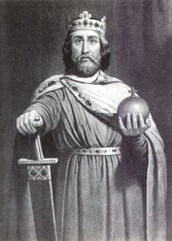
Age of Charlemagne
He regularly visited every part of his kingdom
Limited the power of the nobles
Encouraged learning which revived Roman Culture
The Pope crowned him Emperor of the Holy Roman Empire
After he died his united kingdom fell apart

Slide 14
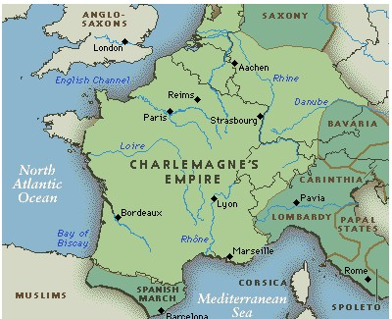

Slide 15
MORE INVASIONS!
From 800 to 1000 the Magyar warriors terrorized Germany and Italy
From the north, the Vikings attacked
Vikings attacked with quick speed.
  They beached their ships, attacked, then shoved out to sea again
  They were also traders and explorers (Leif Ericson)
  Impressive warships

Slide 16
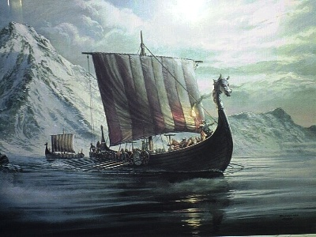

Slide 17
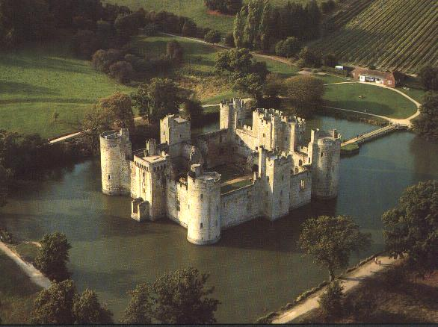
The Middle Ages
Feudalism

Slide 18
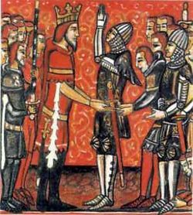
Feudalism Rises
A system of landholding and governing
It was based on an exchange of protection for other services

Slide 19
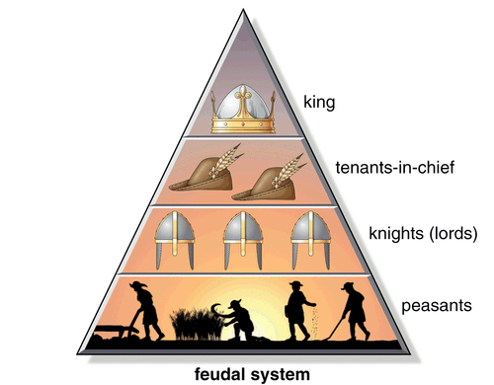
Feudal System
Lords give
knights/vassals
land (fief) in
exchange for
the knights’
promise
to defend the
lord and his
land
lords

Slide 20
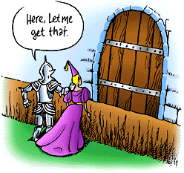
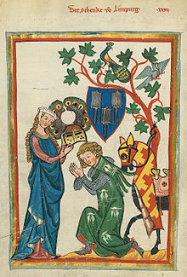
The Role of the Knight
Code of knighthood was to beheld to a strict code of honor =chivalry
Knights who violated this code
were his armor was stripped off
* sword was broken over his head
*shield cracked
*spurs cut off
*priest mocked him

Slide 21
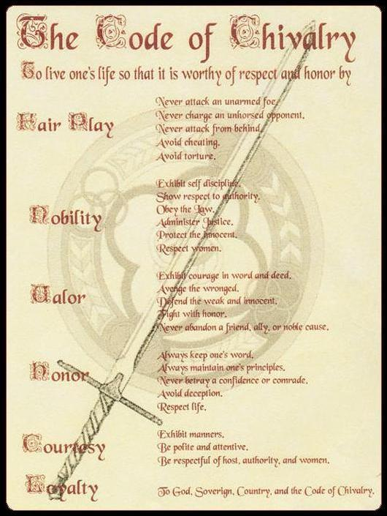
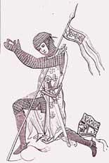
Fair Play
Nobility
Valor
Honor
Courtesy
Loyalty

Slide 22
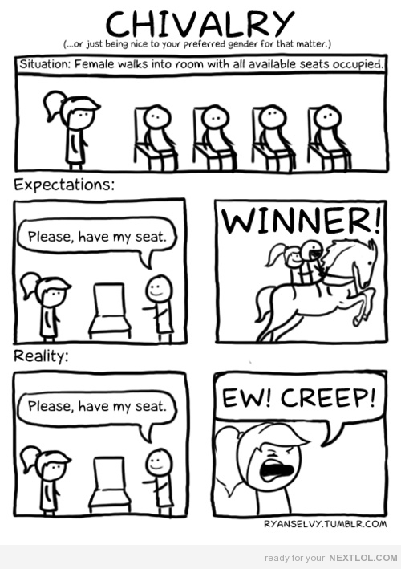
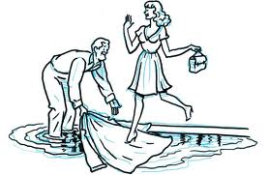
Examples of Chivalry

Slide 23
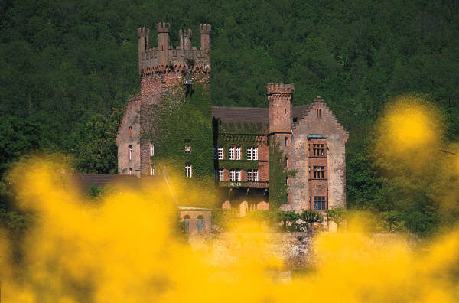
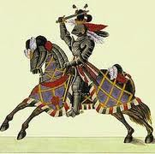
The Role of the Knight
The lords gave the knights direct orders and there was some honor in being a knight. Also the lords paid them in land!
This is the idea behind the feudal system- a way to keep order and make economic gains

Slide 24
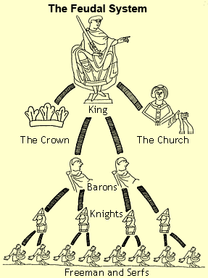
Feudal Pyramid
The idea of serfdom created a stable
workforce

Slide 25
Feudal Society
Rigid (strict) class structure
Fief | Land given to a Vassal from a Lord
Vassal | The person receiving the fief
Serf | Peasants who work the land

Slide 26
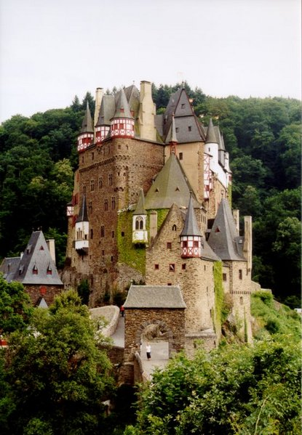
Manors
The manor is the lord’s estate
The manor system is an economic arrangement that is self-sufficient

Slide 27
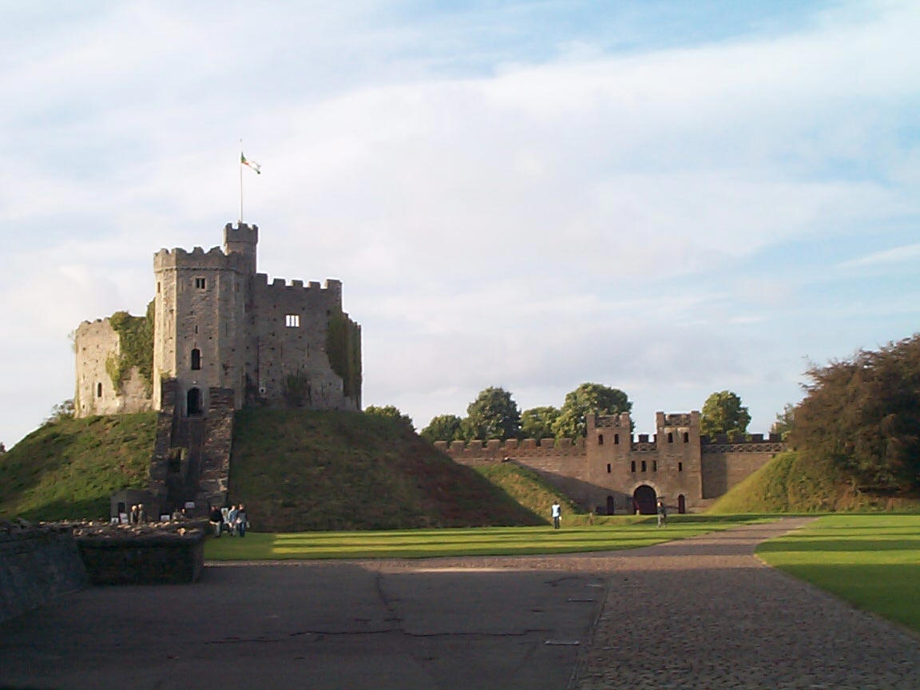
Manors
Lord provides housing, strips of farmland, and protection from bandits
In return, serfs tend the lands, cared for his animals, and maintained the estate/manor

Slide 28
Life on the Manor
Rarely traveled more than 25 miles from the manor
Generally 15-30 families lived in the village on a manor
Everything needed such as food, clothes, fuel, lumber and leather goods were produced on the manor
Only outside purchases were salt, iron and unusual objects

Slide 29
