Slide 1
African Civilizations 1500 BCE-700 CE
World History
Chapter 8
Chapter 15, Section 2

Slide 2
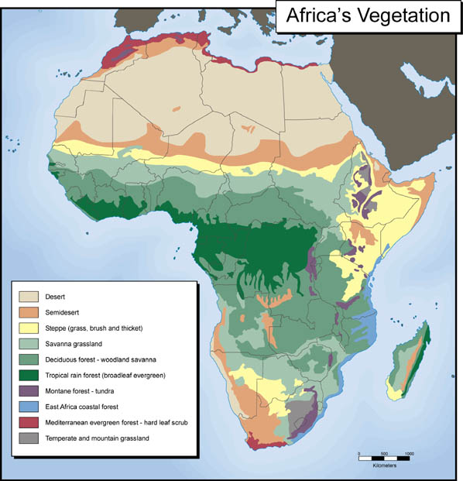
A Land of Geographic Contrast
Second largest continent in the world
Deserts
Rain Forests

Slide 3
Review: Early Humans Adapt to their Environments
Nomadic lifestyle (hunter-gatherers)
Domestication of plants and animals
Transitions to settled lifestyle around 6000 BCE

Slide 4
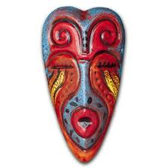
Religion
Most African religions involved a belief in one god.
They also believed in animism: a religion in which spirits play an important role in daily life (spirits are present in animals, plants, and other natural forces, and also take the form of the souls of their ancestors).

Slide 5
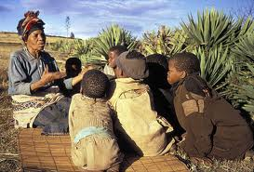
Keeping a History
Few African societies had written languages.
Oral History: Story tellers shared orally the history and literature of the culture.

Slide 6
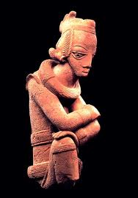
West African Iron Age
Unlike other cultures, the people of Africa seemed to have skipped the Copper and Bronze ages and moved right to the Iron age.
Iron production began in Africa around 500 BCE.
The NOK Culture were the first West African people known to smelt iron.
They used iron to fashion tools for farming and weapons for hunting.

Slide 7
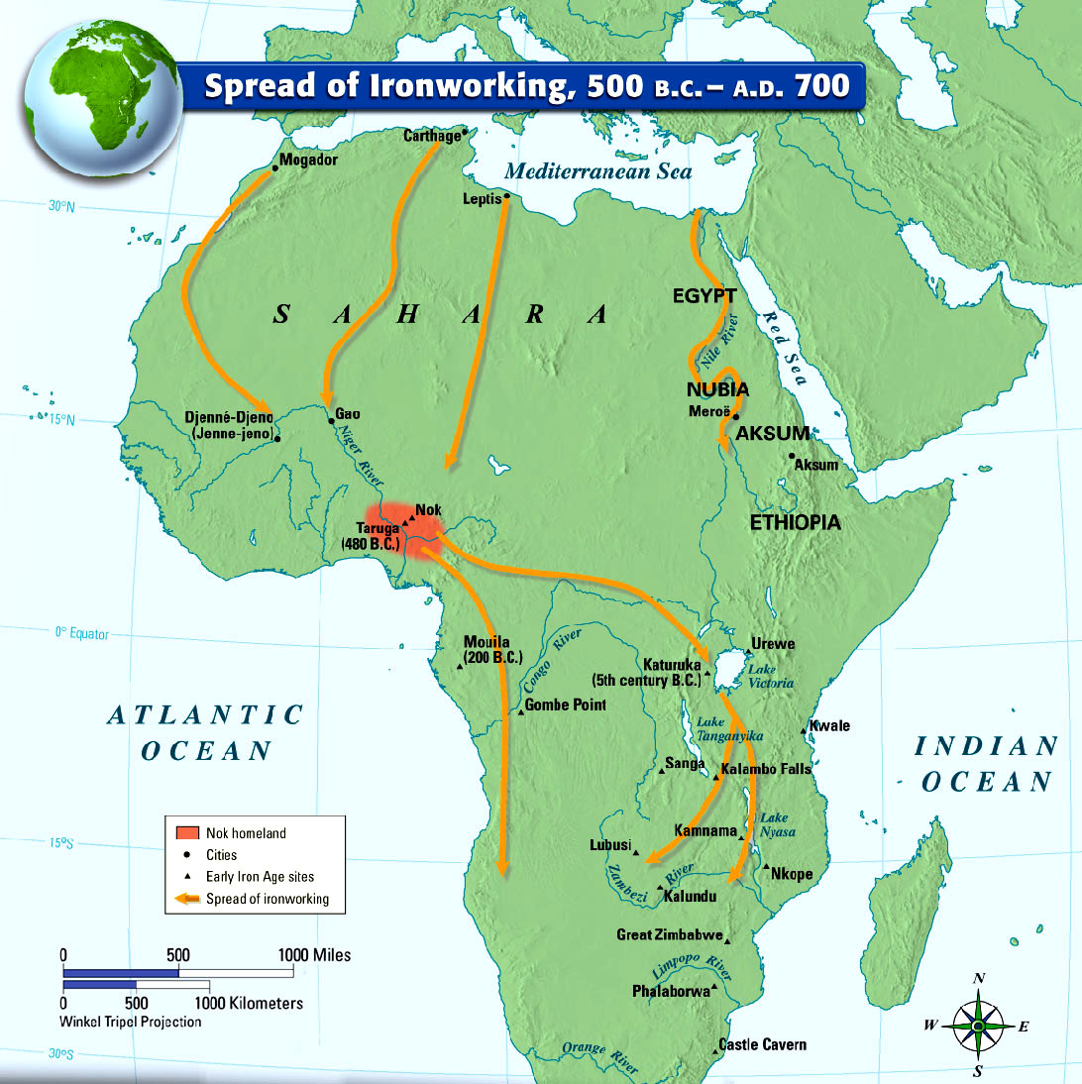

Slide 8
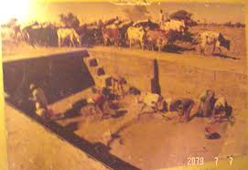
Djenne-Djeno
Located on a tributary of the Niger River in West Africa.
In 1977 hundreds of thousands of objects were found there.
The oldest objects date from 250 BCE
50,000 residents at it’s height
Lived in round reed huts plastered with mud
Learned how to smelt Iron in the 3rd century BCE
Bustling trade center

Slide 9
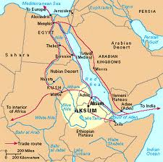
The Kingdom of Aksum
Located in the Horn of Africa.
Aksum was a hub for caravan routes to Egypt and Meroe.
Traded: Salt, rhinoceros horns, tortoise shells, ivory, emeralds and gold for imported cloth, glass, olive oil, wide, brass, iron and copper.

Slide 10
The Kingdom of Aksum
Religion:
Monotheistic: Believed in Mahrem
They believed that their king was directly descended from him.
They were also animists: Worshiped spirits of nature and honored their dead ancestors.
Offered Sacrifices: (Animals) to their dead ancestors, spirits, and Mahrem, and even the Greek god of war, Aries.
And then…they converted to CHRISTIANITY!!!

Slide 11
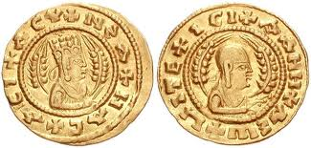
The Kingdom of Aksum
Ezana
Expanded Aksum by conquering part of the Arabian peninsula.
He was educated by a Christian, and when he became ruler, he converted to Christianity and established it as the kingdom’s official religion!

Slide 12
The Kingdom of Aksum
Language:
Ge’ez: Language brought by the Arab’s. Aside from Egypt and Meroe, Aksum was the only ancient African kingdom known to have developed a written language.
Coins: First state south of the Sahara to mint it’s own coins.
“May the country be satisfied”
Terraces:
Steplike ridges constructed on mountain slopes, helped the soil retain water and prevented its being washed downhill in heavy rains.
They also dug canals, built dams, and used cisterns to store water.

Slide 13
The Fall of Aksum
Aksum’s cultural and technological achievements enabled it to last for 800 years.
The reason that Aksum declined was Islamic Invaders.
Between 632 and 750 Islamic invaders conquered vast territories in the Mediterranean world, spreading their religion as the went (map on page 261)
The kingdom of Aksum declined as an international trading power as a result of the Islamic Invasion because the invaders cut of major ports along the Red Sea and the Mediterranean.

Slide 14
The Fall of Aksum
Isolation:
Aksum became isolated from other Christian settlements.
Aksum rulers tried to escape the wave of Islam
Aksum rulers moved their capital to what is now northern Ethiopia
Decline:
This new location (geographic isolation)
Depletion of forests and soil erosion

Slide 15
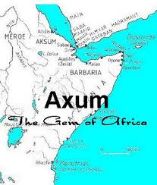
Lasting Legacy of Aksum
Religion
Architecture
Agriculture
Even though they never expanded outside of a small area (this is normal for cultures in Africa and around the world).

Slide 16
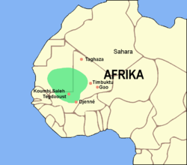
West African Civilizations
Ghana:
Trade:
Harsh Sahara desert: hard for oxen, donkeys and horses to travel without water before the 3rd century.
In the 3rd century BCE people Berber nomads began using camels…who can travel more than 10 days without water.

Slide 17
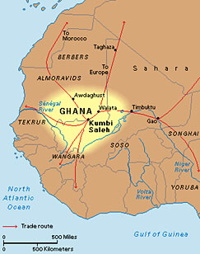
Salt and Gold Trade in Ghana

Slide 18
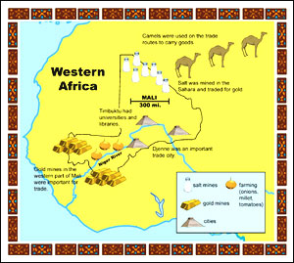
Two most important trade items:
GOLD & SALT

Slide 19
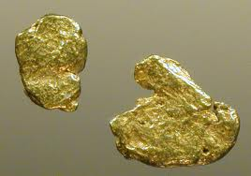
Gold-Salt Trade
Gold:
Gold came from the area between the Niger and Senegal rivers.
Before 1350 2/3 of the worlds gold came from West Africa (that’s a lot)

Slide 20
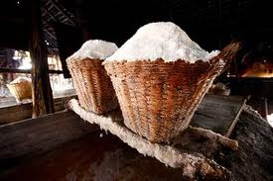
Gold-Salt Trade
Salt:
The Sahara contained deposits of salt, some people even built there houses from salt.

Slide 21
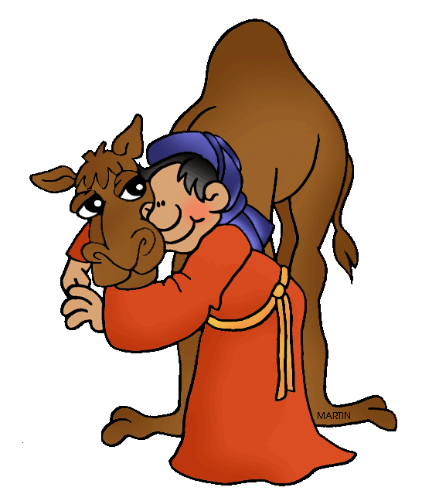
Trade
Arab and Berber traders crossed the desert with salt (and cloth, weapons and other goods)
African traders brought gold north from the forests
They all met in trading cities and exchanged goods (they also paid taxes to the king who had people in the trade cities watching trades and making sure people were honest and fair)
The king also provided guards to protect traders from bandits.

Slide 22
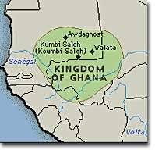
Ghana’s Rule
By 800 CE Ghana had become an empire!
The King:
Had the right to own gold nuggets (any one could have gold dust)
King limited the supply of gold and kept price from falling
Acted as a religious leader
Chief judge
Military commander

Slide 23
Islamic Influences in Ghana
Islamic Influences
Muslim merchants settled in Ghana and spread their faith that way.
Eventually Ghana’s rulers converted to Islam
Muslim advisors helped rule the kingdom
Much of the population kept their belief in Animism (never converting)…even some of the people who converted kept their Animism beliefs.
Among the upper classes, Islam spread quicker because of literacy.

Slide 24
Fall of Ghana
Ghana fell when Muslim invaded from North Africa, even when they left Ghana never regained power because the war disrupted the gold and salt trade.

Slide 25
Empire of Mali
Was a power by 1235 CE
Wealth (like the wealth of Ghana) was built on Gold
Mali sort of took off where Ghana left off…they found new gold deposits and created new trade routes…which shifted power to the east.
Mali’s first leader: Sundiata
Came to power by crushing a bad leader
“ The World knew no other
master but Sundiata”

Slide 26
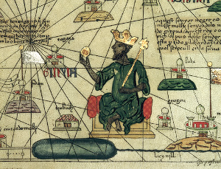
Sundiata of Mali
Great leader in peace and war
Prompted agriculture
Reestablished the gold-salt trade
Niani (the capitol) became a center of commerce and trade

Slide 27
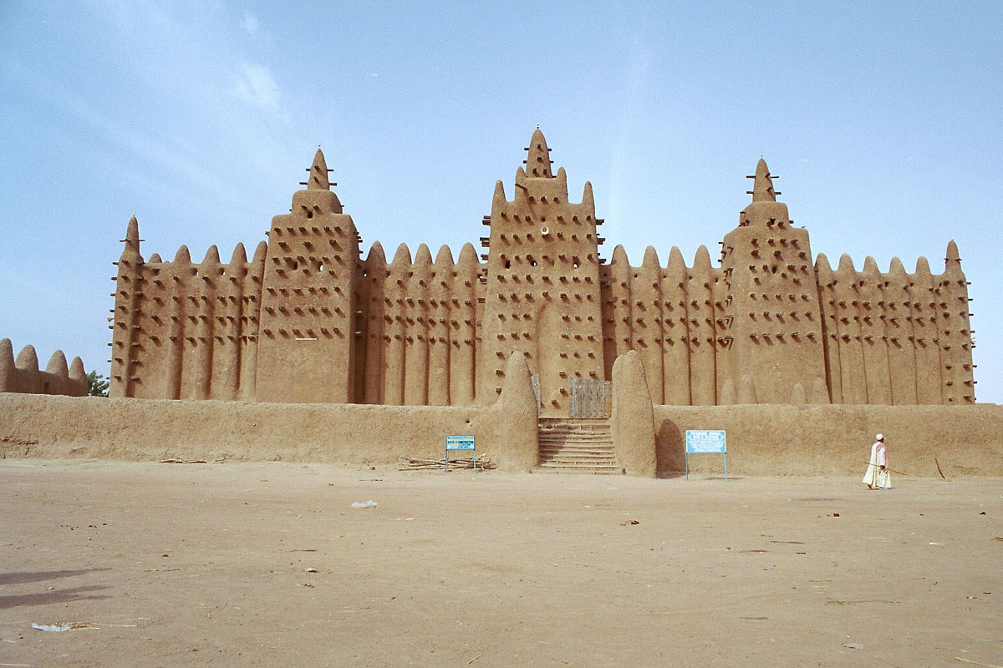
Islam and Mali
When Sundiata died, African Muslim’s ruled for the most part.
They: Built mosques, attended public prayers, and supported Muslim holy men.

Slide 28
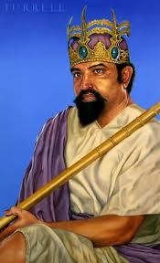
Mansa Musa Expands Mali
The most famous leader was Mansa Musa…
After Sundiata died, Mali experienced turmoil…Mansa Musa was a skilled military leader who kept order and expanded Mali to being twice the size that Ghana was. He also expanded trade.
Mansa Musa was a Muslim, he built new
mosques and universities which brought
Muslim’s from around the world to study
there.

Slide 29
Decline of Mali
When Mansa Musa died, Mali had a bunch of weak leaders.
That in combination with the shift in the gold trade weakened Mali.
The people dispersed and formed new empires, one of them was Songhai.

Slide 30
